Slide 1
OBJECT CODES AND CAPITAL ASSET REQUISITIONS
Presented by Debra Ellison
Property Management
970-491-2270

Slide 2
https://ktrng.is.colostate.edu/kfs-trng/webapp/dashboard/home

Slide 3
AGENDA
CAPITAL EQUIPMENT DEFINITION
COSTS TO CAPITALIZE
COSTS TO EXPENSE
SELECTING CAPITAL OBJECT CODES
ACCOUNT NUMBER/FUNDING
FUND SOURCE CODES
OWNERSHIP/TITLE
ASSET TYPE CODE
PUTTING IT ALL TOGETHER
SPLIT FUNDING

Slide 4
CAPITAL EQUIPMENT DEFINITION
Capital Equipment: Capital equipment, also known as movable equipment, includes items which are not considered an integral part of a university building, are non-expendable, and do not lose their identity through incorporation into a more complex unit.
An item must meet two specific criteria in order to qualify as capital equipment. It must have (1) an acquisition value of at least $5,000 (unless part of a contract or grant where it specifically states equipment will be tracked at any value), and (2) a useful life expectancy of one year or greater.
Notes:
(Expendable items consist of things like consumables and disposables).

Slide 5
COSTS TO CAPITALIZE
Examples of service costs that can be capitalized with equipment purchases may include:
Shipping or Freight
Transportation or In-Transit Insurance
Installation
Cost of Assembling the Asset
Preparing the Site and Asset for its Intended Use
Modifications, Attachments, Accessories or Auxiliary Apparatus that are necessary to make the property useable for the purpose of which it was acquired.
Notes:
If including these costs to the asset put the value over $5,000.00, it should be capitalized.

Slide 6
COSTS TO EXPENSE
Repair or replacement parts that are not considered a betterment or upgrade (use 6202-Repair Part).
An item or substance that has no shape or identity, or loses that shape or identity upon detachment or removal from its original location (i.e. Materials/Consumables).
Maintenance*, Warranty*, Support*, or Service Agreements* (6602-Maintenance Services or 6802-Repair Services).
Training*
*If these items are lumped into the cost without a separate amount, then they are capitalized.
Demolishing or dismantling, reassembling or reinstalling due to movement or rearrangement of equipment.
Notes:
Travel costs will depend upon what it is necessary for. If it is for installation, it should be capitalized. If it is for Training, it should be expensed.

Slide 7
ASSET VALUE
Assets are recorded net of cash and other earned discounts.
In addition, a trade-in allowance can result in the reduction of the acquisition value.

Slide 8
SELECTING CAPITAL OBJECT CODES
THERE ARE MULTIPLE OBJECT CODES TO CHOOSE FROM
FACTORS THAT INFLUENCE OBJECT CODES:
FUNDING (53, 77, 99, etc.)
FUND SOURCE CODE (11, 21, 22, 31, 32, 33, 34, 35, 41, 51, 51, and 71)
TITLE (CSU/Conditional, Federal, Sponsor, External)
ASSET TYPE CODE (General Equipment, Vehicles, Software, Art)
LEASES (Payments and Down Payments)

Slide 9
ACCOUNT NUMBER/FUNDING
CSU account numbers vary.
Construction (plant fund) accounts usually start with 77.
County Extension accounts usually start with 99.
Sponsor/Federal accounts usually start with 53.

Slide 10
FUND SOURCE CODES
There are 12 Fund Source Codes.

Slide 11
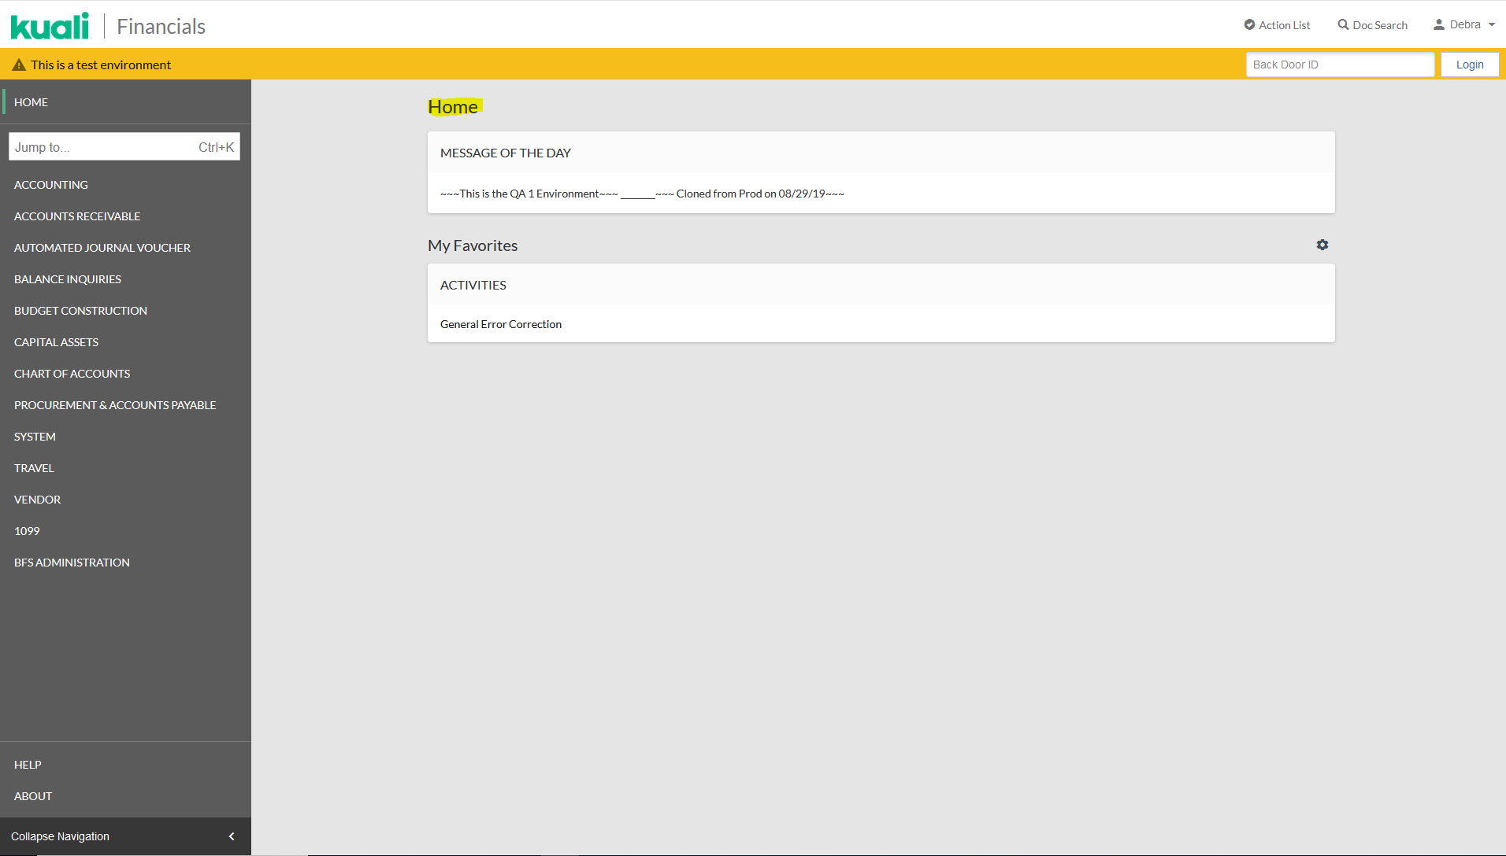
FINDING THE FUND SOURCE CODE
You will need to do an account lookup in Kuali to find the Fund Source Code.
Notes:
You can get to this page by doing an account lookup from the main page in Kuali or by clicking on the account being used in your requisition.

Slide 12
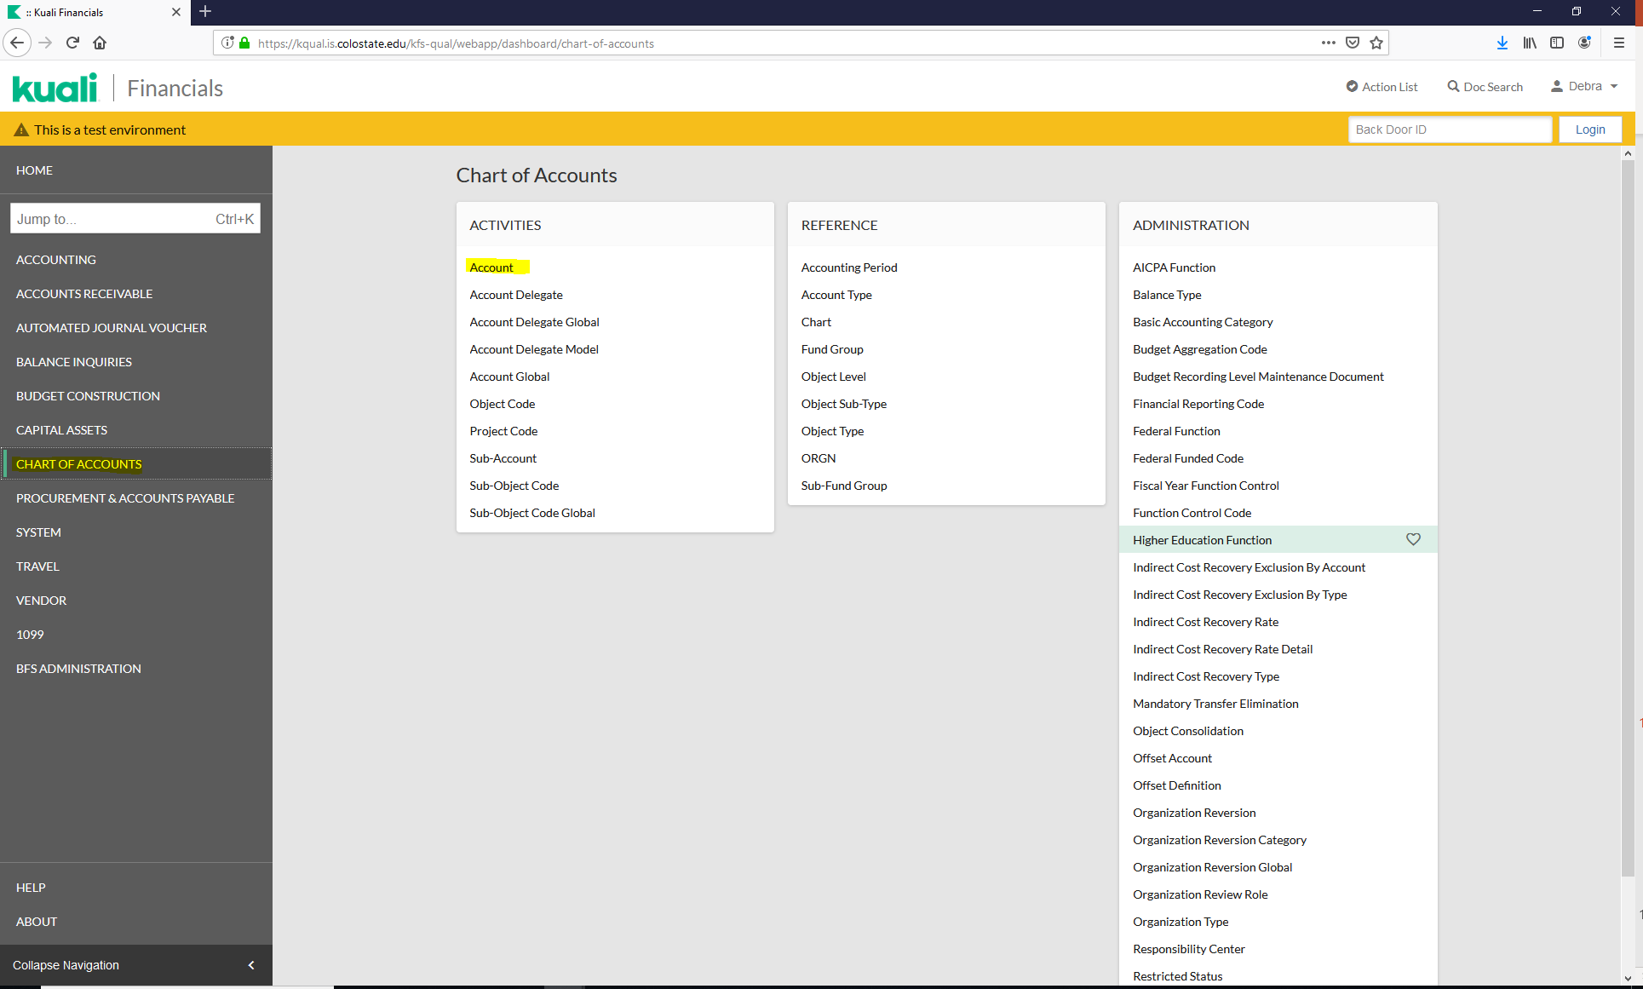
FINDING THE FUND SOURCE CODE
Click on “CHART OF ACCOUNTS” to open the screen. Click on “Account”.

Slide 13
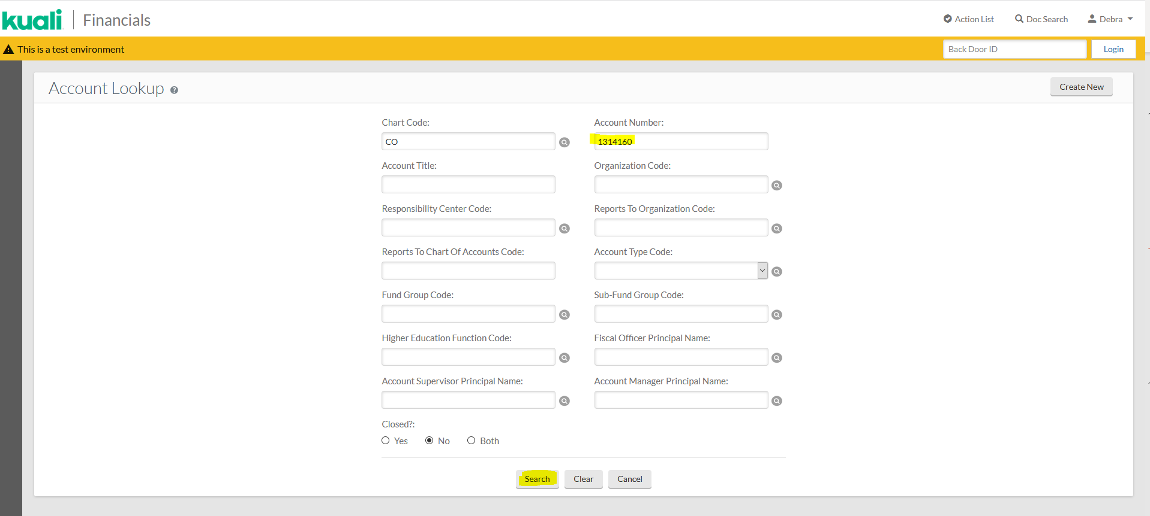
FINDING THE FUND SOURCE CODE
Enter the account number (use 1314160) and click on “Search”.

Slide 14
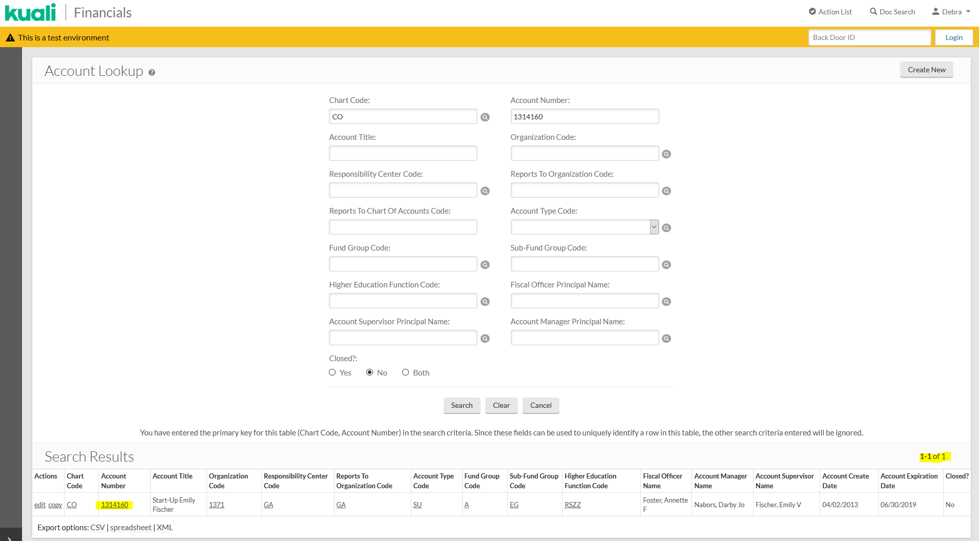
FINDING THE FUND SOURCE CODE
When you have your result, click on the underlined Account Number.
Notes:
Note, the returned results numbers have moved to the right of the page now.

Slide 15
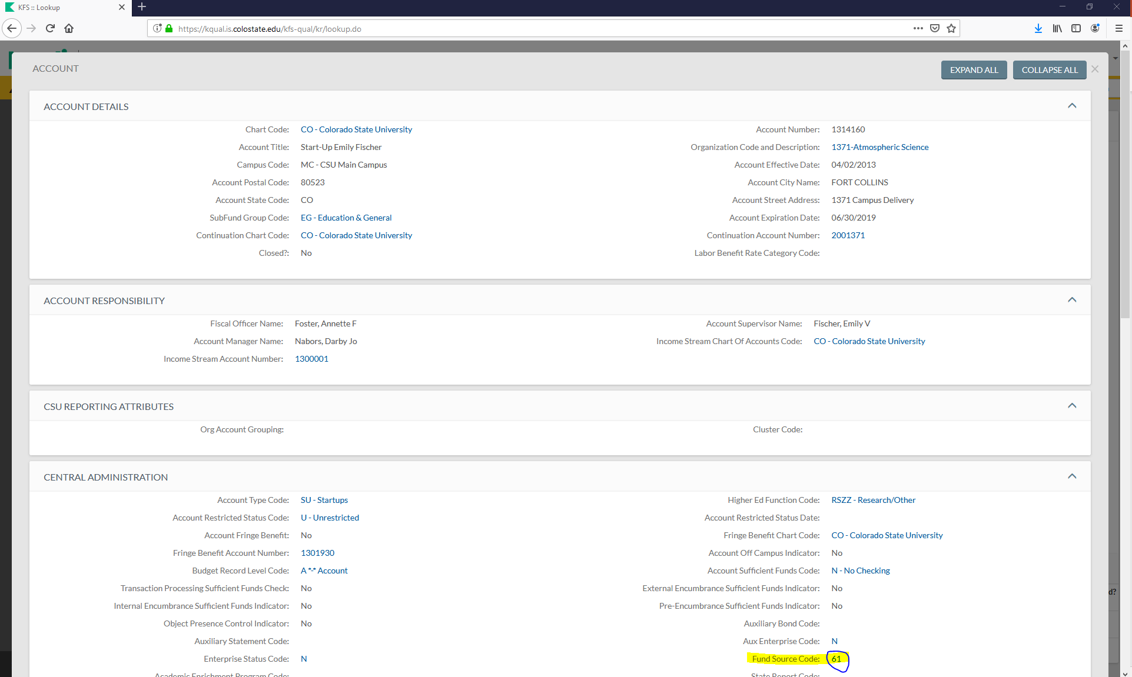
FINDING THE FUND SOURCE CODE
The fund Source Code is located on the right side towards the bottom.
Notes:
Very important, you do not have a new tab opened.

Slide 16
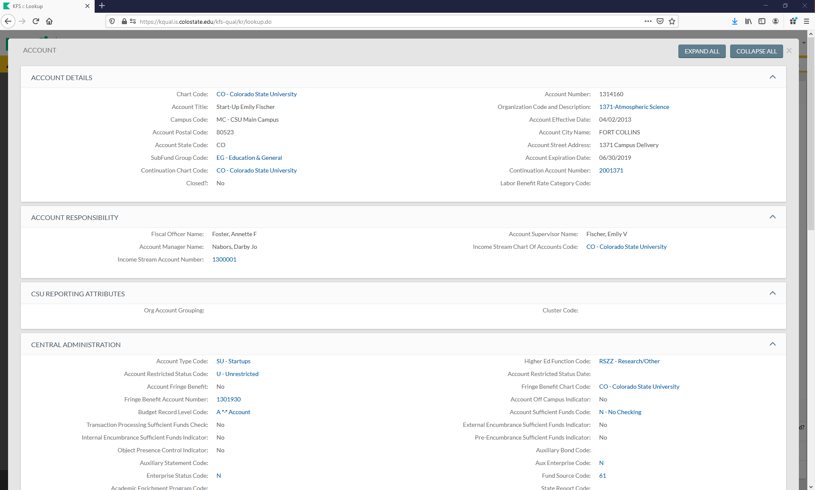
FINDING THE FUND SOURCE CODE
To close the Account Screen, look for the “X” next to “COLLAPSE ALL”.
Notes:
Note, clicking the tab at the top will close Kuali and you will need to log back in.

Slide 17
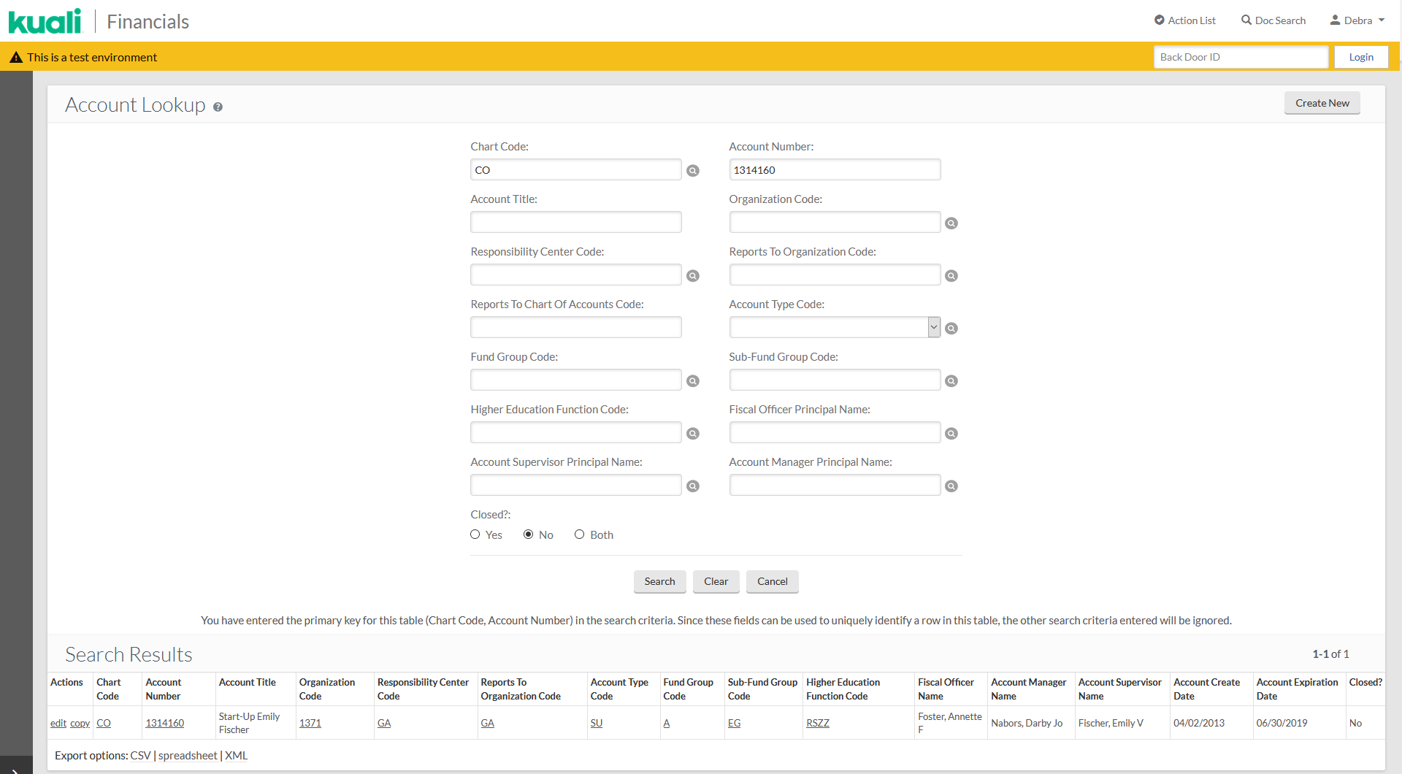
Once you are back to the Account Lookup, you can either click on “kuali” to go back to the home page or click in the grey area to open the table of contents.

Slide 18
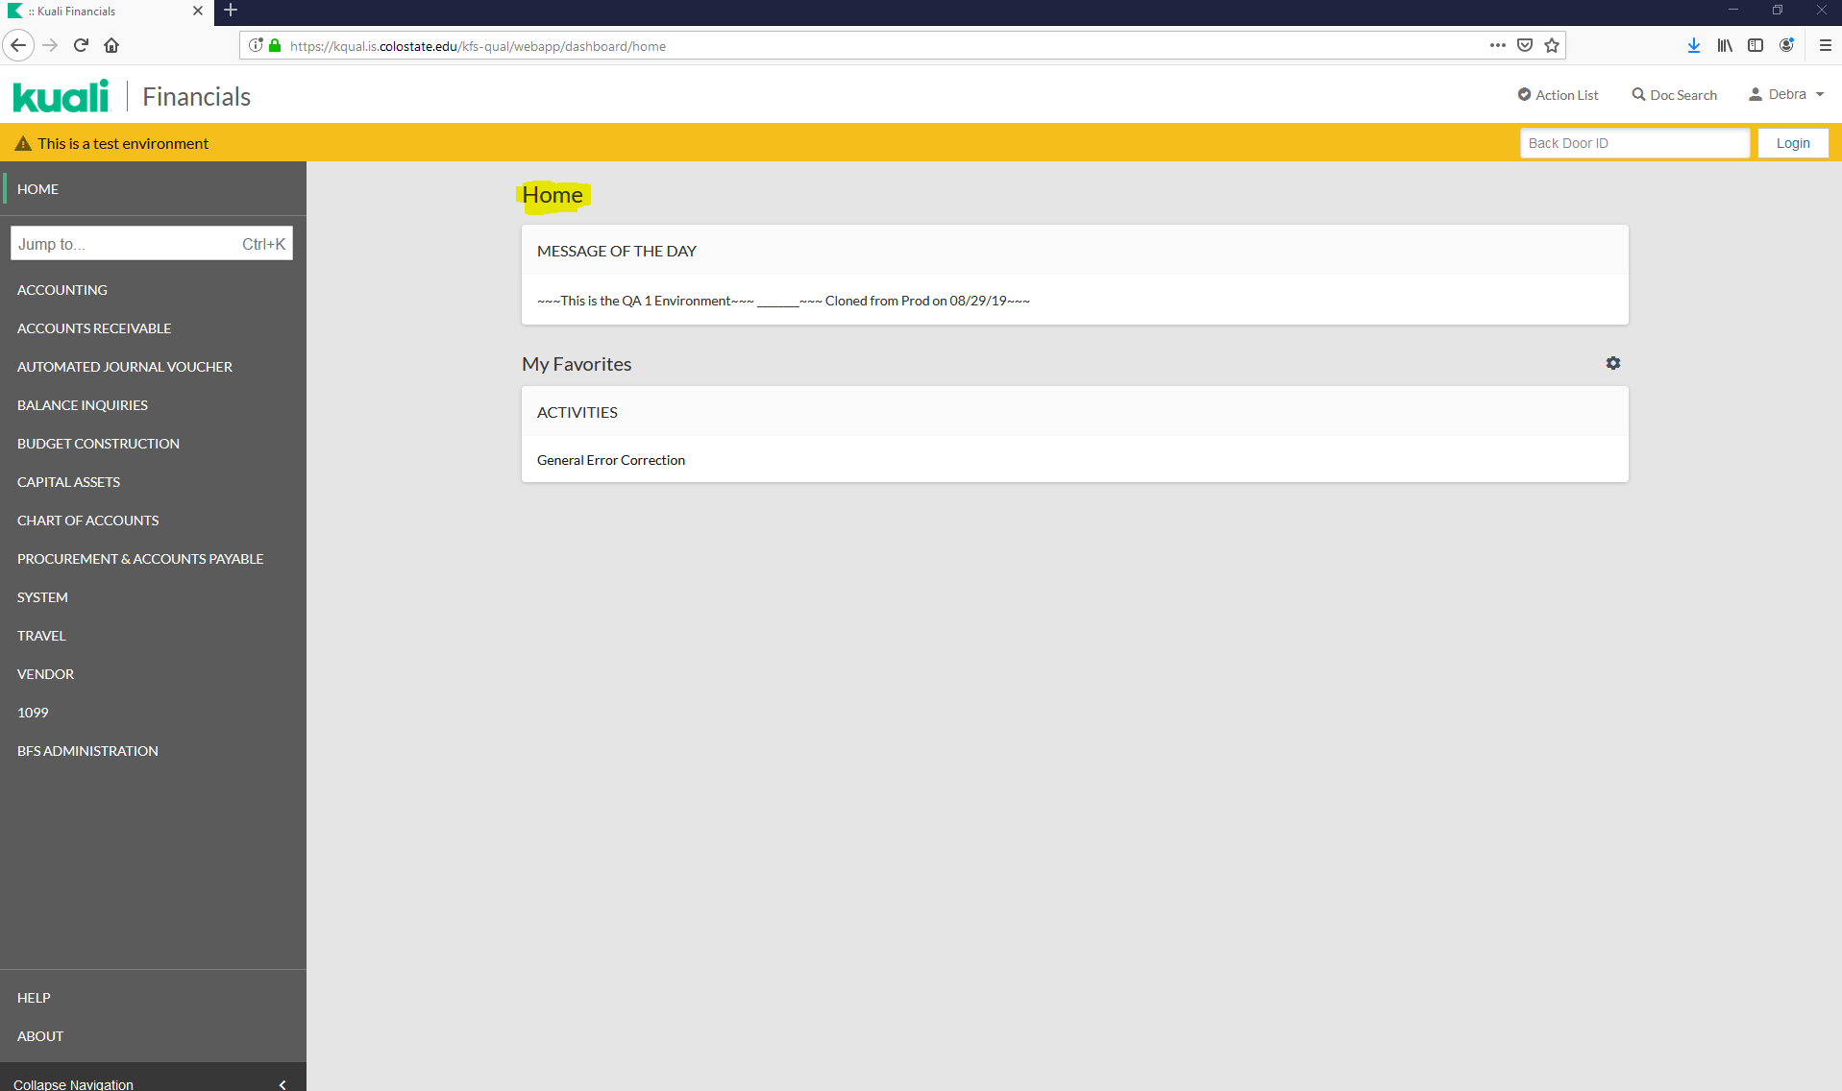
You should now be back at the Home page.

Slide 19
RELATIONSHIP BETWEEN THE ACCOUNT NUMBER AND THE FUND SOURCE CODE
CSU FUNDS
Fund Source Codes 11, 61, and 71
11 Sponsored-Internal-NonFederal
61 NonSponsored-Internal-NonFederal-Miscellaneous
71 NonSponsored-External-NonFederal-Miscellaneous
Plant funds also have specific object codes.
These are usually 77 funds.
Fund Source Codes 11, 61, and 71
County Extension funds.
These are usually 99 funds with Org Code 4XXX.
Fund Source Codes 61 and 71
FEDERAL FUNDS (need to be tracked separately)
Fund Source Codes 22, 32, 34, 41, and 51
22 Sponsored-External-SubFederal-Private
32 Sponsored-External-SubFederal-Colorado-State Agency
34 Sponsored-External-SubFederal-Colorado-Local Agency
41 Sponsored-External-Federal Agency
51 NonSponsored-External-Federal Agency
These are usually 53 funds but can also be other.
SPONSOR FUNDS
Fund Source Codes 21, 31, 33, and 35
21 Sponsored-External-NonFederal-Private
31 Sponsored-External-NonFederal-Colorado-State Agency
33 Sponsored-External-NonFederal-Colorado-Local Agency
35 Sponsored-External-NonFederal-Colorado State Agency-STx
These are usually 53 funds but can also be other.

Slide 20
OWNERSHIP/TITLE
For CSU funds, including 77 and 99 funds; assume ownership/title to be CSU.
For 53 funds, ownership/title will either be; CSU/CONDITIONAL, SPONSOR, or FEDERAL

Slide 21
FINDING THE TITLE
For all 53 funds, you will need to go to the Research Project Status Report (RPS) page to look up the title. OSP is also available to provide title information.
From CSU’s homepage, click on RESOURCES.

Slide 22
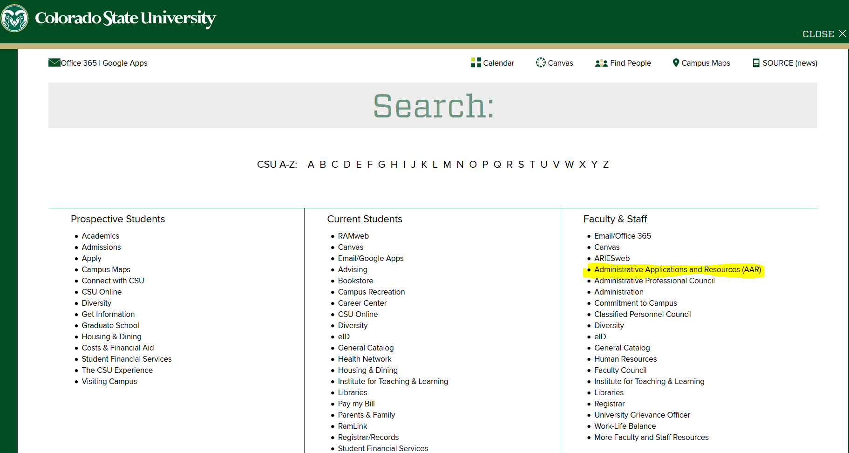
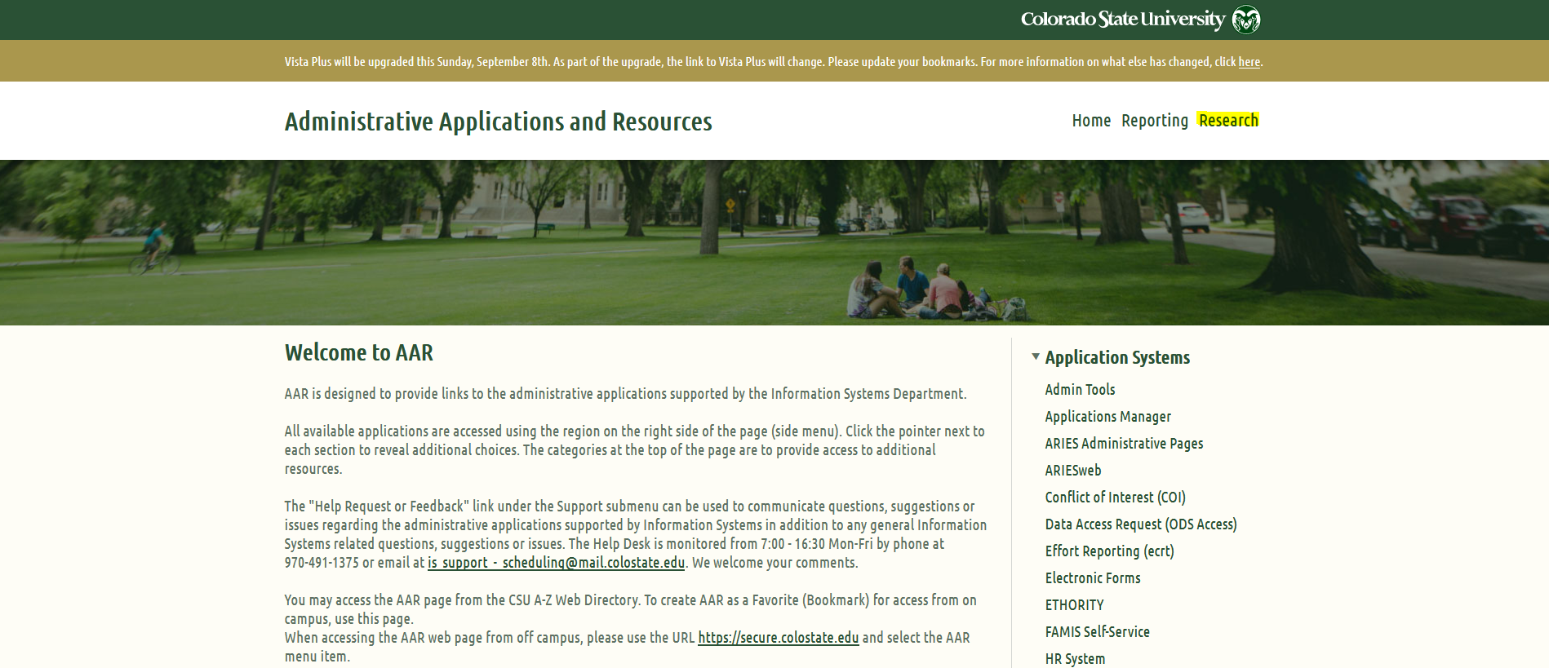
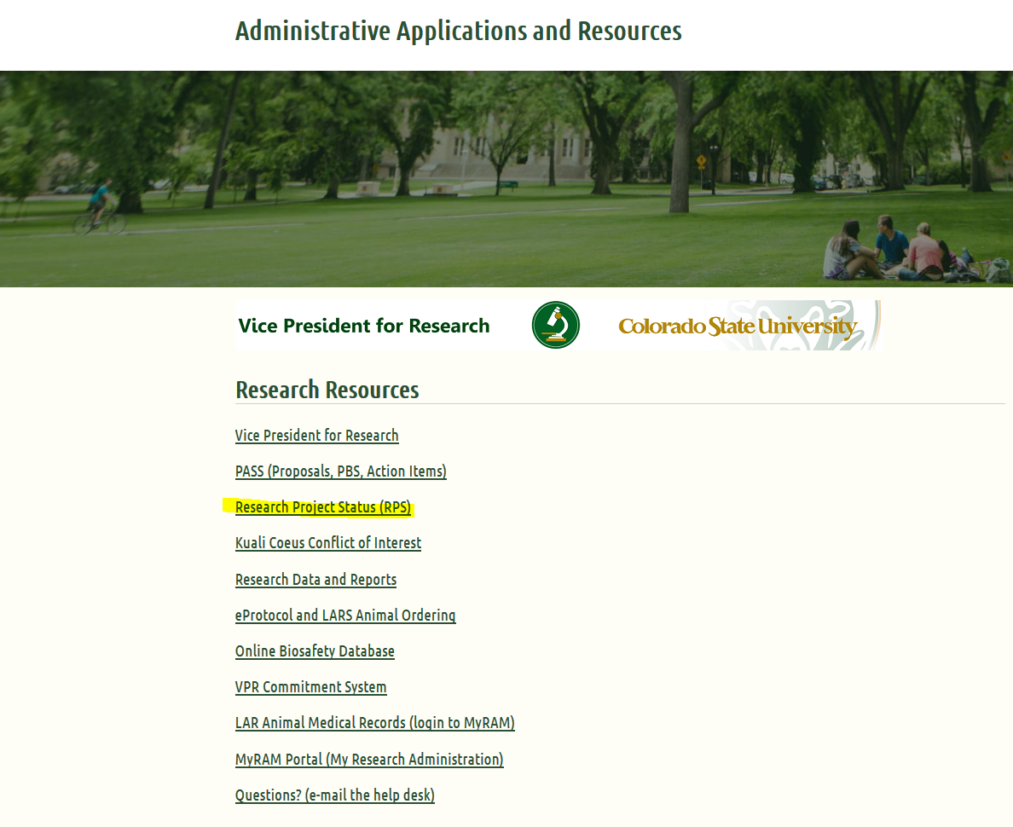
FINDING THE TITLE
From the CSU resources page, click on Administrative Applications Resources (AAR). Next, click on the “Research” heading.
Then click on Research Project Status (RPS)

Slide 23
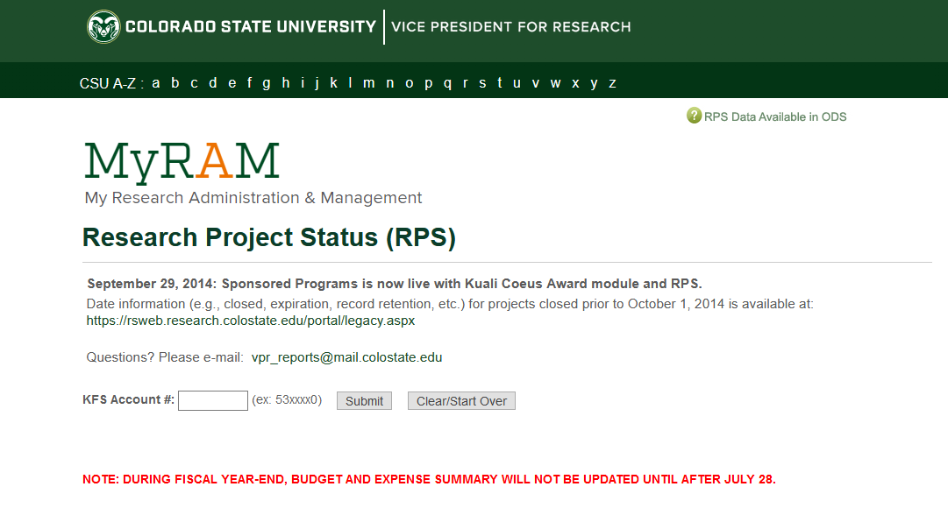
FINDING THE TITLE
You may need to log in. Otherwise, the Research Project Status (RPS) page will appear.
Enter the 53 account number (5300462) and click on Submit.

Slide 24
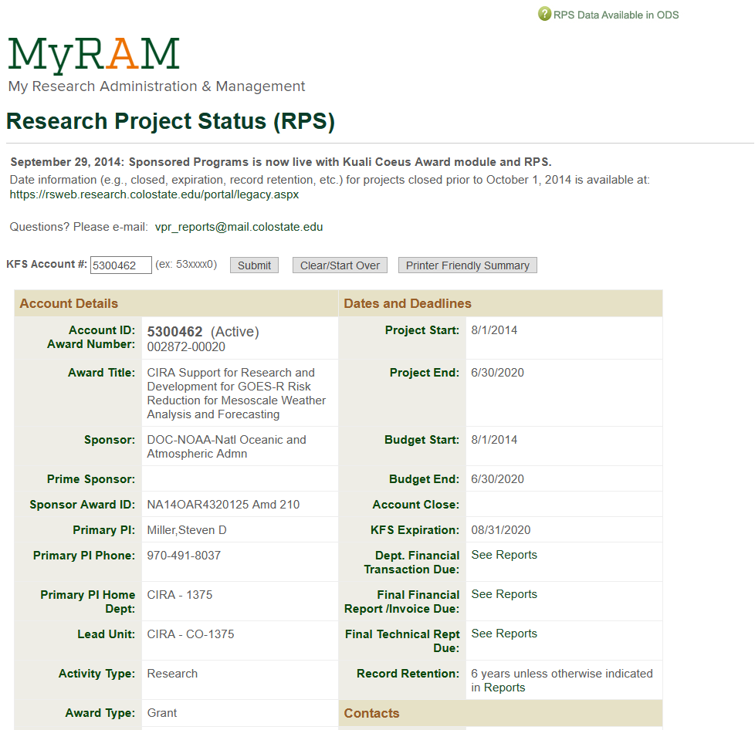
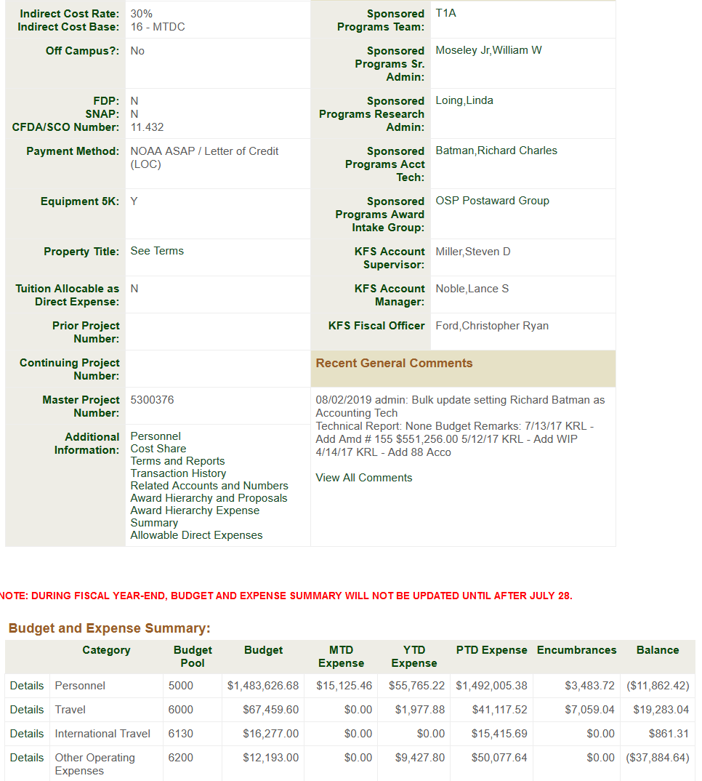
FINDING THE TITLE
Find the Property Title and click on “See Terms”.

Slide 25
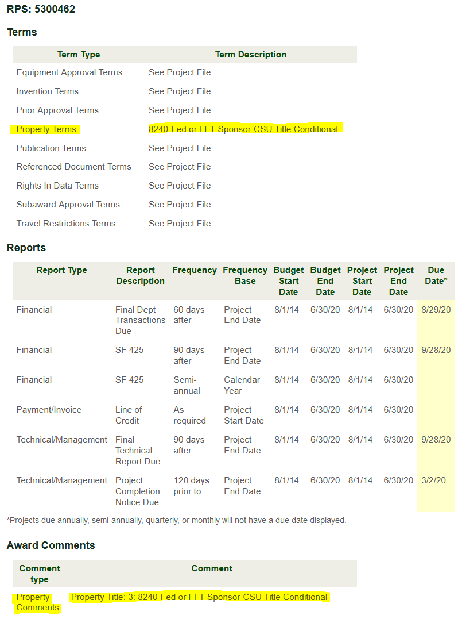
FINDING THE TITLE
From the Terms page, look for Property Terms and or Property Comments. Look for the title.
Notes:
You may see an object code listed, it may or may not be up-to-date. Use the fund source code and title to chose the correct object code.

Slide 26
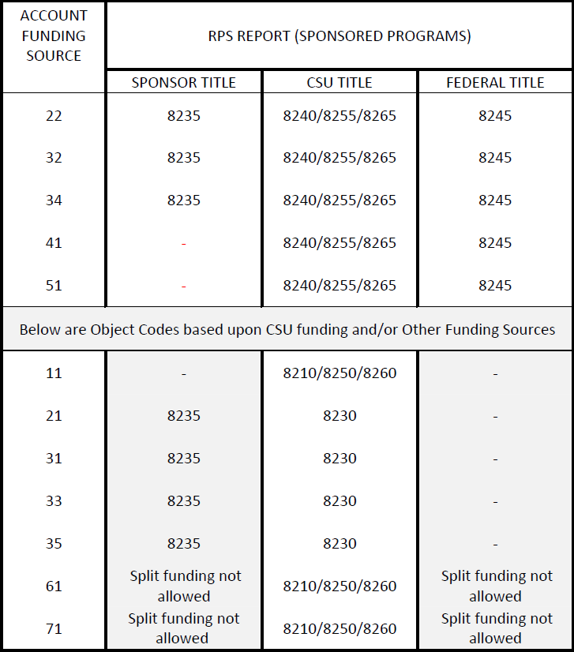
RELATIONSHIP BETWEEN OBJECT CODES, FUND SOURCE CODES, AND OWNERSHIP/TITLE
Notes:
All Sponsor Titled equipment will be 8235. All Federal Titled equipment will be 8245. Depending upon the asset type code, CSU titled equipment object codes will vary. This chart is for 53 funds, 77 funds and Art object codes are not referenced here.

Slide 27
ASSET TYPE CODE
General Equipment
(SI) Scientific Instruments
(OF) Office Equipment [Furniture, etc.]
(IS) Info Systems [Computer Hardware, etc.]
(ME) Machinery [Farm/Ground, Tractors, Shop/Maintenance, etc.] (RE) Recreation Equipment [ATV’s, Golf Carts, etc.]
(VH*) Other Vehicles [Watercraft*, Aircraft*, Trailers/Storage Containers*, and Snowmobiles*.]
Vehicles
(VH) Buses, Trucks, Vans, Automobiles, and Motorcycles.
Software
(SW) Stand-Alone Software. If software will be preloaded, use the appropriate equipment object code.
Art/Museum Objects
(AH) Individual Items or Collections.

Slide 28
RELATIONSHIP BETWEEN THE ASSET TYPE CODE AND OBJECT CODES
Equipment: (SI, OF, IS, ME, RE, VH*)
8210/8240/8230/8245/8235/8910
Vehicles: (VH) (Buses, Trucks, Vans, Automobiles, Motorcycles)
8250/8255/8915/8245/8235
Software: (SW) (Stand-Alone)
8260/8265/8930/8245/8235
Art/Museum Objects: (AH)
8280/8900/8245/8235

Slide 29
PUTTING IT ALL TOGETHER
Notes:
Watch for special funding object codes (53, 77, 99). Federal title will always be 8245 and Sponsor title will always be 8235.

Slide 30
SPLIT FUNDING
When split-funding a line item; if the line item is capital, you may need mixed capital object codes (i.e. 8210 with 8240).
Do not mix capital and non-capital object codes on the same line item (i.e. 8210 with 6201). It is ok to have capital and non-capital object codes on the same requisition, however.
Be cautious when mixing titles.
Do not mix ownership/title between Federal and Sponsor on the same line item (i.e. 8235 with 8245).
Using split-funding where one asset should be on one account and an identical asset should be on another account, create a line item for each account.
Notes:
For example, shipping should be capitalized when purchasing a capital asset. If the shipping is split up on the quote between a capital asset and a supply, you will need to make a separate line item for the non-capital item’s shipping cost. If the shipping cost is a lump sum and you are ordering both capital assets and supplies, capitalize the entire shipping amount.

Slide 31
QUESTIONS?

Slide 32
AGENDA
CAPITAL ASSET REQUISITION
COLLAPSE ALL BUTTON
ITEMS TAB
CAPITAL ASSET TAB
Capital Asset System Type
Capital Asset System State
Individual Assets
One System
Multiple Assets
Modify Existing
PRACTICE REQUISITION
MAKING CHANGES

Slide 33
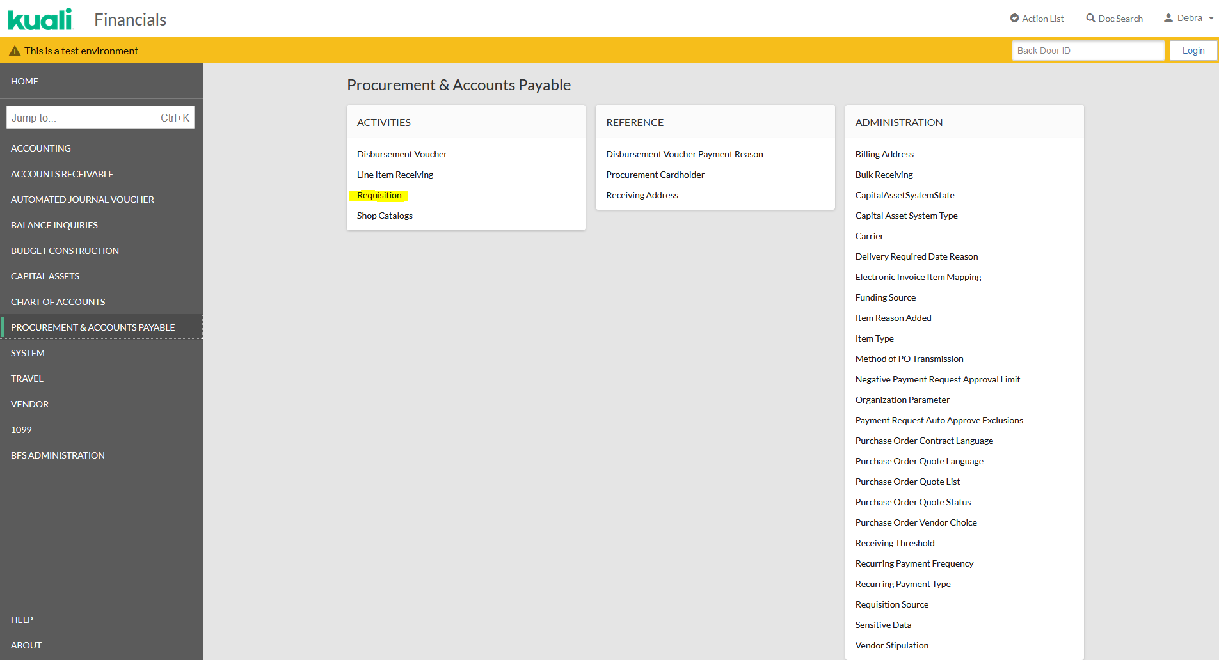
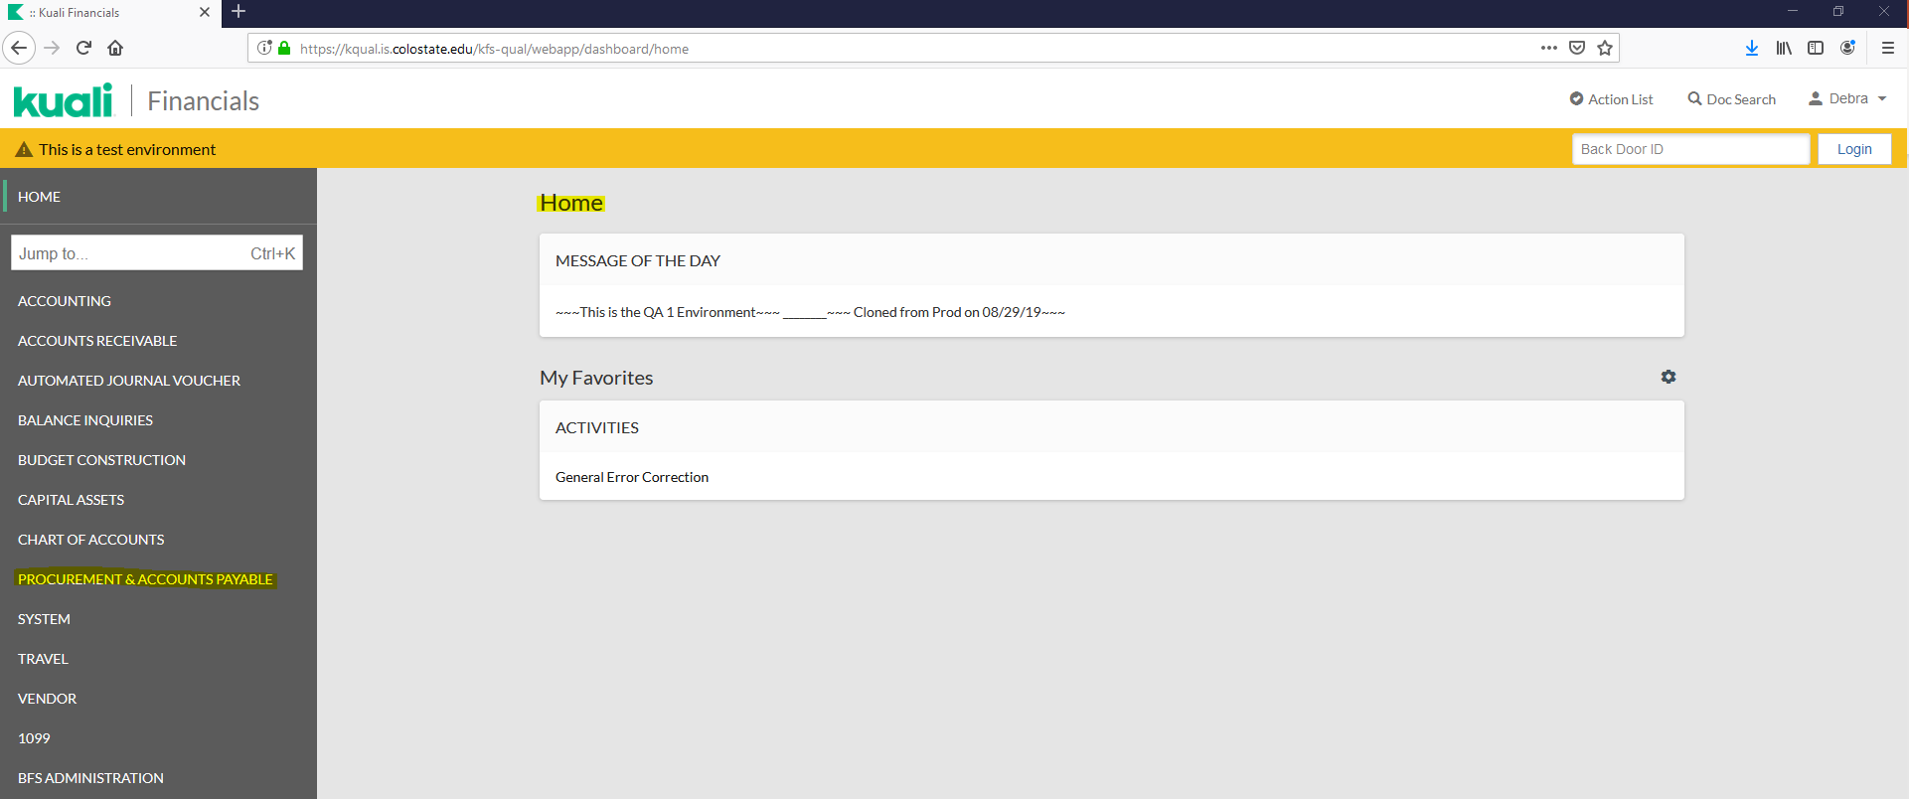
CAPITAL ASSET REQUISITON
From Home, click on “PROCUREMENT & ACCOUNTS PAYABLE”, then click on “Requisition”.

Slide 34
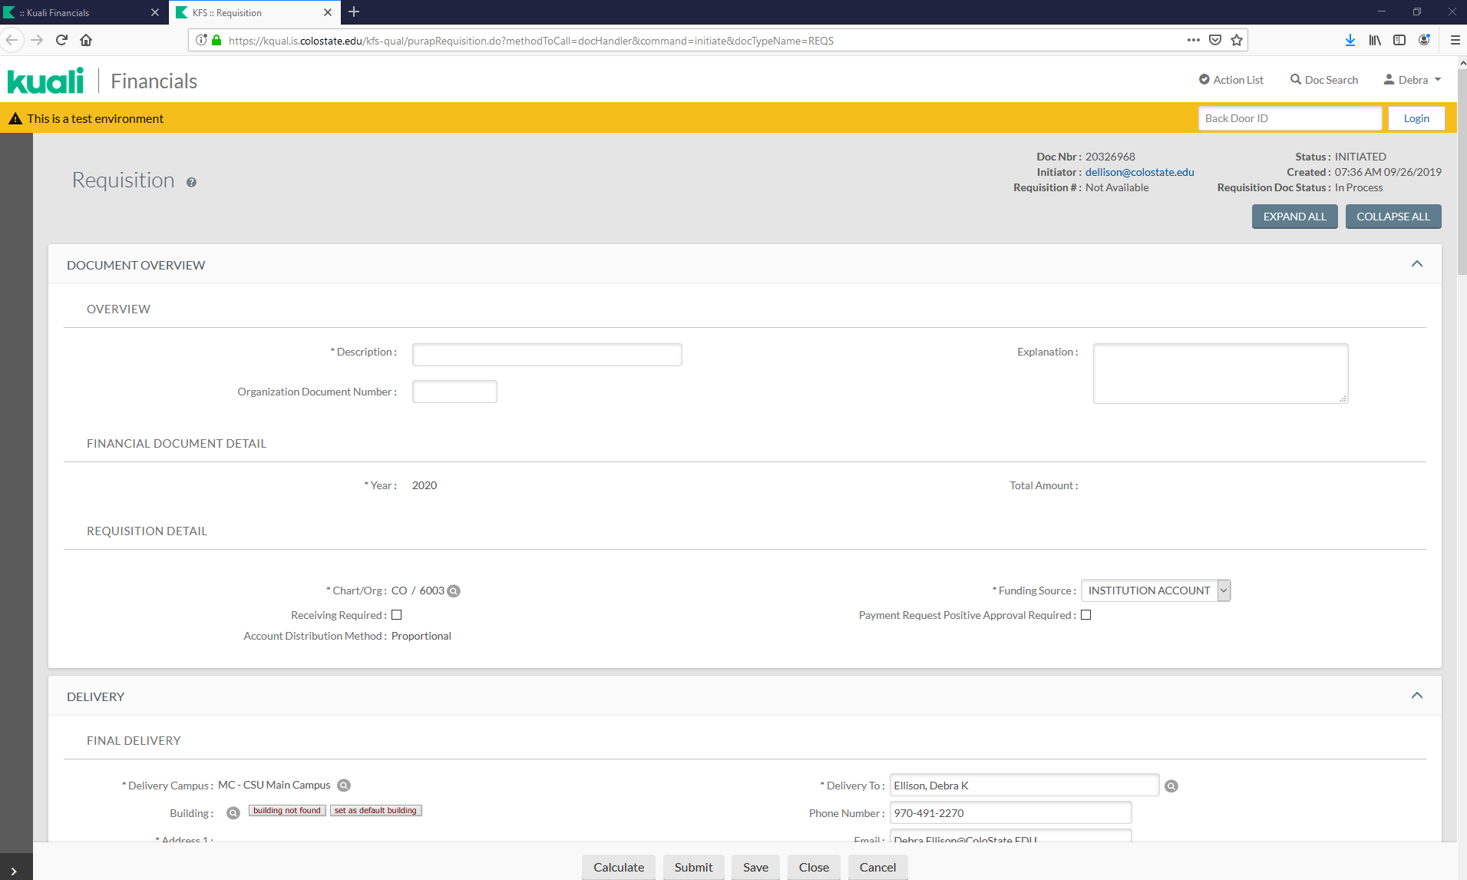
COLLAPSE ALL BUTTON
Notes:
Let’s take a moment to show some tips that will help when completing requisitions. Let’s start with the Collapse All button. This will collapse the document into a “tabs only” view. From here, you can open the tabs you want to work on.

Slide 35
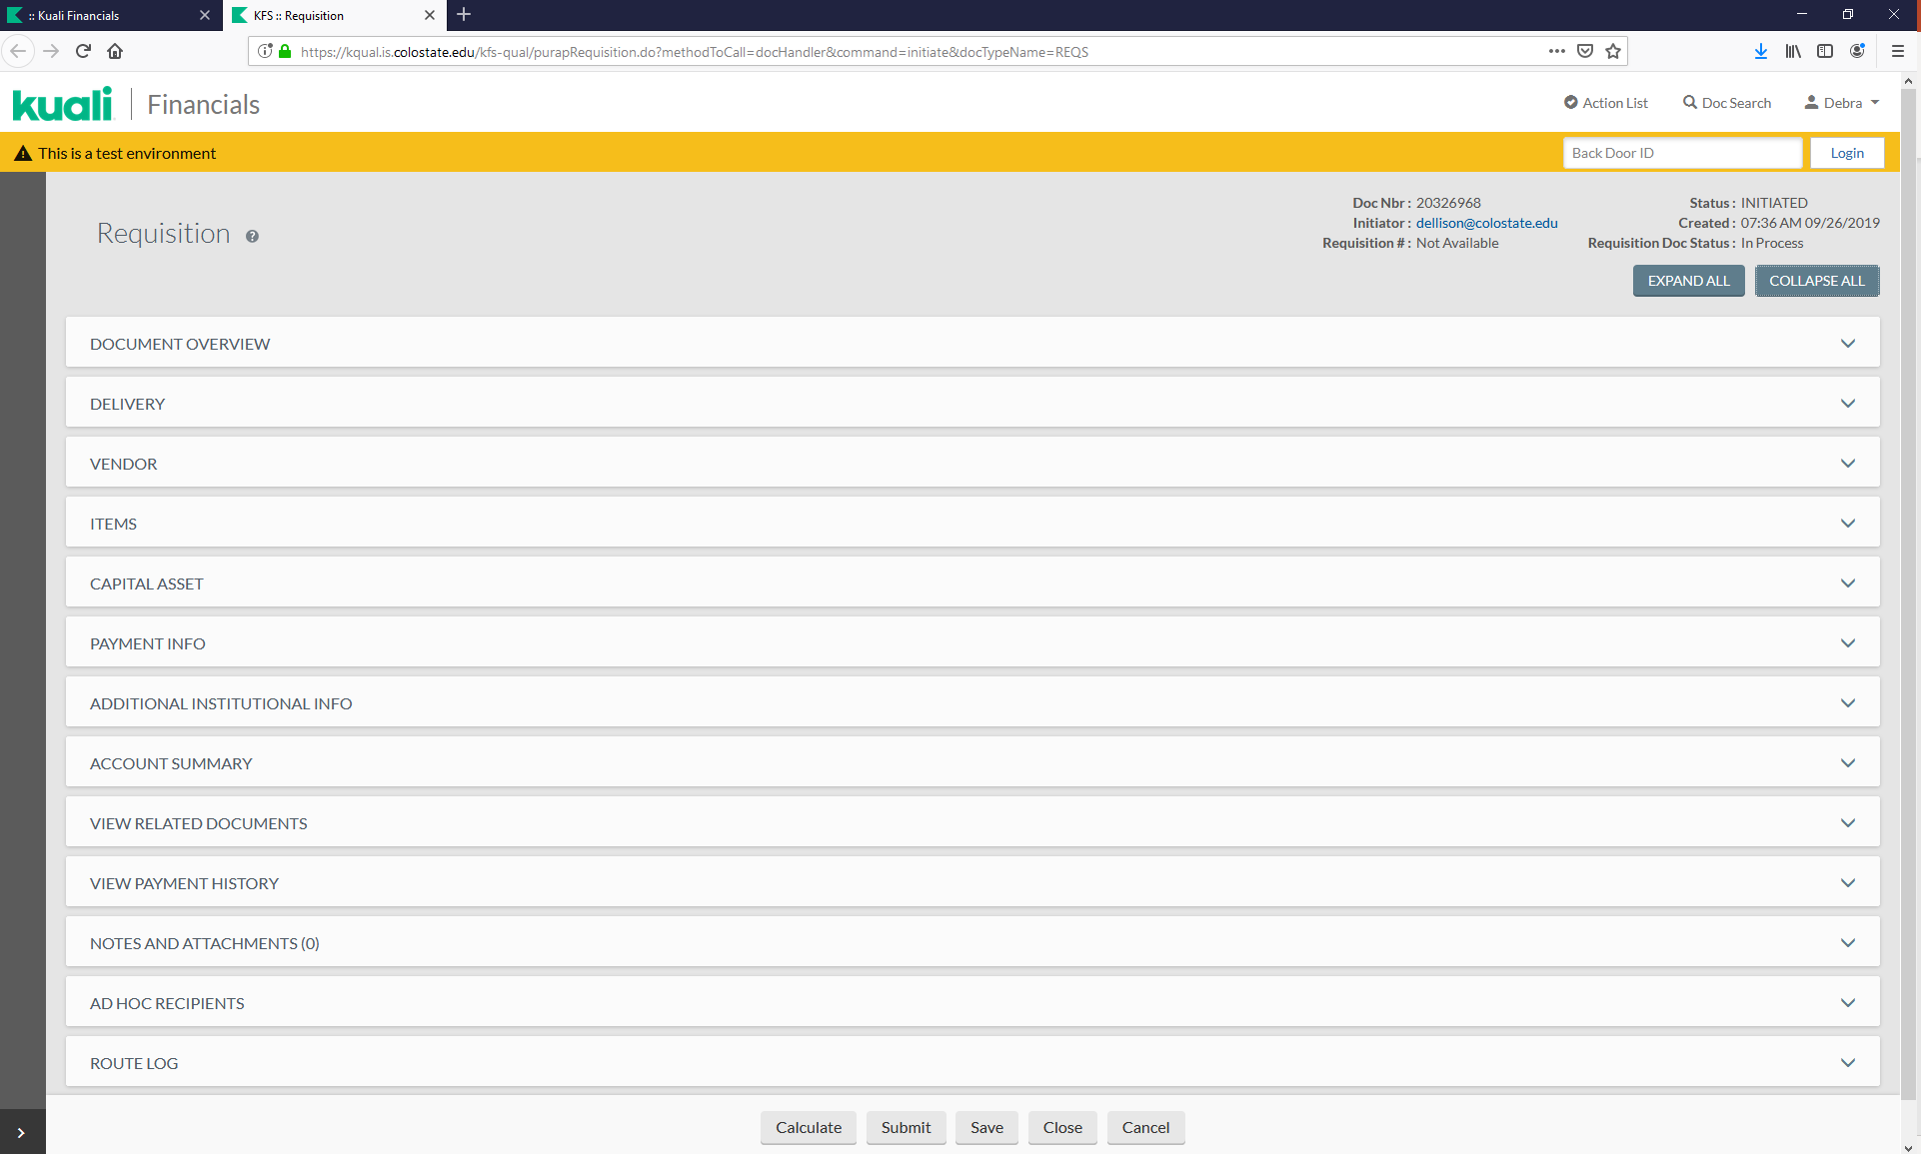
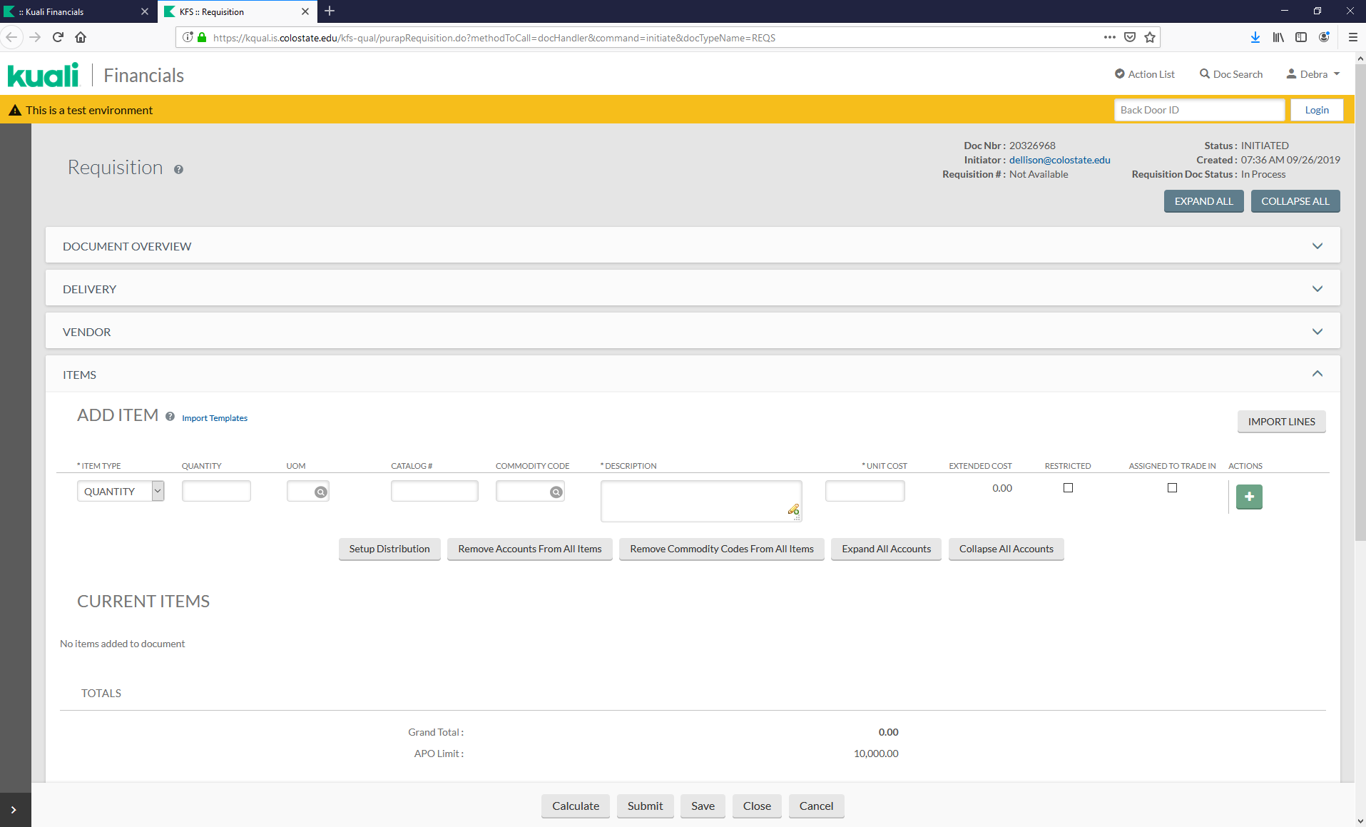
ITEMS TAB
A quantity is required for capital assets, you can use “no quantity” for services.
The Items tab should be lined out to match the quote.
Shop Catalog items should be uploaded from the Shop Catalog site.
Notes:
The Items Tab will affect the Capital Asset Tab. A Quantity is required for capital assets, unless it is a service that will also be capitalized. You will still use the capital object code for the service, however, when we cover the capital asset tab, I will show you how to process it so you won’t get an error because a quantity wasn’t entered.

Slide 36
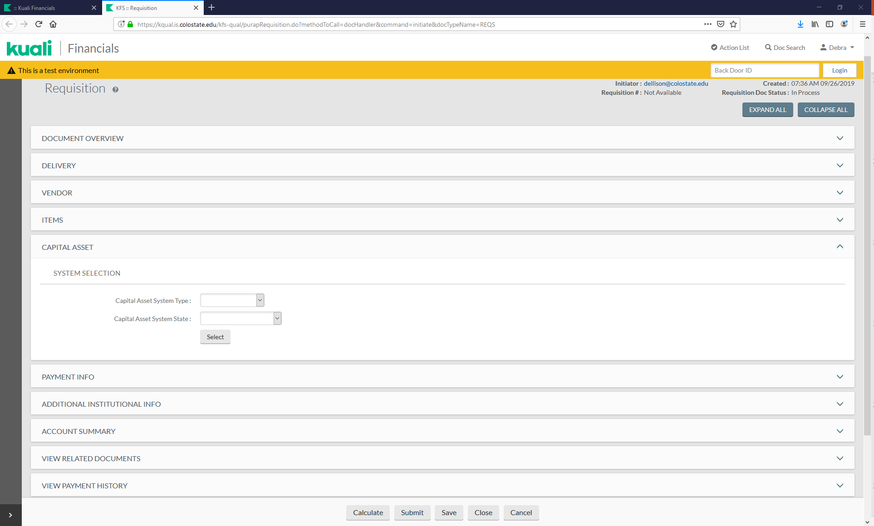
CAPITAL ASSET TAB
If capital object codes were used in any of the line items, the Capital Asset Tab will need to be completed.
Notes:
The Items Tab will affect the Capital Asset Tab. A Quantity is required for capital assets, unless it is a service that will also be capitalized. You will still use the capital object code for the service, however, when we cover the capital asset tab, I will show you how to process it so you won’t get an error because a quantity wasn’t entered.

Slide 37
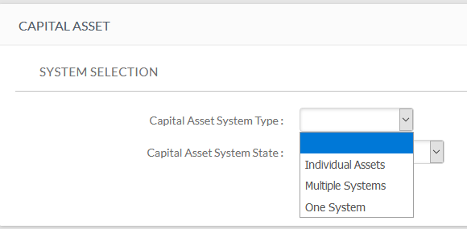
CAPITAL ASSET SYSTEM TYPE
Individual Assets is used when none of the lines on the requisition will be combined with any other line. Any lines using a capital object code will create an individual asset (or assets based on the quantity ordered on that line). The item should meet the $5,000 threshold. (Each line item stands-alone)
Multiple Systems is used when you have mixed object codes (capital and non-capital). Capital line items will be combined in different ways to create an asset or multiple assets with different costs. It is also used when modifying an existing asset or when combining multiple requisitions for a purchase. (Any combination of lines)
One System is used when you are combining all of the lines together to make an asset or identical assets with identical costs. All lines must have a capital object code. (All lines combined as one)
Notes:
The Capital Asset System Type tells how the line items are to be combined, not how many assets will be created. For example, will the lines stand-alone (individually), will they be combined in any type of combination (multiple) or will they all be combined together (one).

Slide 38
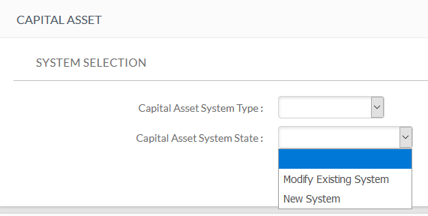
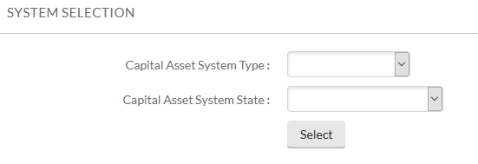
CAPITAL ASSET SYSTEM STATE
Modify Existing System (adding to or upgrading an existing active asset)
New System (create a new capital asset)
Note: The threshold limit is $1,000 when using modify existing within the same fiscal year and $5,000 if in a different fiscal year than the original asset.
Notes:
Depending upon the information entered in the System Selection section, different information will be required when completing the Capital Asset tab.

Slide 39
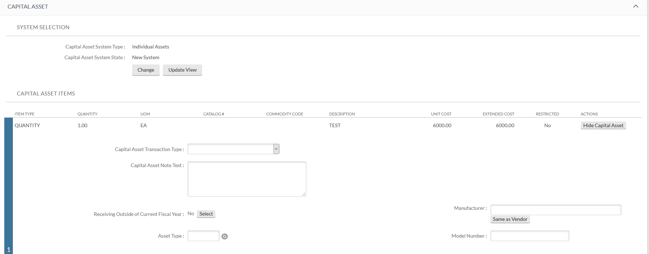
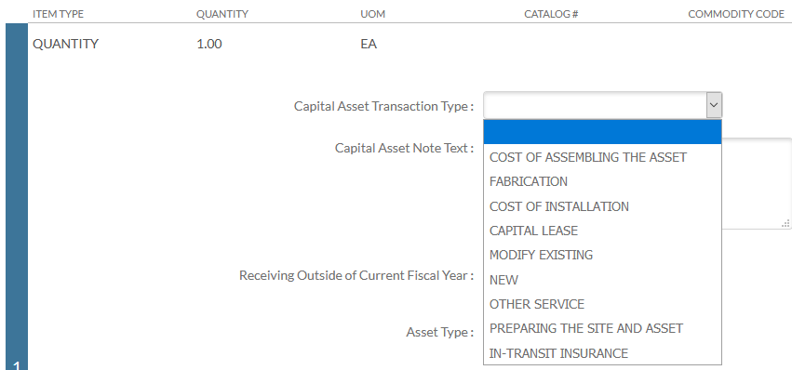
INDIVIDUAL ASSETS
Notes:
Capital asset object codes need a quantity. However, if you have a service that will be capitalized, you can use “no quantity” in your Line item but here is where you will select a “service” Capital Asset Transaction Type. Other Service is the one used mostly for shipping. If you get an error message when saving or submitting, check to see if you have a quantity or no quantity in your line items and make sure you have the correct Capital Asset Transaction Type that matches.

Slide 40
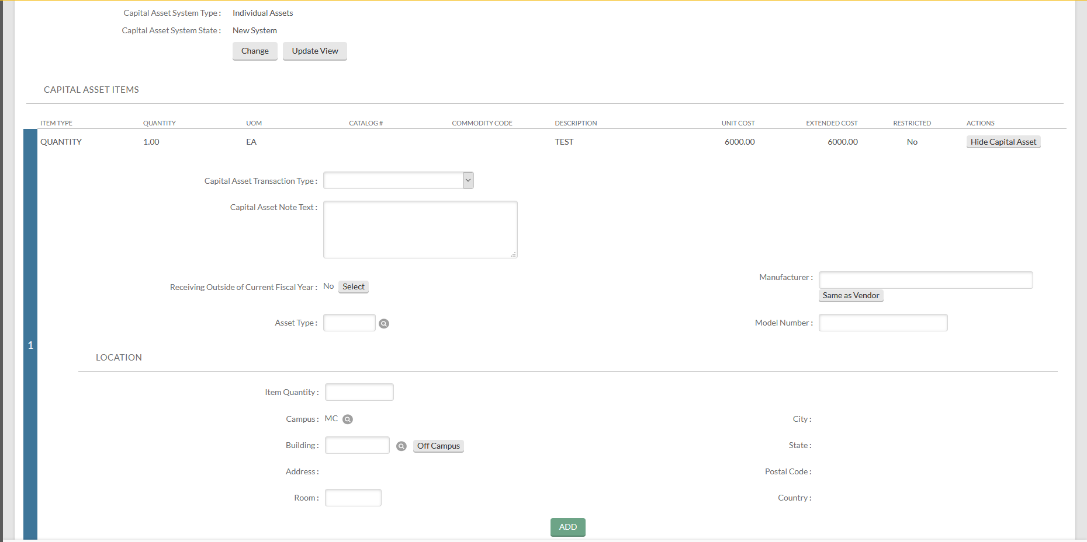
INDIVIDUAL ASSETS
Capital Asset Note Text: The note text is used to describe how capital line items are connected and other necessary information.
Manufacturer: Enter if known, otherwise click on “same as vendor”
Model: Enter if known, otherwise put “unknown”
Asset Type: Look it up using the magnifying glass. It should match the asset description.
Location information is not required and can be left blank. Otherwise, the quantity ordered will need to match the Item Quantity you are entering the location for.

Slide 41
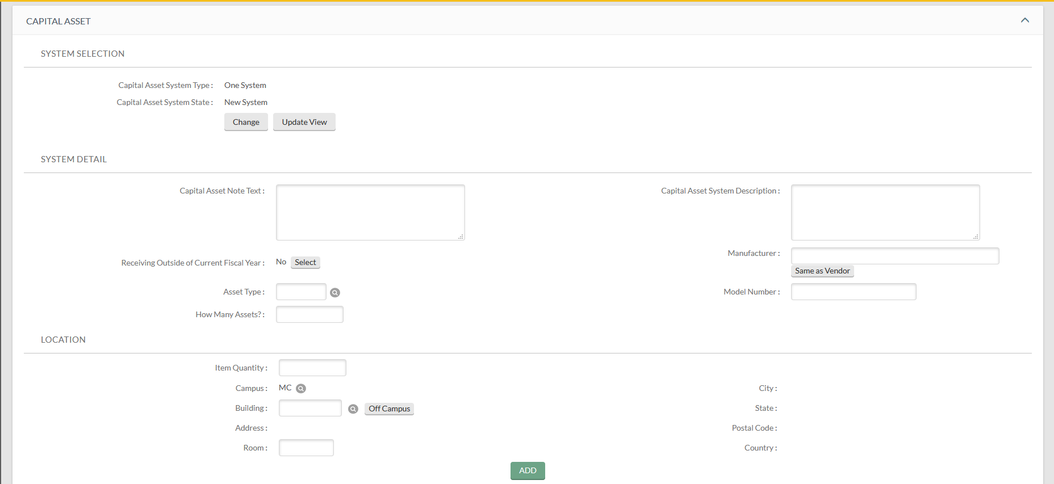
ONE SYSTEM
Capital Asset Note Text: Combine all lines
Capital Asset System Description: Asset description should match Asset Type Code description
Manufacturer: Enter if known, otherwise click on “same as vendor”
Model: Enter if known, otherwise put “unknown”
Asset Type: Look up the asset description and return to populate the Asset Type Code
How Many Assets?: Number of assets to be created (may or may not match quantities ordered)
Capital Asset Transaction Type: L1: New/L2: New/L3: Other Service
Notes:
When entering the number of assets, if more than one asset, these should be identical assets when One System is used.

Slide 42
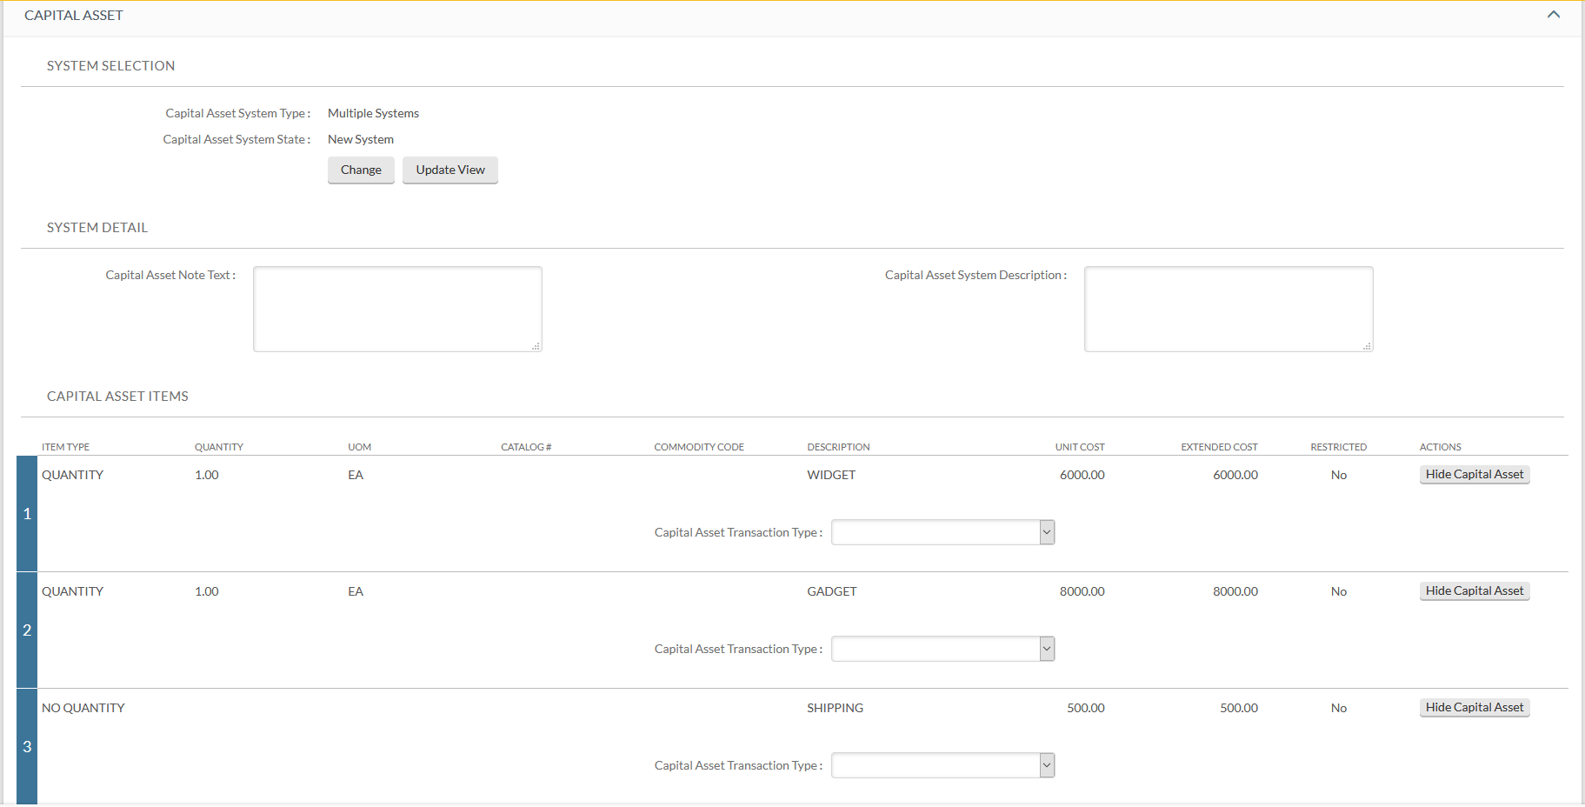
MULTIPLE SYSTEMS
Multiple Systems doesn’t ask for the same detailed information as Individual Assets and One System.
The Capital Asset Note Text is extremely important. It describes how to combine lines.
The Capital Asset System Description should include all assets created from the combined lines.
Notes:
Only the capital object code lines should be brought in. Line 3 is under $5,000.00, this informs me Individual Assets should not be used. One system isn’t used because we aren’t combining all of the lines (lines 1 and 2 are separate and line 3 will be allocated to them). The capital asset note text is used to describe how the lines items should be combine along with any other relevant information, such as number of assets being created. Next we have the capital asset system description. This wasn’t required in the individual assets tab but was in One System. Here you will describe the asset or assets you are ordering. Notice, Manufacturer, Model, Asset Type and Number of Assets are not shown or required. Also notice, the Capital Asset Transaction Type Code is in a different location than the Individual Assets example. Neither lines 1 or 2 are services, so “new” should be used for the Capital Asset Transaction Type Code. Line 3 is a service (no quantity), so a service Capital Asset Transcation Type Code should be used.

Slide 43
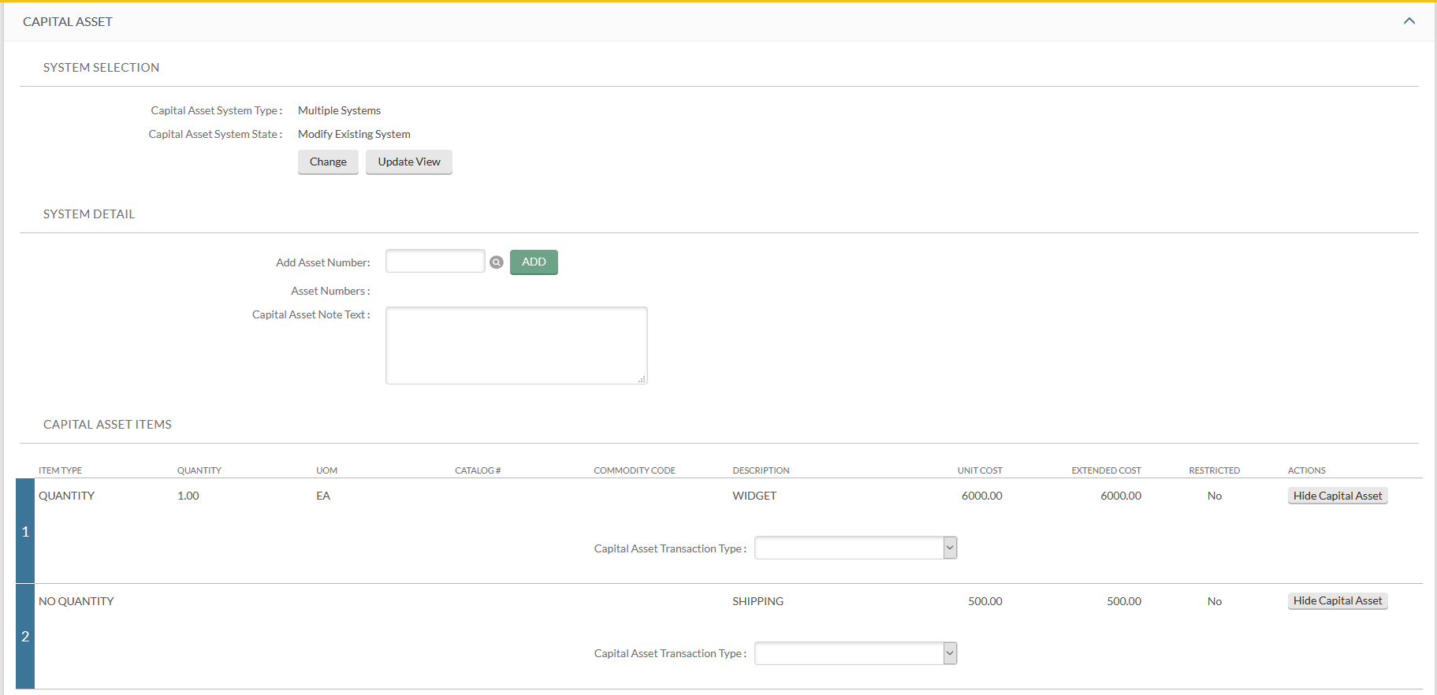
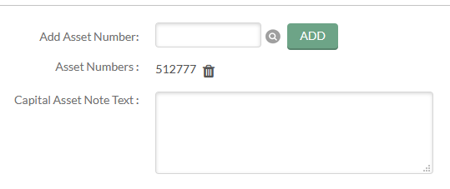
MULTIPLE SYSTEMS (MODIFY EXISTING)
You will be asked for the Asset Number. This is not the decal/tag number. You can click on the magnifying glass to find the asset number. Once found, click on return selected.
The Asset Number will populate in the field.
Then, click on “add”.
You can add additional assets or delete assets for changes.
Capital Asset Note Text: Put in a description such as; accessory for decal xxxxxx
Capital Asset Transaction Type: Select “MODIFY EXISTING” and “OTHER SERVICE”.
Notes:
Modify Existing is also used when making Direct to Vendor Lease Payments. The lease accountant in BFS will set up assets and the department will submit the requisition for the payments.

Slide 44
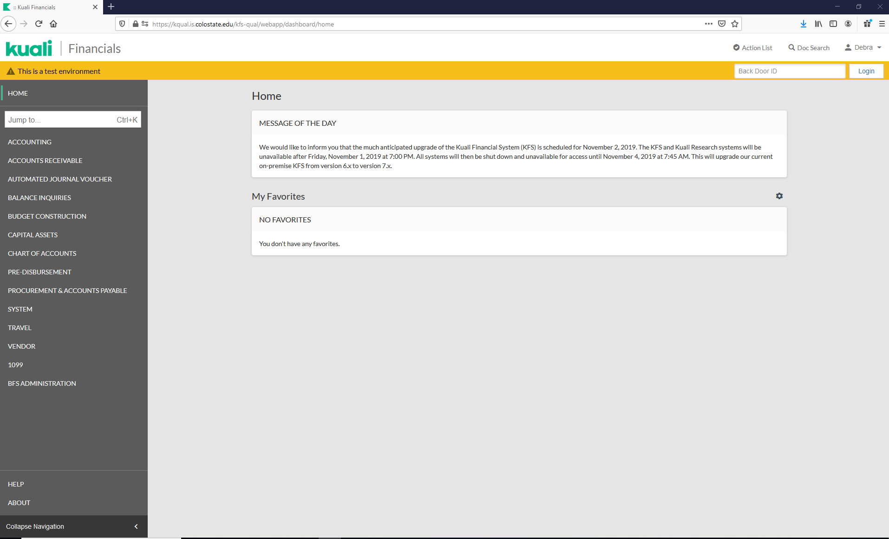
PRACTICE REQUISITON
Notes:
https://kqual.is.colostate.edu/kfs-qual/webapp/dashboard/home
https://kqual2.is.colostate.edu/kfs-qual/webapp/dashboard/home
https://kqual1.is.colostate.edu/kfs-qual
https://kqual1.is.colostate.edu/kfs-qual/portal.jsp
https://kqual3.is.colostate.edu/kfs-qual/

Slide 45
PRACTICE REQUISITON
From Home, click on “PROCUREMENT & ACCOUNTS PAYABLE”, then click on “Requisition”.
Notes:
https://kqual.is.colostate.edu/kfs-qual/webapp/dashboard/home
https://kqual2.is.colostate.edu/kfs-qual/webapp/dashboard/home
https://kqual1.is.colostate.edu/kfs-qual
https://kqual1.is.colostate.edu/kfs-qual/portal.jsp
https://kqual3.is.colostate.edu/kfs-qual/

Slide 46
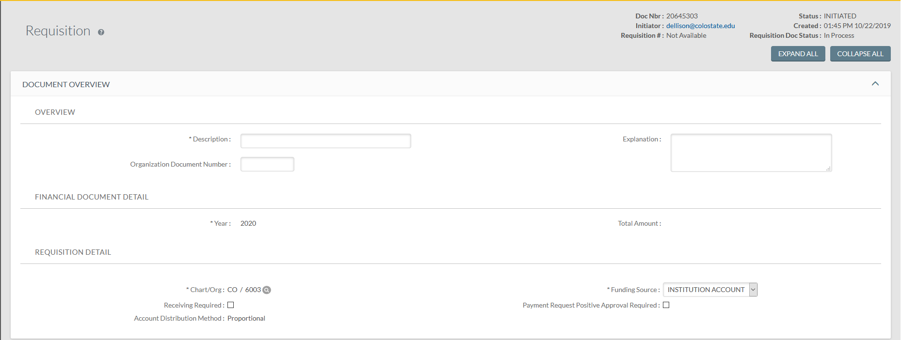
PRACTICE REQUISITON
Enter the following information:
Description: Test
Explanation: Test

Slide 47
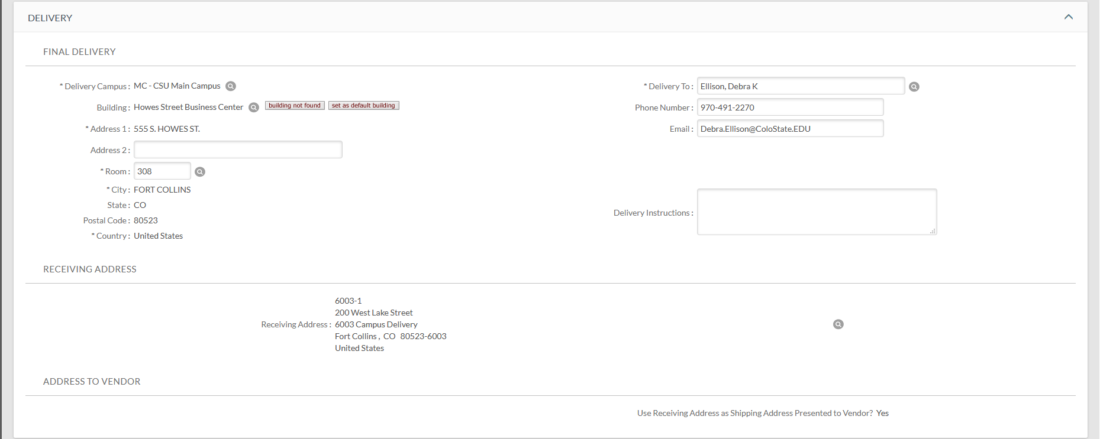
PRACTICE REQUISITON
Enter the following information:
Building: Use the Magnifying Glass to Lookup 0926
Room: 308
Delivery Instructions: Internal Use Only (Vendor will not see this)

Slide 48
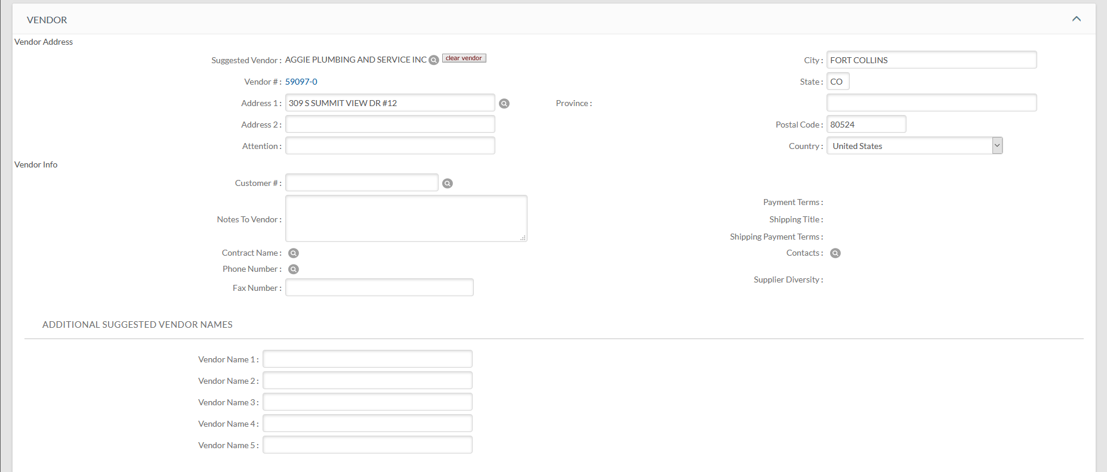
PRACTICE REQUISITON
Enter the following information:
Vendor: Use the Magnifying Glass to Lookup AGGIE PLUMBING AND SERVICE INC

Slide 49
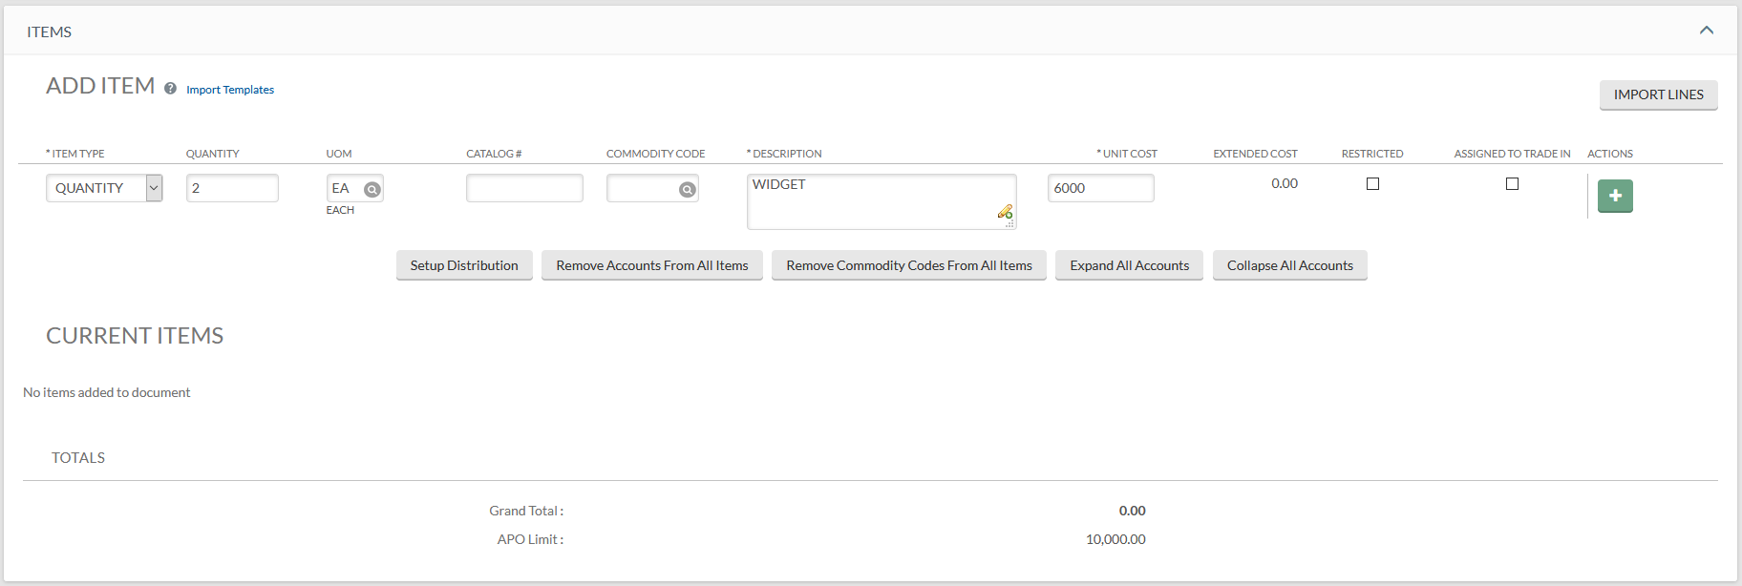
PRACTICE REQUISITON
If you have multiple lines, you can use “IMPORT LINES” (contact procurement for template).
Enter Line 1:
Item Type: QUANTITY
Quantity: 2
UOM: EA
Description: WIDGET
Unit Cost: 6000
Click on the Plus Sign to add the line
Notes:
As you enter each line, keep in mind if it meets capital criteria or not (i.e. is it a stand-alone item, is it an accessory, or is it a capitalized service cost).

Slide 50
PRACTICE REQUISITON
Enter Line 2:
Item Type: QUANTITY
Quantity: 2
UOM: EA
Description: GADGET
Unit Cost: 7000
Click on the Plus Sign to add the line

Slide 51
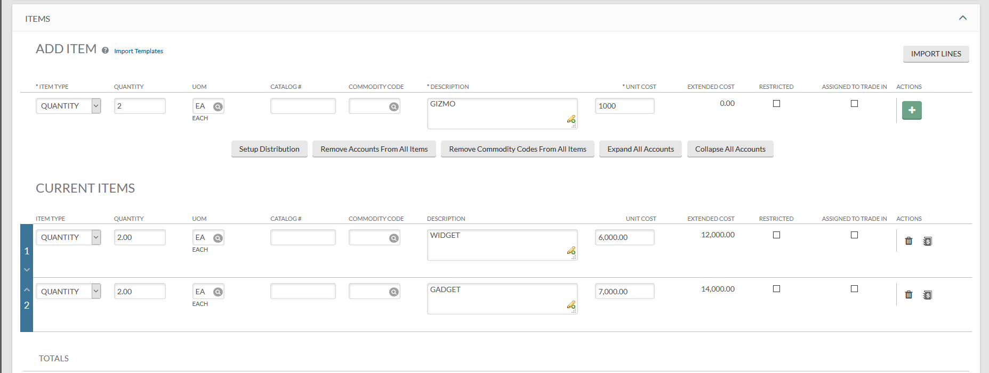
PRACTICE REQUISITON
Enter Line 3:
Item Type: QUANTITY
Quantity: 2
UOM: EA
Description: GIZMO
Unit Cost: 1000
Click on the Plus Sign to add the line

Slide 52
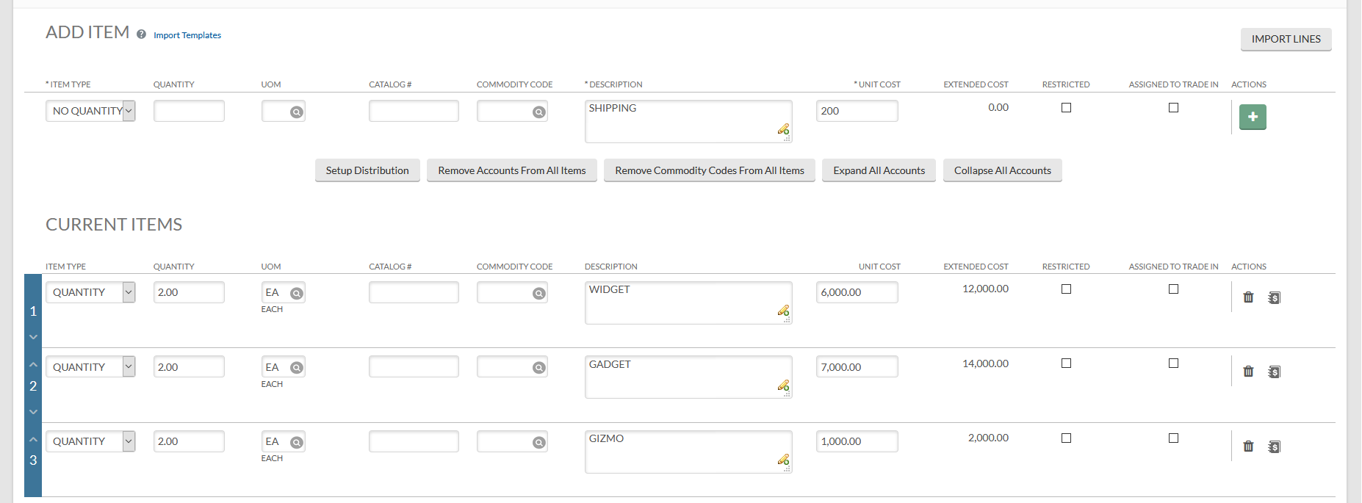
PRACTICE REQUISITON
Enter Line 4:
Item Type: NO QUANTITY
Quantity: BLANK
UOM: BLANK
Description: SHIPPING
Unit Cost: 200
Click on the Plus Button to add the line

Slide 53
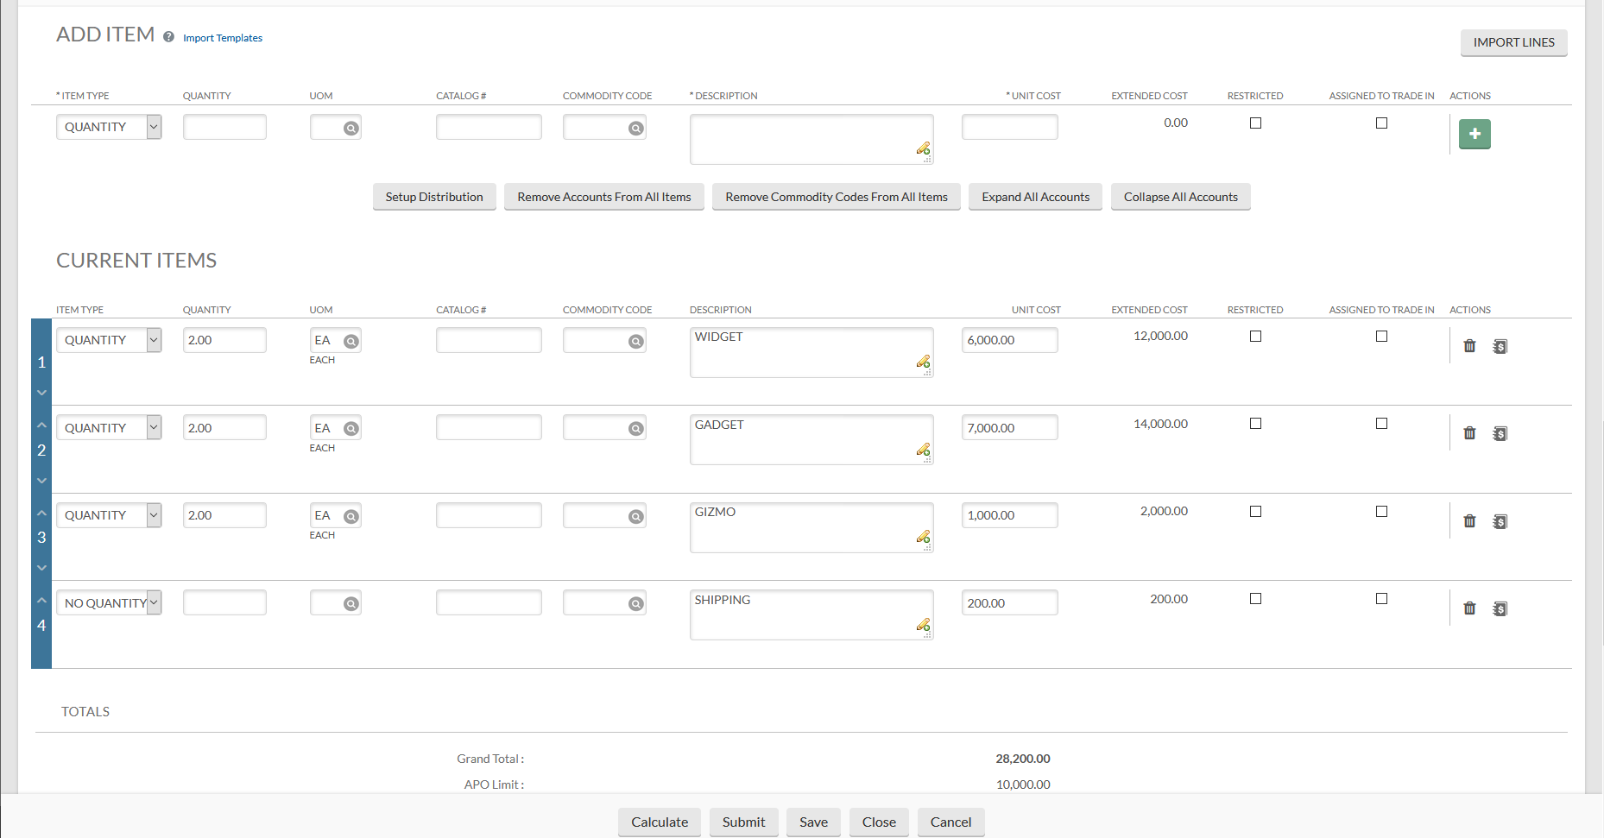
PRACTICE REQUISITON
You can enter the accounting lines individually by clicking on the “dollar sign”
Or you can enter accounting lines by clicking on “Setup Distribution”
Click on: Setup Distribution
Notes:
Looking at the costs only, in this example, you may have some capital items and non-cap or all lines are capitalized. It is important to know what is being purchased to recognize what object code (capital or expense) to use for each line.

Slide 54
PRACTICE REQUISITON
Enter Account: 1356580
Enter Object Code: 8210
Click on the Plus Button to add the accounting line
Notes:
What object code is most appropriate? Keep in mind, you may need to make changes on each individual line regarding the account or object code, etc.

Slide 55
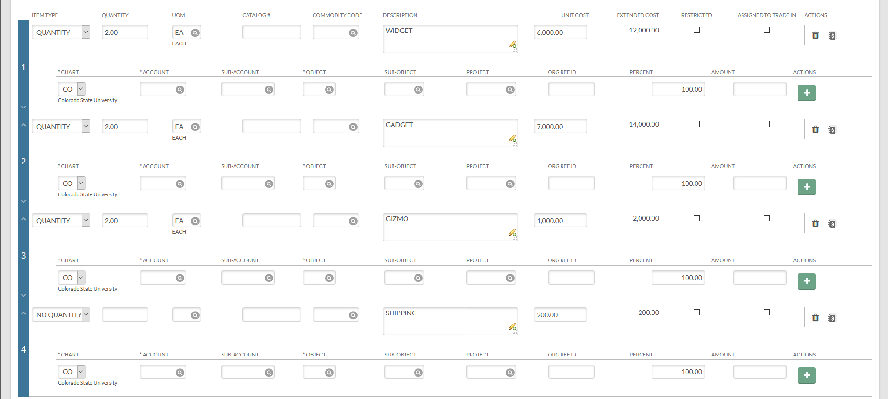
PRACTICE REQUISITON
When using Setup Distribution, you can continue to enter accounts (split funding).
Clicking on “Distribute to Items” will distribute all entered accounting lines to each line item that does not have accounting line information already populated.
Click on: Distribute to Items

Slide 56
PRACTICE REQUISITON
You will get a message at the top of your Requisition.
And all accounts will be populated under the line items.

Slide 57
PRACTICE REQUISITON
Enter the following in the Capital Asset tab:
Capital Asset System Type: One System
Capital Asset System State: New System
Click on “Select”

Slide 58
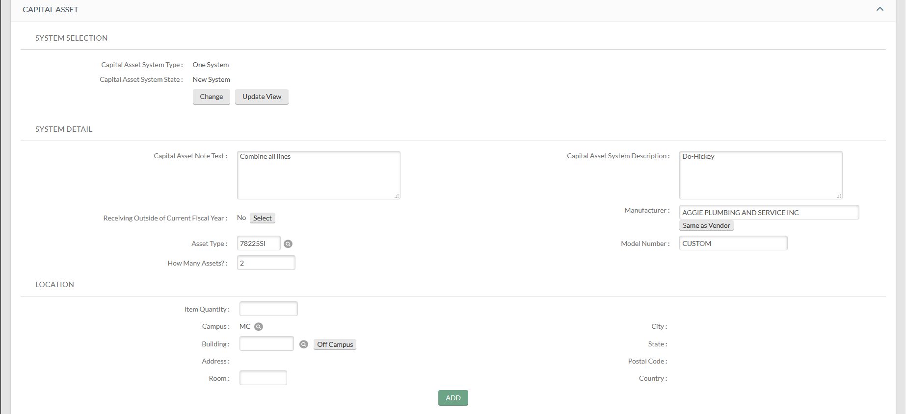
PRACTICE REQUISITON
The CAPITAL ASSET tab will open.
Capital Asset Note Text: Combine all lines
Capital Asset System Description: Do-Hickey
Manufacturer: Enter or click on “Same as Vendor”
Model: Custom
Asset Type Code: Lookup or use 78225SI
How Many Assets: 2
The location is optional, however, if you know where the asset(s) will be located, you would enter this information.
The Item Quantity must match the number of assets created.
Make sure you click on “ADD” if you entered the location (Building and Room Number are required).
Do not use “Off Campus”.
Notes:
As we reviewed earlier, you will need to enter different information based upon which Capital Asset System Type and Capital Asset System State was selected. The Note Text is used to let the asset processor know how to combine line items to create an asset or assets. The Description should help determine the Asset Type Code (remember, the asset type code helps with the object code).

Slide 59
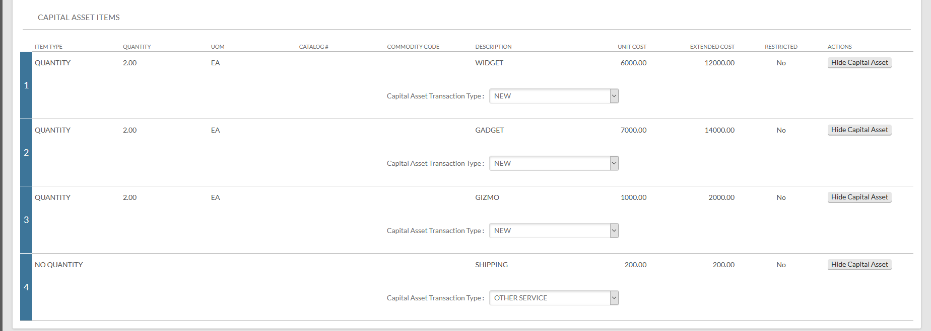
PRACTICE REQUISITON
The line items that used a capital object code are brought into the CAPITAL ASSET tab.
Enter the following Capital Asset Transaction Types: Line 1: NEW; Line 2: NEW; Line 3: NEW; Line 4: OTHER SERVICE

Slide 60
PRACTICE REQUISITON
The PAYMENT INFO tab needs to be completed if you are submitting a “direct to vendor” lease.
Enter the Type of Recurring Payment (select from the drop down).
Enter the Begin/End Date.

Slide 61
PRACTICE REQUISITON
The ADDITIONAL INSTITUTIONAL INFO tab will be populated with the person’s information who created the requisition.

Slide 62
PRACTICE REQUISITON
The ACCOUNT SUMMARY tab may or may not be populated with the total amount by account and object code. When we review “making changes”, this tab plays an important role. If it is not populated, you can click on “Refresh Account Summary”.

Slide 63
PRACTICE REQUISITON
The VIEW RELATED DOCUMENTS tab and VIEW PAYMENT HISTORY tab should both be blank.

Slide 64
PRACTICE REQUISITON
The NOTES AND ATTACHMENTS tab is used for notes.
Attaching quotes, equipment release authorizations, and/or other necessary documents.
When needed, you can click on “Send to Vendor?”.
Make sure you click the “add” button.

Slide 65
PRACTICE REQUISITON
The AD HOC RECIPIENTS tab can be used to send the document to others not listed in the route log.
You can send to an individual and select the Action Requested (APPROVE, COMPLETE, FYI, or ACKNOWLEDGE).
You can send to a group and select the Action Requested (APPROVE, COMPLETE, FYI, or ACKNOWLEDGE).
Click on “ADD”.

Slide 66
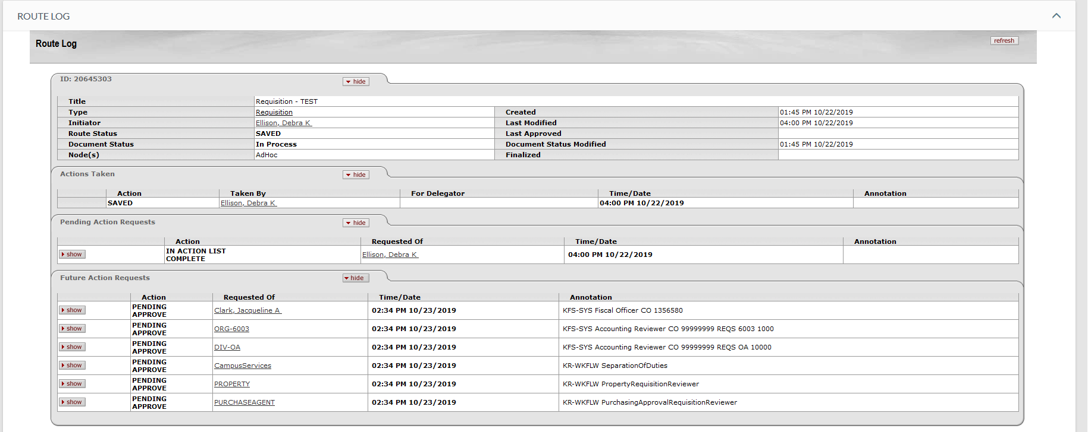
PRACTICE REQUISITON
The ROUTE LOG tab may or may not be populated. If you save your document, it will populate.
You can see who is listed next in the routing and what Action is needed.
If you have a group, you can click on the group to see the name of individuals within the group who can take the shown action (click on “close” to go back).

Slide 67
PRACTICE REQUISITON
You will then have the following options:
Calculate: This will populate the line item monetary values.
Submit: This will submit your document (if you have any errors, you will get an error message).
Save: This will save your document. You can find it again in your action list to complete it.
Reload: This will revert back to the last entered information. If you saved your document, it will only revert back to information at that point in time.
Close: This will close your document (you will be asked if you want to save it before you close it).
Cancel: This will cancel your document.
Copy: This will copy your document with the exception of the Capital Asset tab. NOTE: If you used Shop Catalog, this is not available. Also, if your document was disapproved, once you have acknowledged it, you can do a search to find it and copy it so you don’t have to reenter information.

Slide 68
MAKING CHANGES
Before making any changes, it is important to know how changes will affect the CAPITAL ASSET tab and the ACCOUNT SUMMARY tab.
There are two buttons available on the CAPITAL ASSET tab:
Change
Update View
“Update View” should be used whenever:
Changing an object code from non-cap to cap (need to bring the line in).
Changing an account number that is tied to a capital asset object code.
Changing quantities on a capital asset object code line item.
Changing the description on a capital asset line item.
Changing an amount on a capital asset line item.
NOTE: Any time you make changes and before you have saved your document, you may always click on “reload” at the bottom of your document to start over with your changes.

Slide 69
MAKING CHANGES
“Change” should be used whenever:
Changing an object code from capital to non-capital
The change requires the Capital Asset System Type to be changed
The change requires the Capital Asset System State to be changed.

Slide 70
MAKING CHANGES
Changes also effect the ACCOUNT SUMMARY tab.
You will need to click on the “Refresh Account Summary” button after making any line item changes.
Notes:
After any line item change, the ACCOUNT SUMMARY tab needs to be refreshed.

Slide 71
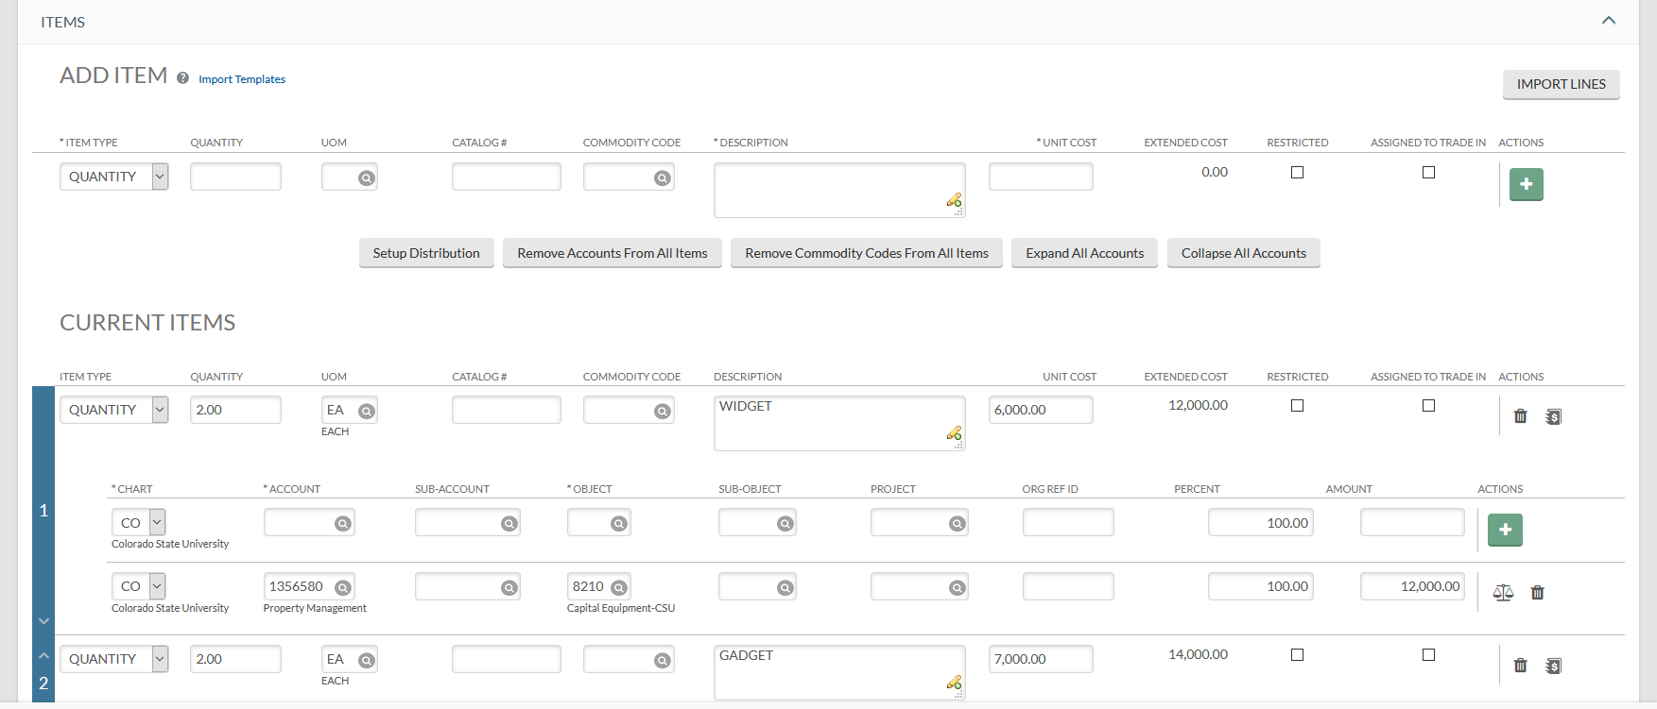
MAKING CHANGES
TYPES OF CHANGES TO THE ITEMS TAB
Edit Current Items: Item Type, Quantity, Unit of Measure, Catalog #, Commodity Code, Description, and Unit Cost. NOTE: You cannot edit shop catalog costs.
Adding/Deleting lines
Account Changes
Object Code Changes

Slide 72
MAKING CHANGES
Practice “change” CAPITAL ASSET tab
Practice Adding/Deleting Lines
Practice changing object codes
Practice “update view” CAPITAL ASSET tab
Practice “refresh account summary” in the ACCOUNT SUMMARY tab

Slide 73
QUESTIONS ON CAPITAL ASSET TAB?

Slide 74
Thank you from the Property Management Team 491-2899 Jacque Clark - Property Administrator/Cost Accountant 491-6513 Laila Dillsi - Leases / Accounting 491-7362 Cheri Richardson - Accounting 491- 2270 Debra Ellison – Supervisor / Acct Tech III 491-1045 Rachel Drenth - Inventory Specialist / Data Entry 491-1358 Michelle Miller - Inventory Specialist / Data Entry We are available to help

