Slide 1
Electronic EACR
Campus Training

Slide 2
Important facts:
EACR.colostate.edu
One Building location per EACR entry
PM will scrub and validate prior to sending to dept approver
EACR’s are for non-capital items only, capital will still go through Kuali
No paper EACR forms after June 30th 2016
Direct drops will only be accepted with an electronic entry validated by PM

Slide 3
Log on: EACR.colostate.edu
https://wsnet.colostate.edu/CWIS12/EACR/_auth/auth.aspx
Notes:
on January 4th ,The electronic eacr will be located at EACR.colostate.edu
Anyone with an EID can enter the site and submit a form

Slide 4
Designate approvers
Notes:
EACR.colostate.edu and the Property Management page have the current Authorized Signer form which will be replaced with a new form after December 18th
Approvers must be regular staff or faculty, no temporary placements, retirees, or students

Slide 5
Current PAAS form
Verify and designate your approvers before December 18th
No changes will be accepted the last week of December

Slide 6
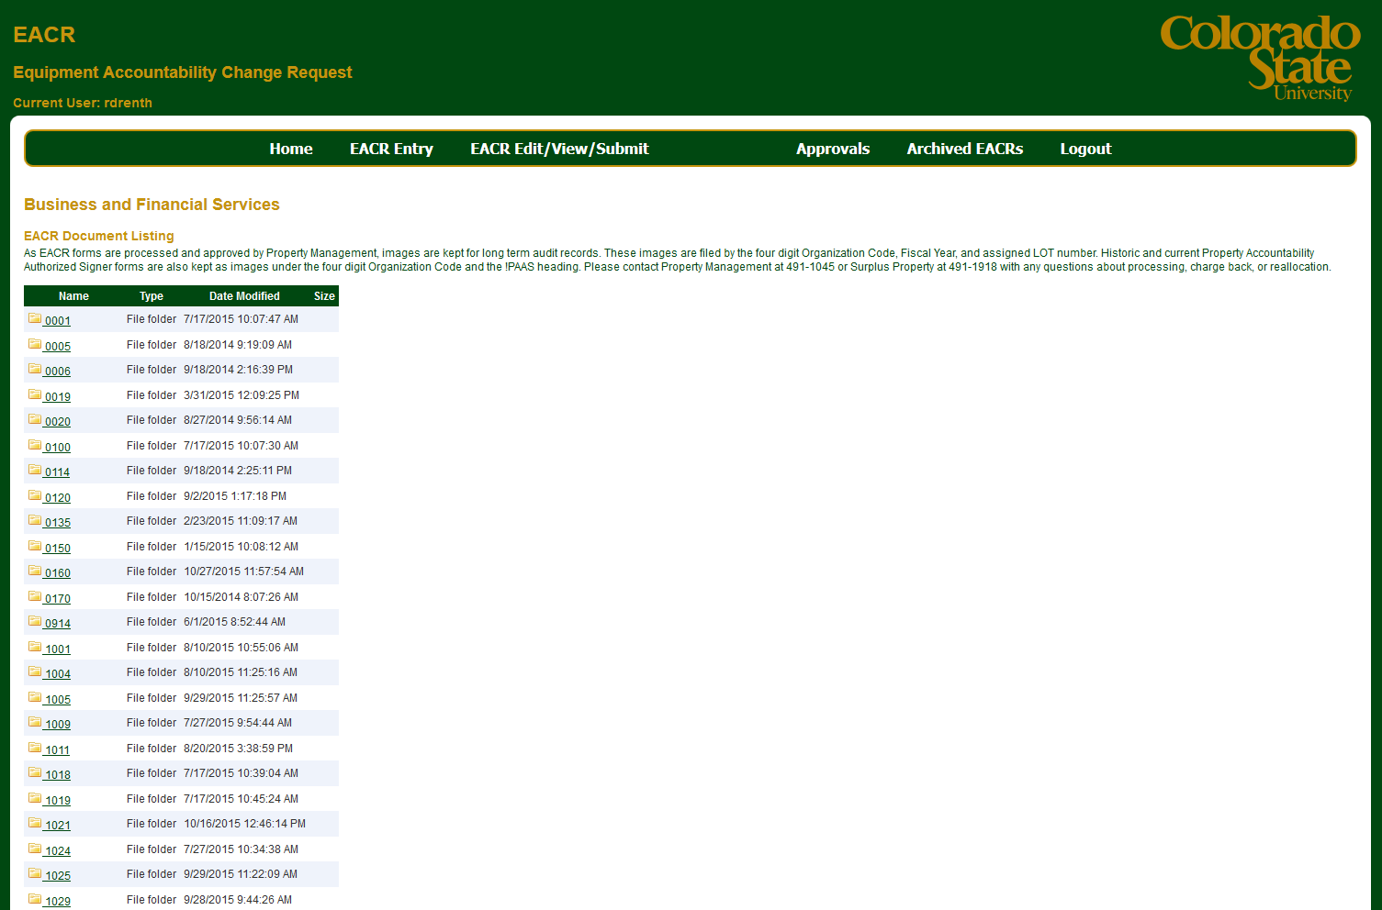
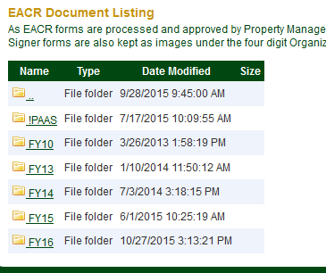
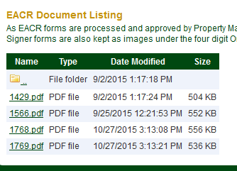
Paper forms and Authorized signer sheets
Notes:
Called Archived EACR’s in the e program and Documents on the current page
PDF images of all paper forms including the PAAS property accountability authorized signer forms are filed by:
your department number,
fiscal year
Lot number (eacr number)

Slide 7
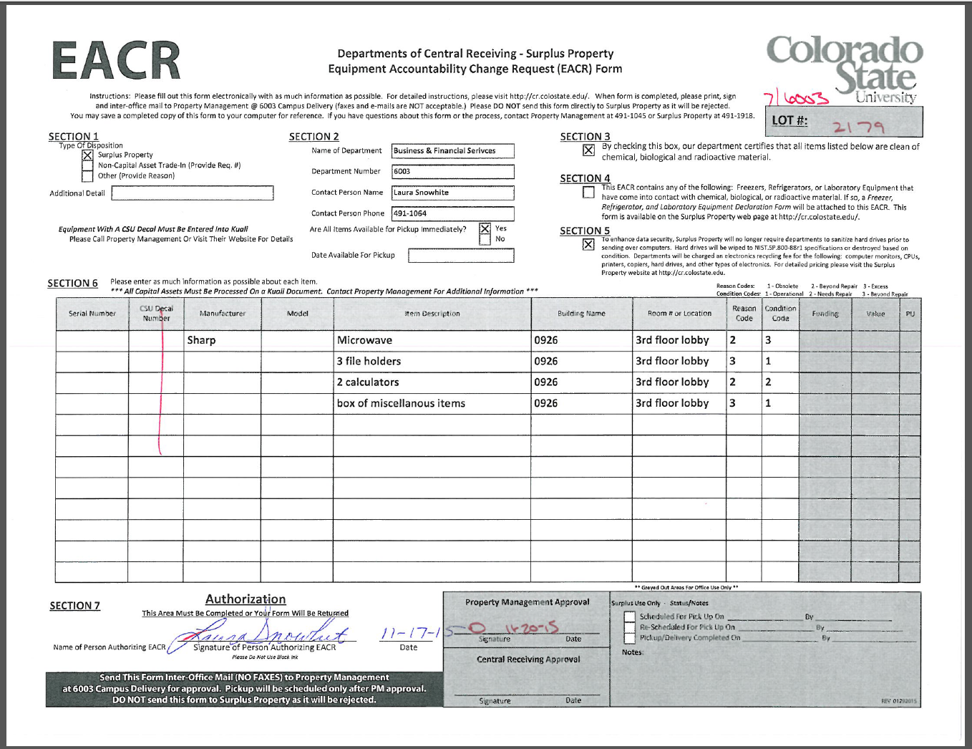
Paper EACR form

Slide 8
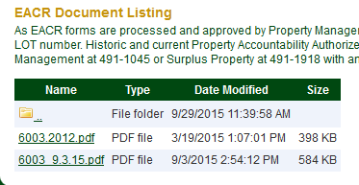
Paper forms and Authorized signer sheets
Notes:
PDF images of all paper forms including the PAAS property accountability authorized signer forms are filed by:
your department number,
fiscal year
Lot number (eacr number)

Slide 9
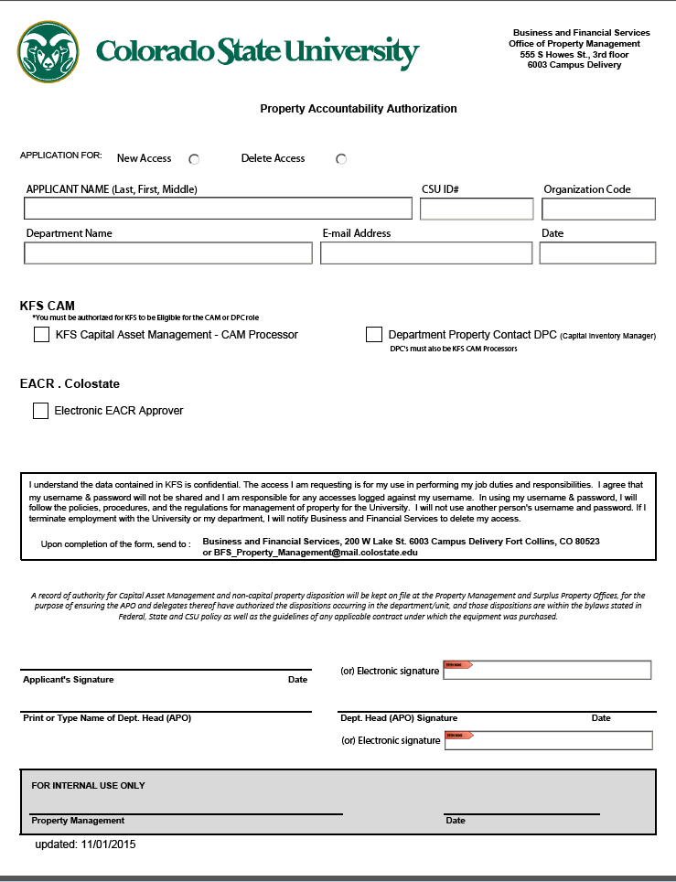
Property Accountability Designation Form
Notes:
Form can be found on the EACR.colostate home screen or the Property Management webpage

Slide 10
Designate approvers
EACR.colostate.edu
Notes:
EACR.colostate.edu and the Property Management page have the current Authorized Signer form which will be replaced with a new form after December 18th
Approvers must be regular staff or faculty, no temporary placements, retirees, or students

Slide 11
Test your knowledge!
Look up your most current signer sheet
Is it still accurate?

Slide 12
Log on: https://wsnetdev.colostate.edu/CWIS12/EACR/_auth/auth.aspx
https://wsnetdev.colostate.edu/CWIS12/EACR/_auth/auth.aspx
Notes:
Testing is at the location listed above
Anyone with an EID can enter the site and submit a form
on January 4th ,The electronic eacr will be located at EACR.colostate.edu

Slide 13
Home Screen
New routing process for: Trade-in, External Transfer, Project Closeout, etc.
Notes:
Note a new form for Trade in Requests and External Transfers

Slide 14
Trade in or warranty replacement
Use this form for:
Trade in to vendor
Warranty replacement
Exchanges
Anytime property is being released to a vendor
Either capital or non-capital property
Notes:
New form on eacr.colostate.edu or the Property webpage
Use this PDF form to request a trade in, warranty replacement, exchange, or any time a vendor takes possession of CSU assets

Slide 15
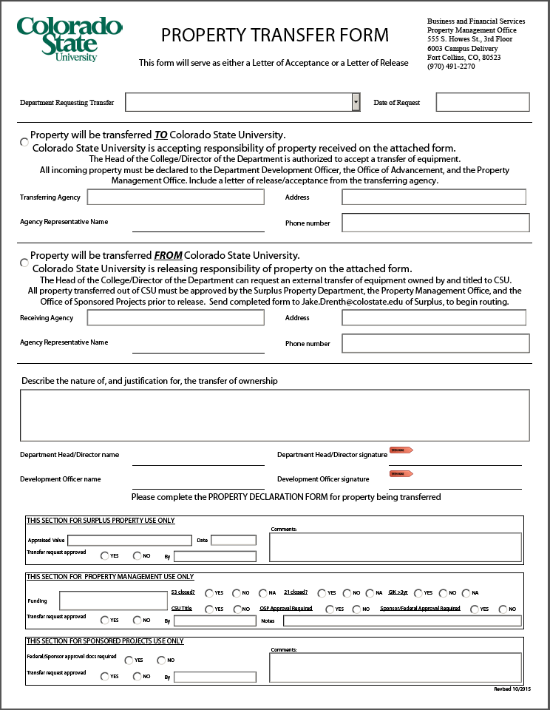
Property Transfer form
For incoming or outgoing property
To accompany a document releasing or accepting responsibility and title

Slide 16
To begin, click EACR entry
Notes:
Click on EACR Entry to begin a new EACR request

Slide 17
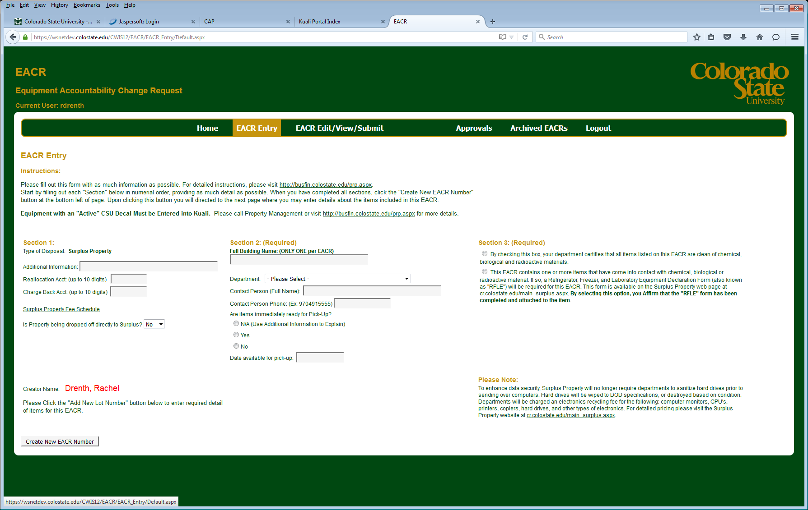
EACR entry screen
Notes:
The Entry screen is designed to look like the existing form

Slide 18
EACR entry instructions
Notes:
Active assets cannot be listed on an EACR request, use Kuali to transfer active assets to Surplus.
Any active asset in the line items will be deleted

Slide 19
EACR entry Section 1:
Notes:
Additional information is your opportunity to provide special instructions, directions, security procedures or notes regarding the items contained in this EACR request
Reallocation account is for items sold beyond the Surplus fee threshold
Chargeback Account is for the fees Surplus will charge to dispose of your items
Property can be dropped off by CSU on campus departments, only after a request document has been entered and validated by PM. This option is designed and intended for CSU departments located outside of Fort Collins and non CSU entities (i.e.: Pueblo, CSURF, Extension)

Slide 20
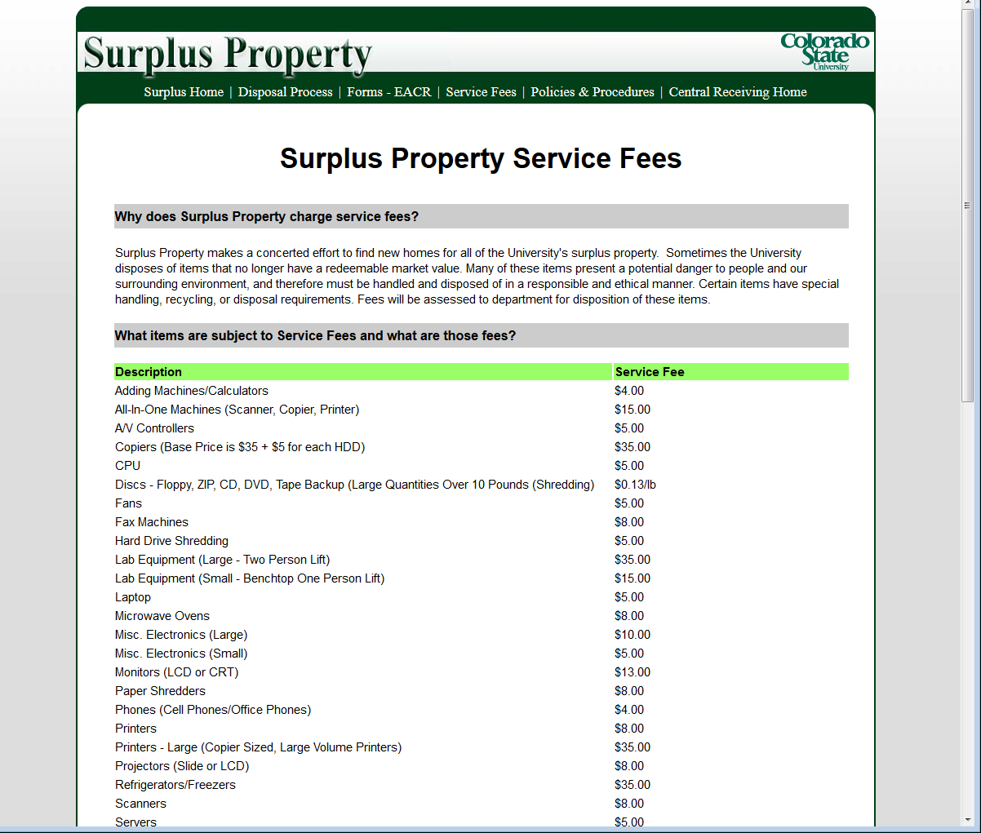
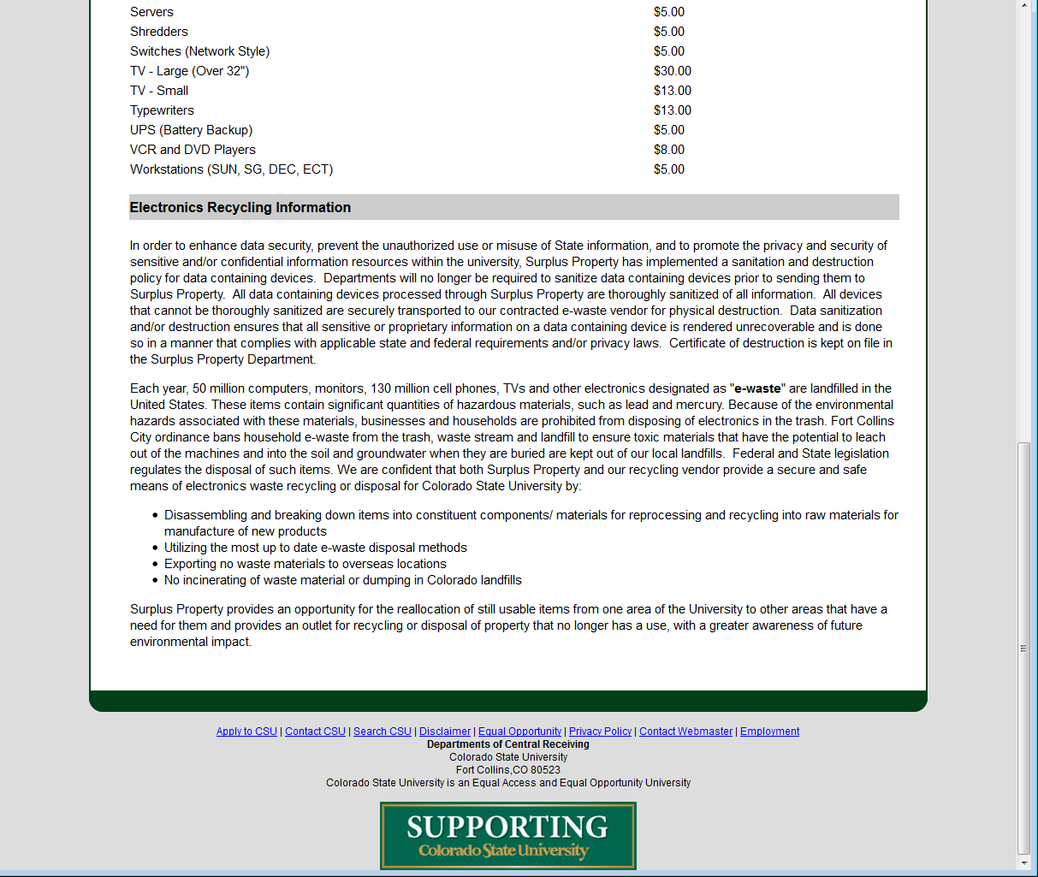
Surplus Fee Schedule

Slide 21
EACR entry Section 2:
https://maps.asu.edu/?id=120&mrkIid=63019
Notes:
Begin typing the building name or 4 digit code, then select the correct option from the dropdown. In January, a link to campus maps will be provided to assist you in locating your building name
Contact person is the best contact for the drivers when they arrive to pick up your items
Are items ready for pickup?
Na: to be used with a direct drop, or an offsite sale arrangement
Yes: Surplus can come anytime from today to pick up your items
No: enter the date available for pickup

Slide 22
EACR entry Section 3:
Notes:
Section 3 applies to any or all items listed on this EACR request, if any item on the request has been in contact with contaminates, fill out the RFLE and tape it to the item.
Surplus has the equipment to wipe or destroy electronic equipment to NIST standards and will not charge a fee for items that are resold

Slide 23
EACR entry Create New EACR Number
Notes:
Click the button to be directed to the line item entry screen

Slide 24
EACR entry Error message
Notes:
If any of the required fields are not populated, you will receive an error message to correct the entry prior to creating a new EACR number

Slide 25
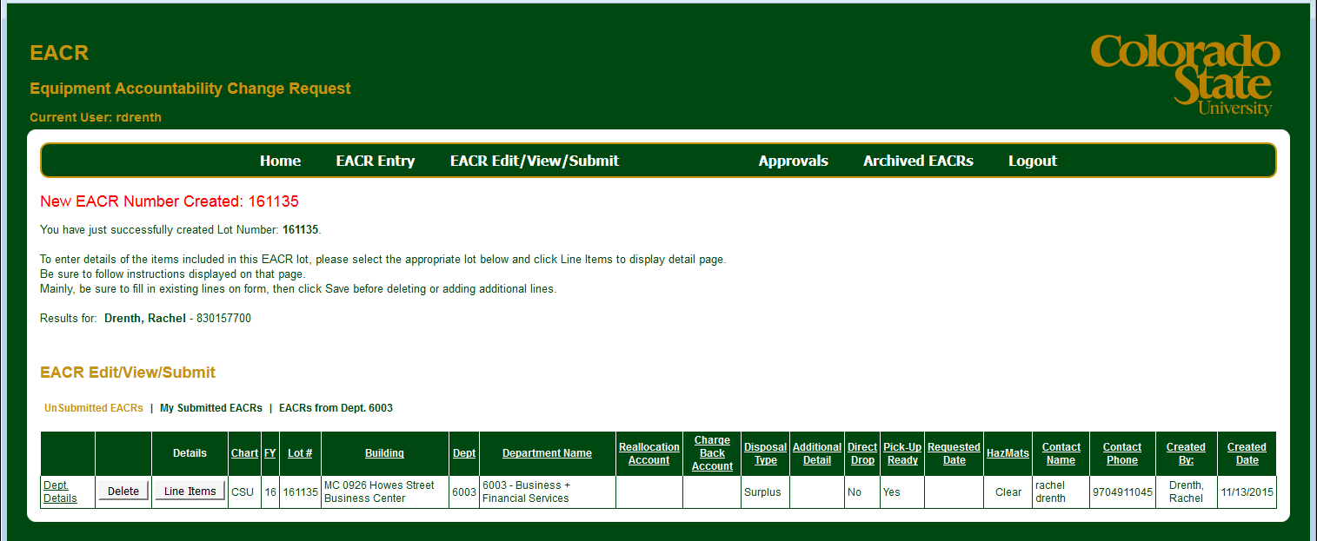
New EACR number Created
Notes:
This page opens automatically to allow you to enter your line items.
The new lot number will be displayed at the top of the page

Slide 26
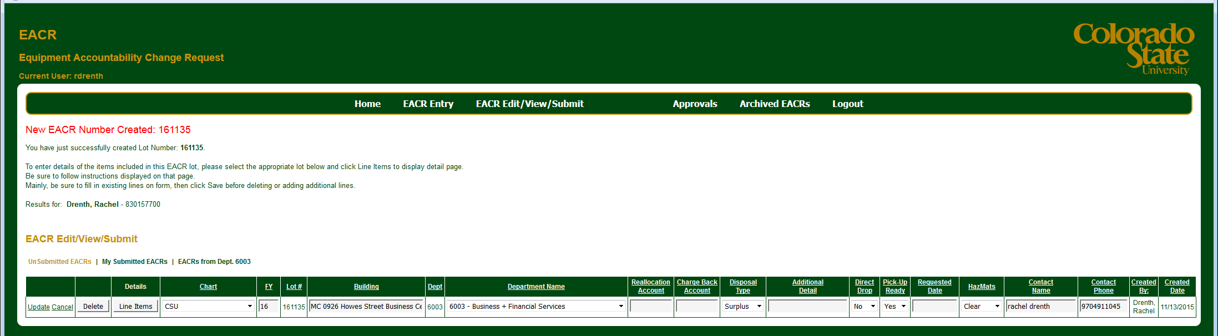
Update Department Details
Notes:
Click on department details to edit:
Building
Department
Reallocation
Chargeback
Additional detail
Direct drop
Contact name
Contact phone

Slide 27
Line item entry screen
Notes:
To enter the items you are requesting Surplus to pick up, click on “line Items”

Slide 28
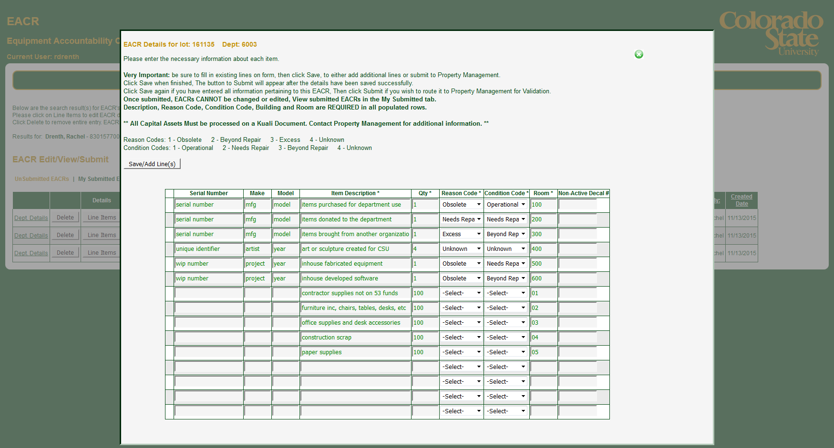
Notes:
Times to use serial:
Times to use qty:
Non-Active decal numbers still have relevance at PM, please check kuali for active status, then list the non active number on EACR
Active capital assets, must be transferred in Kuali, any active capital asset listed will be deleted from the EACR request by PM
When done click on save/add lines
Save often, the screen will time out with 20 minutes of inactivity and lose all your entries

Slide 29
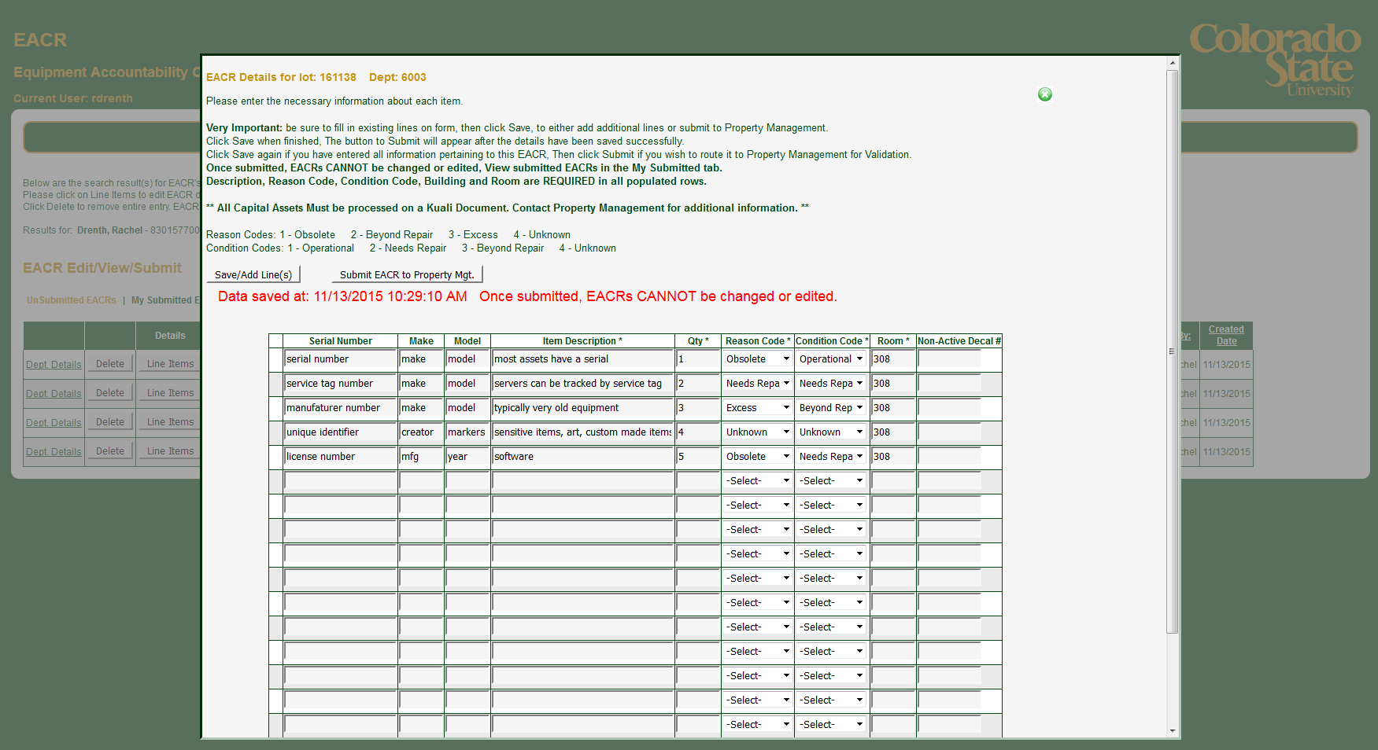
Notes:
Line text will turn black when saved
15 line items on initial entry
Click save at the end of your entry then 15 more lines appear and so on until 90
At this point you can either close the screen to revisit later, or submit the request to Property

Slide 30
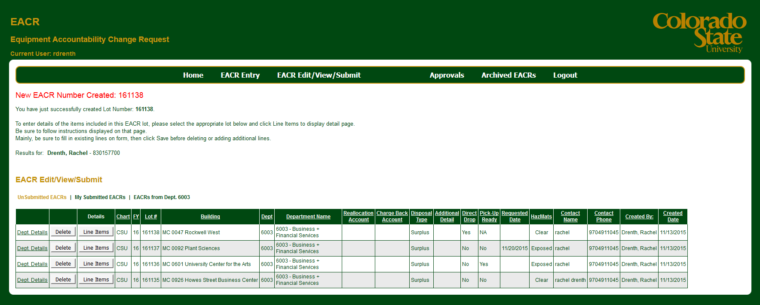
Multiple EACR’s in queue
Notes:
For any number of reasons, you may at some point have multiple EACR requests pending in your unsubmitted, the most recent will queue on the top line and you can match the “New EACR Number Created” with the EACR # in the queue
Any Unsubmitted EACR’s in the queue longer then 30 days will be system deleted

Slide 31
Delete EACR in queue
Notes:
You can delete any unsubmitted EACR you no longer need by clicking the “delete” button. That EACR number will once again become available for assignment on a new request

Slide 32
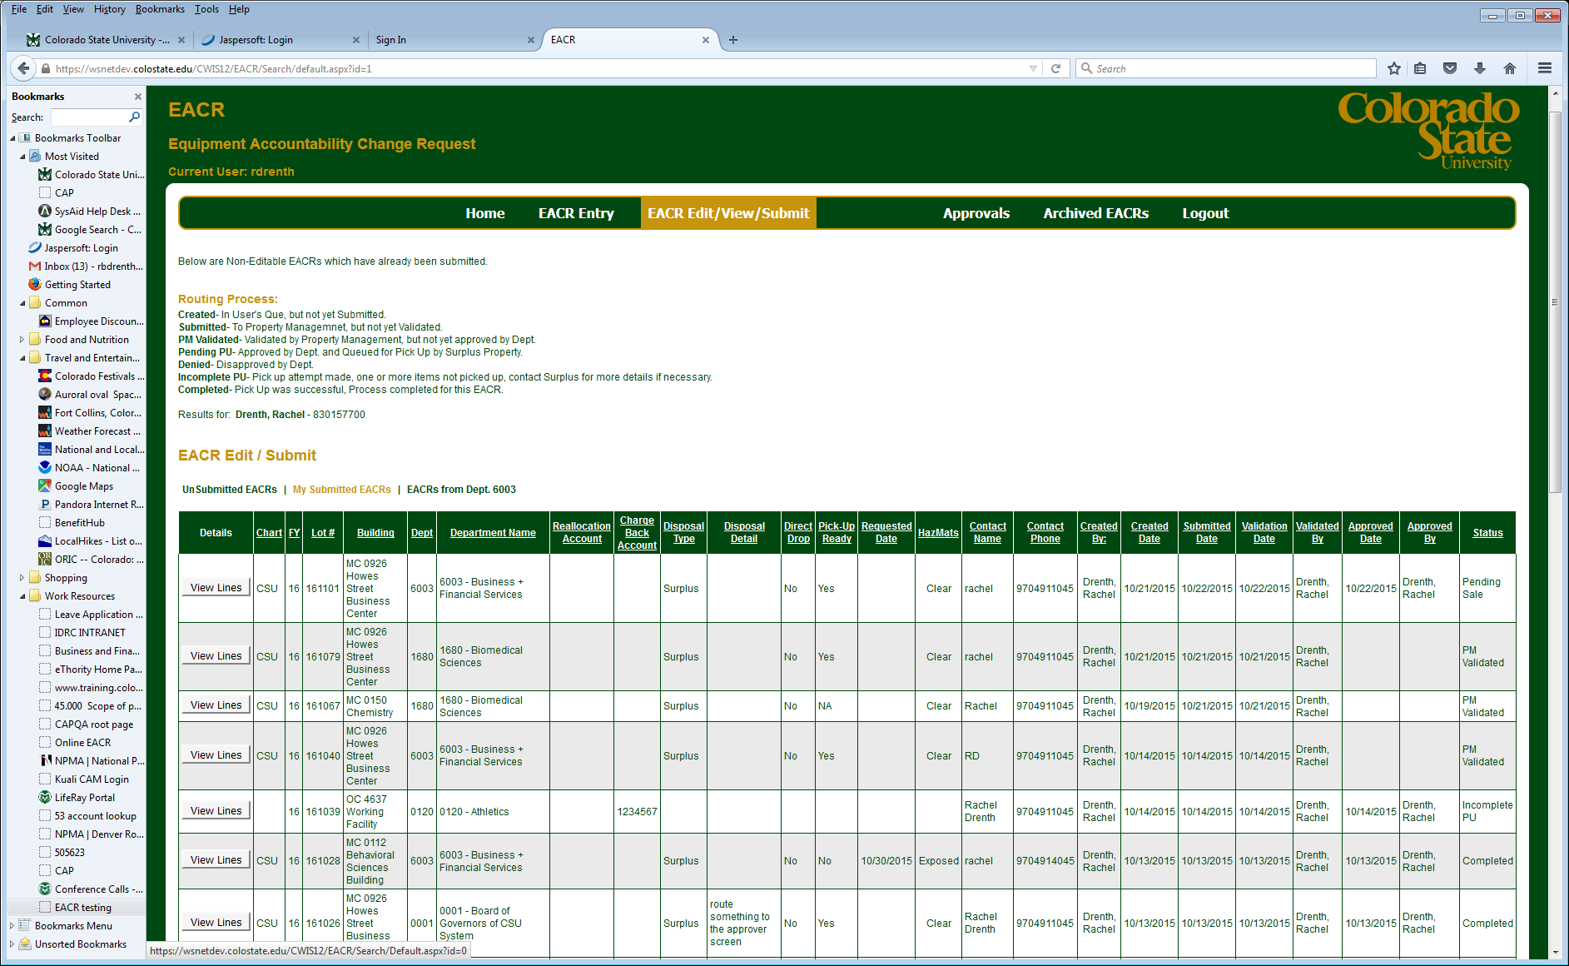
All EACR’s submitted by “me” regardless of dept.

Slide 33
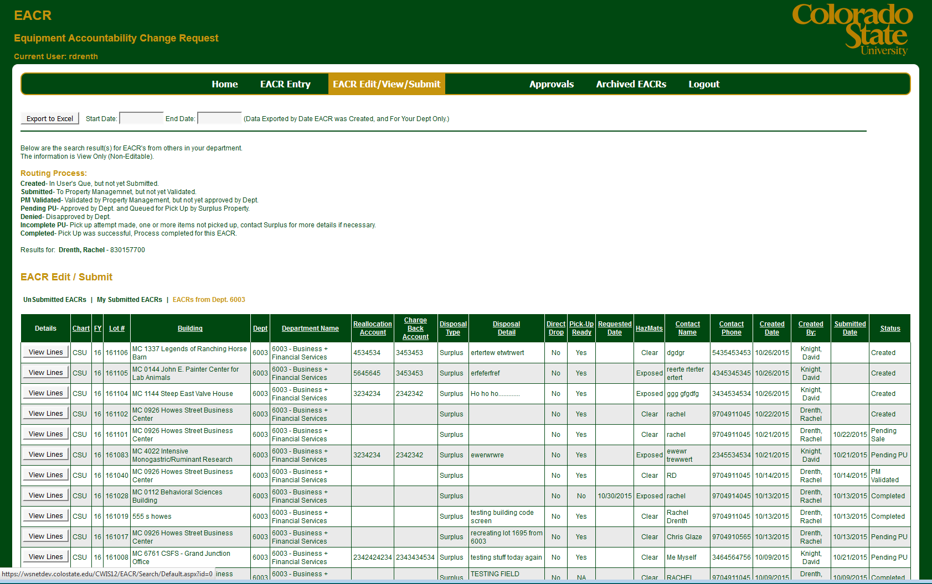
All EACR’s submitted for “my” org code
Notes:
It might be worth checking the Submitted by department tab prior to entering a new EACR request, particularly if you have multiple people who typically enter requests. A duplicate entry will be deleted by PM or Surplus and has the potential of creating confusion if you keep internal records

Slide 34
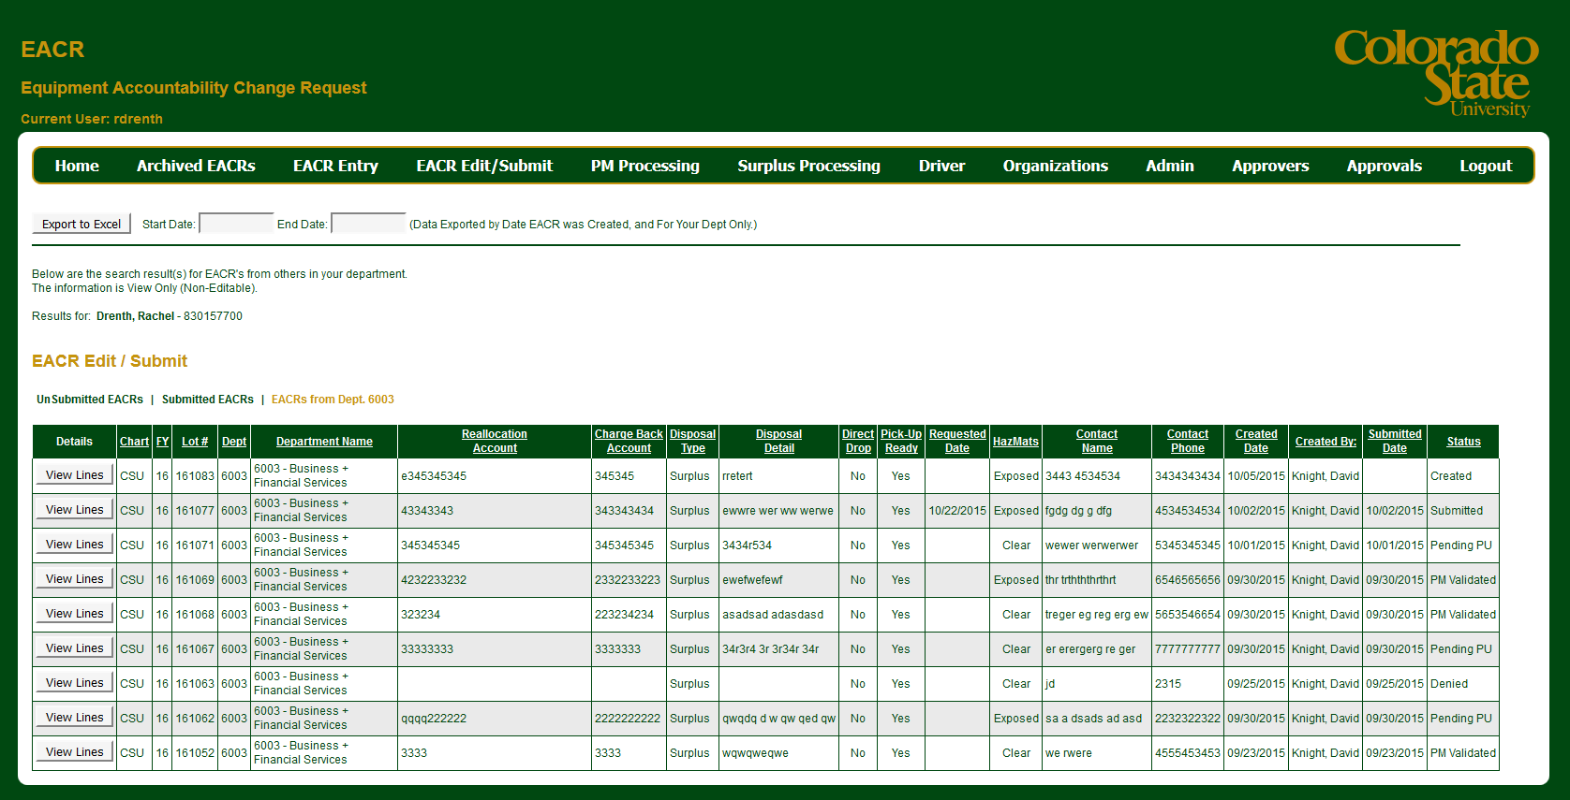
Export feature for EACR’s from your department
Notes:
As the enterer, you have the ability to export all submitted requests by your department.
The approvers have an export feature in their screen as well and they will see the scrubbed and final version of requests for each department they are listed as an approver

Slide 35
Status
Created= EACR created and pending in the users unsubmitted queue
Submitted= user has submitted the request and it is pending validation by PM
PM validated= PM has verified, scrubbed and submitted the request and it is pending approval by the department approver
Pending PU= Request has been finalized and approved by the department approver and is queued in the Surplus drivers pickup requests
Denied= The department approver has denied the request and a record of the request will be kept on file
Completed= Surplus driver has successfully retrieved your requested pickup

Slide 36
Test your EACR entry knowledge!
Create an EACR request for your department with your name and contact information
Try to use all the fields on the entry screen
Try to use a real example and fill in all fields on the line items screen

Slide 37
Approver notification
Notes:
The DPC and all the signers listed for the department will receive this e-mail
The APO=Department Head will not be listed as an EACR approver unless they are listed as a DPC or Signer

Slide 38
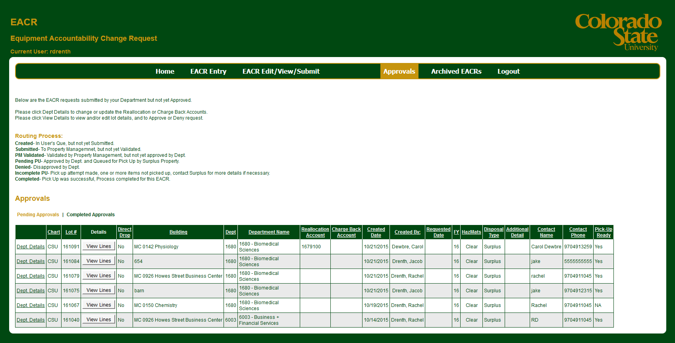
Approver screen, pending approvals
Notes:
Approvers will see requests for all departments they are authorized to approve for
A reminder e-mail will be sent weekly to the DPC and signers until the request is approved

Slide 39
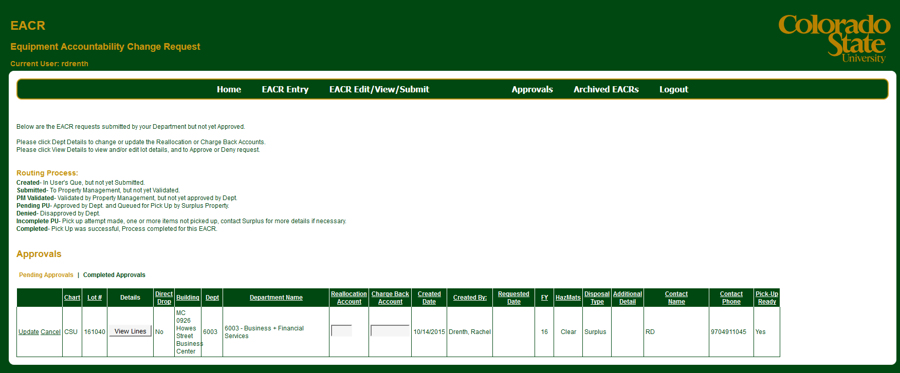
Update Department Details
Notes:
Click on department details to edit:
Reallocation
Chargeback

Slide 40
Approver screen, view request
Notes:
Click View Lines to review the request

Slide 41
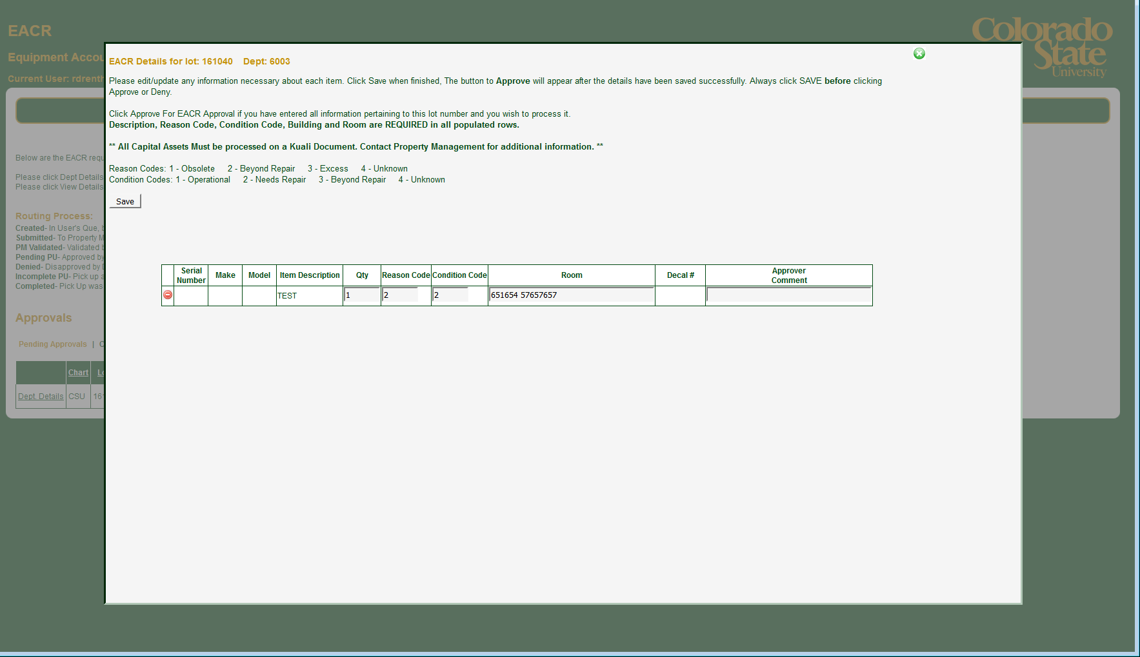
Approver Authorization
Notes:
The department approver has the ability to change:
Qty
Reason
Condition
Room
And to add a comment to each line item
The approver has the ability to delete individual line items, however deleted line items will not have a comment box for explanation
To approve and submit to Surplus, click save then submit

Slide 42
Notes:
Example of qty change with comment

Slide 43
Notes:
You may choose to deny the request, please enter a comment with the reason

Slide 44
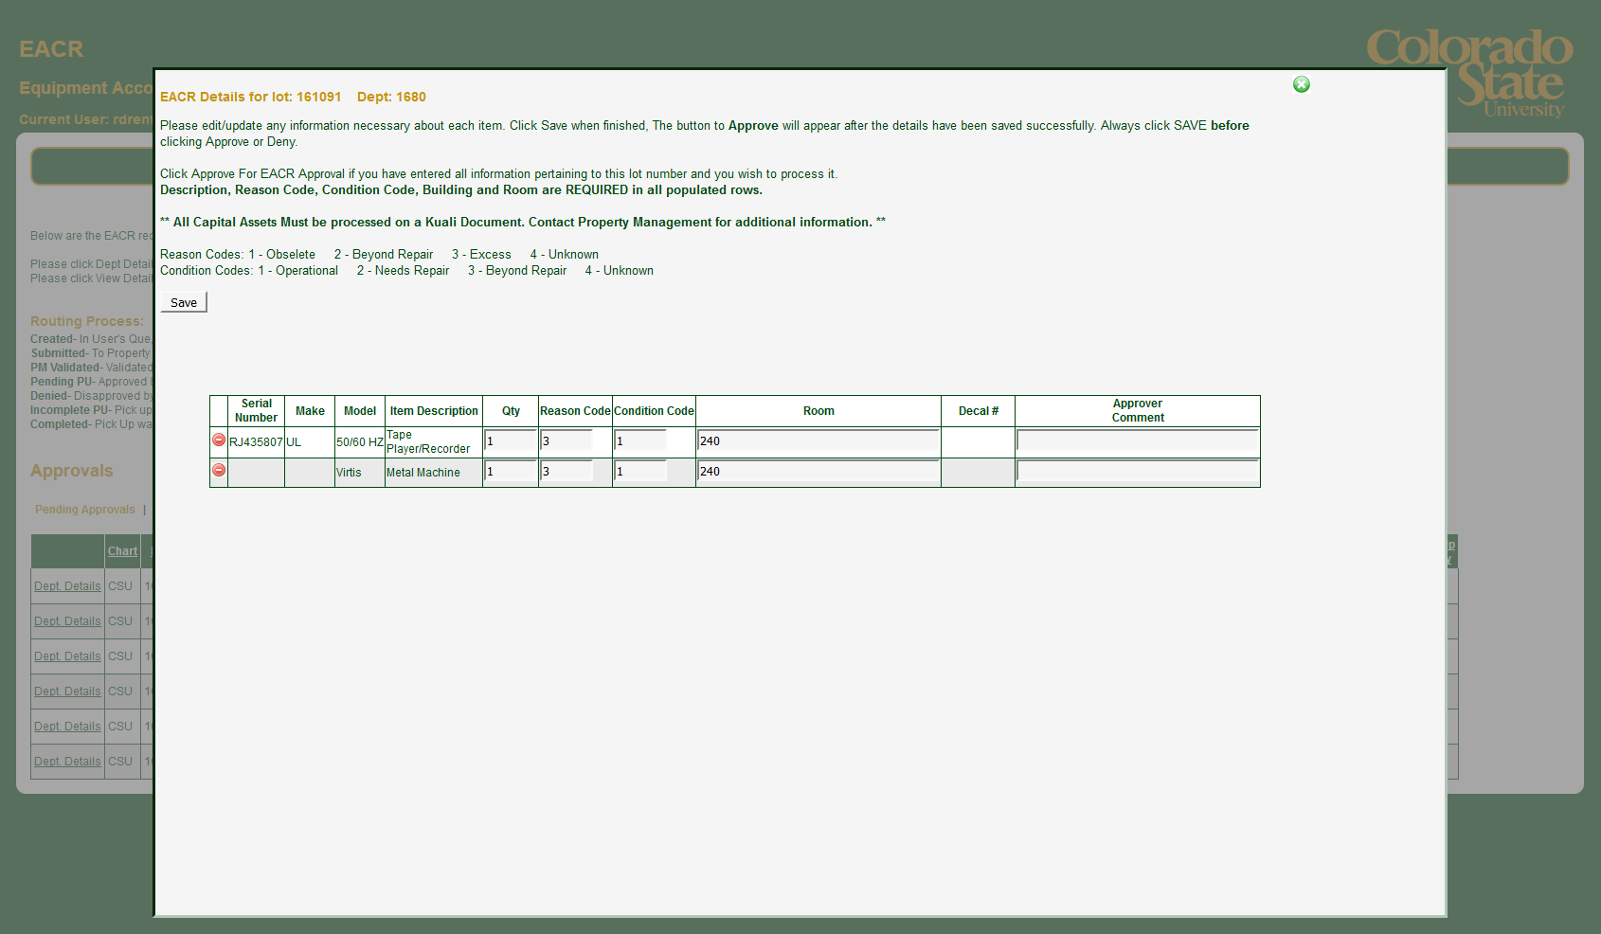
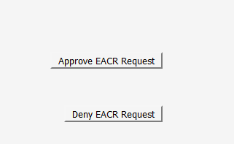
Approval Screen line items
Notes:
If you approve of the request, click save, then approve

Slide 45
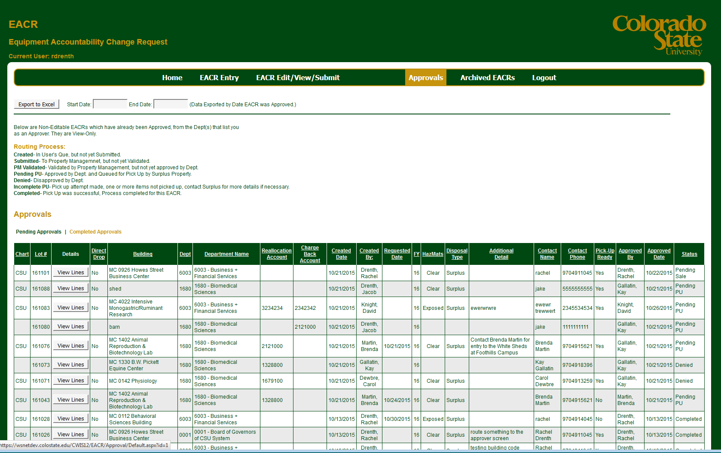
Approver screen, completed approvals
Notes:
Approvers will see completed requests for all departments they are listed on, who they were approved by, and current status

Slide 46
Approver screen, completed approvals export
Notes:
Approvers can export approved EACR requests

Slide 47
Test your Approver knowledge!
Enter the pending screen and approve your EACR request
Export the completed request to Excel

Slide 48
Additional Resources
This training and a detailed instructions document will be available on the Property Management and Surplus Property Page
Training will continue through June 2016 to prepare for the July 1 launch, watch Training and Organizational Development for dates
The link to the E-EACR will be available on the Property Management and Surplus Property Page
Contact Property Management immediately if you encounter any glitches in the program bfs_property_management@mail.colostate.edu

