Slide 1

Capital Assets…Start to Finish
Business & Financial Services
Property Management
Professional Development Institute 2018
Notes:
Welcome to Property Management’s presentation of Capital Assets…Start to Finish
Introductions

Slide 2
AGENDA
What is Property Management & Why Should You Care?
Responsibilities & Roles
Acquisition
Tracking
Disposal
Notes:
Today we will be covering details about Property Management’s role in the control of assets, department personnel’s role as asset users or administrators, and the life of assets from acquisition to disposal.

Slide 3
PROPERTY MANGEMENT OVERVIEW
Record and track capital assets
Calculate depreciation
Issue reports to management and sponsors
Manage the physical inventory of capital CSU and sponsor-owned assets
Serve as a liaison with property auditors
Provide guidance to departments, faculty, and staff regarding property administration and inventory issues
Notes:
On Property Management’s webpage, you will find a brief description of the services our office provides to campus.

Slide 4
DID YOU KNOW?
Colorado State University is accountable for
  Over 11,000 active capital assets for a total value of over $380M
    Federal – $5M and Sponsor – $2M
Notes:
Were you aware that CSU is accountable to the taxpayers, sponsors, and other government agencies for over $380 million in capital assets? As such, CSU is responsible for abiding by several state and federal regulations and ensuring that members of the CSU community are aware of the responsibility we each have.

Slide 5
POTENTIAL PROPERTY AUDIT ISSUES
Items not tagged or permanently marked with a CSU inventory number
Incorrect location recorded in the Property Management Asset System
Incorrect description recorded in the Property Management Asset System
Employees not trained to fulfill their inventory responsibilities
Notes:
Outside audits can and will occur periodically throughout the lifecycle of an asset. Potential areas of concern have included items improperly tagged, incorrect locations or descriptions listed in the asset record, and a lack of training for employees/asset users. Consequences can be restrictions on the university, as well as losing federal funding. Property Management can help departments manage all of these key points in an effort to keep records up-to-date and stay in compliance.

Slide 6
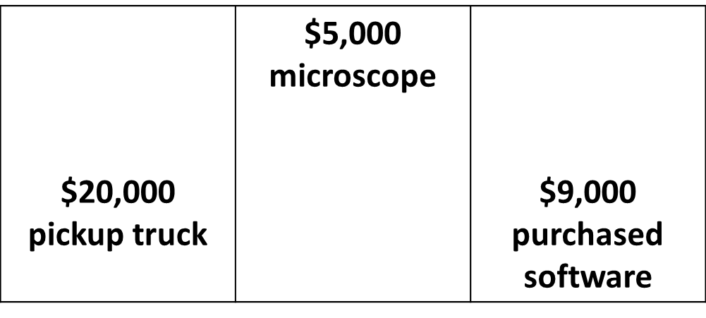

CAPITAL ASSETS
  Equipment that has an acquisition cost of $5,000 or more and has a useful life of more than one year.
Notes:
Most People have heard of Property and Plant. For Property, capital assets are also known as moveable capital assets. The Plant side tracks “fixed” assets, such as land, buildings, and systems attached to buildings (i.e. HVAC, lighting, plumbing, etc.). Consumables are not capitalized.
Capital assets depreciate, non-capital assets do not depreciate.
Depreciation means that an item decreases in value as it ages. When an asset is created, it is assigned a life (the asset type code is used to determine the life of an asset). Each month depreciation is calculated. So, a $10,000 item with a 5 year life may have a book value of $5,000 within a few years.
If the original cost met the capitalization threshold, the item will remain on the department’s inventory until it is properly retired or transferred to surplus for disposal. Property is tracked “cradle to grave”.

Slide 7
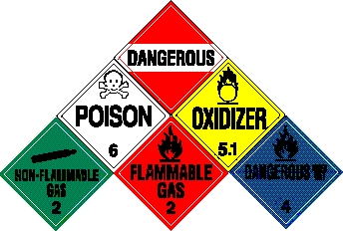




CONTROLLED ASSETS
  Items that the State Controller’s Office classify as high risk and need to be monitored by the department.
HAZARDOUS MATERIALS
WEAPONS
EXPORT CONTROL
SENSITIVE DATA
Notes:
Controlled assets are high risk items that need to be monitored and stored in a safe and secured environment.

Slide 8
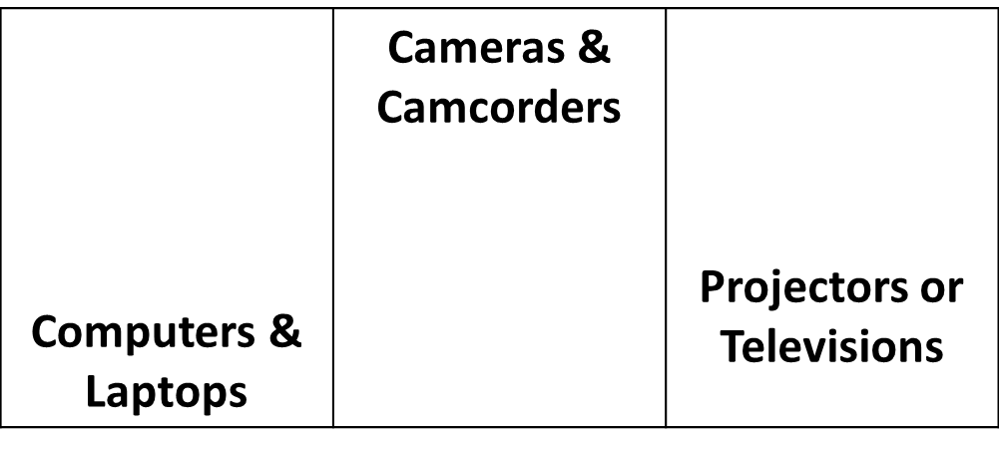

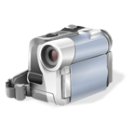
HIGH THEFT ASSETS
Notes:
High theft items costing under $5,000.00 each, can be tracked within your department.
Our office can assist with decals, if your department chooses to use them. These decals will be smart-coded for easy identification, and begin with a “9”.

Slide 9
Who is responsible for the management of CSU’s property?
EVERYONE IS!
Notes:
CSU’s Strategic Plan is organized around five broad objectives. The 5th objective being; CSU will be accountable, sustainable, and responsible.

Slide 10
ROLES
Procurement, Sponsored Programs, Property Management, Surplus Property
Accountable Property Officer (APO)
Department Property Contact (DPC)
Responsible Party
Notes:
Several departments on campus play a role in CSU’s capital assets; including Procurement Services, to service your acquisition needs; Sponsored Programs, through the responsible management of sponsor funds; Property Management, for assistance with tracking and movement of equipment; and Surplus Property, who manages the disposal process. We all work together to help meet our university’s strategic plan.
The Accountable Property Officer, or APO, is primarily the Department Head, Dean, or Manager. The APO is accountable and responsible for the physical possession and control of all equipment entrusted to the activities within their respective unit. Responsibility cannot be delegated from this role.
The Department Property Contact, or the DPC, is the primary contact point regarding property matters within a specific department. This role is assigned by the Accountable Property Officer, allowing the ability of the DPC to act on behalf of the APO. The DPC is responsible for providing guidance to department personnel concerning property matters such as acquisition, transfers, equipment at alternate locations, maintenance, physical inventory, and disposal.
The Responsible Party includes any CSU employee who utilizes, stores, or maintains the equipment in their day-to-day duties.

Slide 11

ACQUISITION
TRACKING
DISPOSAL
Notes:
Starting at the beginning phase in the lifecycle of an asset…the acquisition process.

Slide 12
ACQUISITION
There are multiple ways to acquire capital assets.
Purchase Orders
Transferred-In
Direct Donations
Loaned to CSU
Gift-in-Kind
Notes:
Besides Purchase Orders, what are some other ways CSU can acquire capital assets?

Slide 13
Completing a Requisition
Purchase Orders
To purchase capital assets you will need to complete a requisition document in Kuali. The following items will help get your requisition approved so it can become a Purchase Order.
Using the correct object code
Line item your requisition to match the quote
Completing the Capital Asset Tab
Uploading quotes from Shop Catalog (when used)
Notes:
Object codes matter for financial reporting purposes. They are categorized by types of assets, types of funding and title. Can anyone tell me the most common capital object code? Hint, capital object codes start with an 8. (8210) A quantity is required when using a capital object code, except for services (i.e. shipping, installation, etc.). When a quote lists individual costs, match the requisition line items to the quote line items. Using a capital object code will prompt you to complete the capital asset tab section. Finally, when using Shop Catalog, upload the quote from the shop catalog site.

Slide 14
OTHER METHODS
Transferred-In equipment is usually brought in when a professor “transfers” to CSU from another institution and brings equipment with them.
Direct Donation equipment is usually given to CSU and the donor waives any tax write-off advantage and may not be given recognition for the donation.
Loaned to CSU equipment is usually provided by the federal government, sponsor, or a vendor for a specific amount of time and needs to be returned after that time period.
Notes:
Inventory Specialists may notice items not on their inventory lists that appear to be capital equipment. The department is responsible for reporting assets acquired by other means by completing specific paperwork and submitting it to Property Management.
When a PI transfers to CSU, they occasionally bring equipment with them. Also, equipment obtained directly from federal agencies or other universities, will not route through Gift-in-Kind (Advancement) and will be considered transferred-in equipment.
Direct donations differ from Gift-in-Kind because the donor will waive any tax write-off advantage and may not be given proper recognition for the donation.
When required, Federal Equipment loaned on a 53 should be tracked and reported, regardless of value.

Slide 15
OTHER METHODS
The following paperwork is required for incoming property:
A signed Letter of Release and a signed Letter of Acceptance listing all incoming equipment.
A Copy of the Loan Agreement (for loaned).
Notes:
Department heads are authorized signers for equipment. When required by terms of an agreement, CSU tracks loaned equipment at any value.

Slide 16
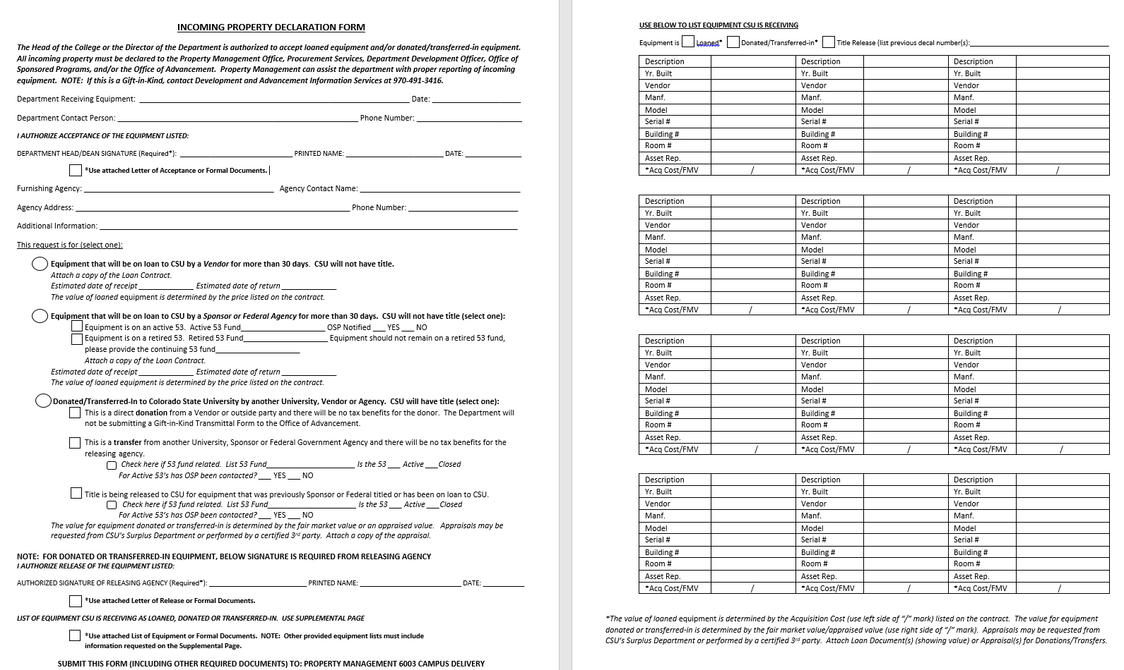
Incoming Property Declaration Form
OTHER METHODS
Notes:
The Incoming Property Declaration Form can be used to help meet the paperwork requirements.

Slide 17
OTHER METHODS
Gift-In-Kind consists of Non-Monetary Gifts that go through the CSU Advancement Office. The donor receives stewardship recognition and may be eligible for a tax write-off.
Advancement forwards Property Management a monthly report and Property sets up capital assets from the report.
Notes:
All GIK’s must remain on campus for a minimum of three years.

Slide 18

ACQUISITION
TRACKING
DISPOSAL
Notes:
Are there any questions regarding acquisitions before we move on to tracking?

Slide 19
TRACKING
Asset Decal
Maintenance
Movement
Inventory Process
Property Management
Notes:
The next section concerns the middle life of your assets. There are many different events that can happen to your equipment once it arrives on campus.

Slide 20
ASSET DECAL
Asset Decal
Who knows where the asset is located?
  Fabricated assets (work-in-progress (WIP) assets).
  Fabricated models not lasting a year and deliverables should not be capitalized.
  Capitalize the WIP upon completing the asset and not waiting until the 53 is closed or closing.
Notes:
Asset Decal:
Asset Decal-Seems straight forward, but sometimes inventory specialists have to go through several different people to find the one person who knows what and where the equipment is. Occasionally fabricated assets (also known as Work-in-Progress (WIP) assets) are cannibalized before we even get a decal placed on them. Fabricated models not lasting a year and deliverables should not be capitalized. It is important to capitalize the WIP once it is complete and being used, and not to wait until the 53 is closed or closing.

Slide 21
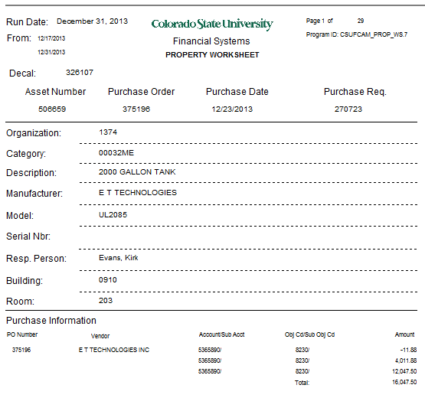
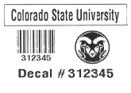
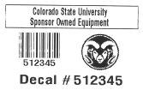
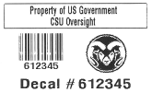
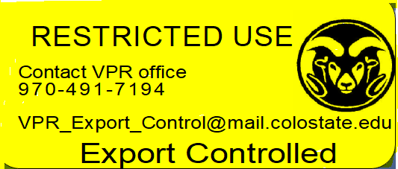
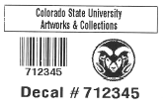
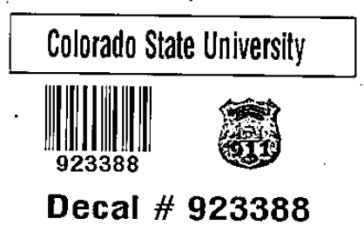
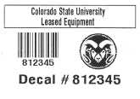
ASSET DECAL
Asset Decal
  Asset Representative
  First Number on the Tag Indicates Title (Owner)
    2 and 3 = CSU owned
    5 = Sponsor
    6 = Federal
    7 = Art
    8 = Leased
    9 = Department tracked
  Locate and Place Tag
    Establishes official location and asset representative
    Begins insurance coverage
    Barrier and offsite equipment requires special processing
Notes:
Asset Decal:
The asset decal is assigned by Property Management, this is different than the asset number, which is assigned by Kuali.
The Asset Processor uses the information provided on the purchase order to create an asset. This will generate a Property Worksheet that the Inventory Specialists use to locate and record asset details on. They will then transfer recorded information into the asset record.
It’s helpful when you are inputting requisitions to include where the equipment will be located and who will be responsible for it.
You may notice different formats on the tags…we use a series of numeric indicators called smart coding to easily identify the title (owner) of the asset.
Who can tell me the most common decal number you have seen in your department?
Decals starting with a 3 designate CSU owned. Depending on the department, these are the most common. Even though we mention sponsor and federal title without distinguishing them as being separate, they are separated when it comes to tag numbers.
Decals that start with a 5, designate sponsor owned. Decals that start with a 6 designate federal owned. Other decals are 7=art, 8=leased, and 9=non-cap (mostly used for controlled assets requiring tracking by the department).
We also have a new Restricted Use tag for items that need to be labeled for Export Control purposes.
Once we locate the asset and place the decal on it, we establish the official location and the asset rep on the property record. The asset record is also used for insurance coverage when processing claims…if the asset record is not correct, you may not receive insurance compensation if a loss happens.
For assets located in bsl3 labs, at a CSU facility outside of 70 miles, or loaned off campus, we rely on the asset representative and DPC to correctly place the decal on the asset, record the serial number and other asset description information, as well as provide the correct asset location information for the property record.

Slide 22
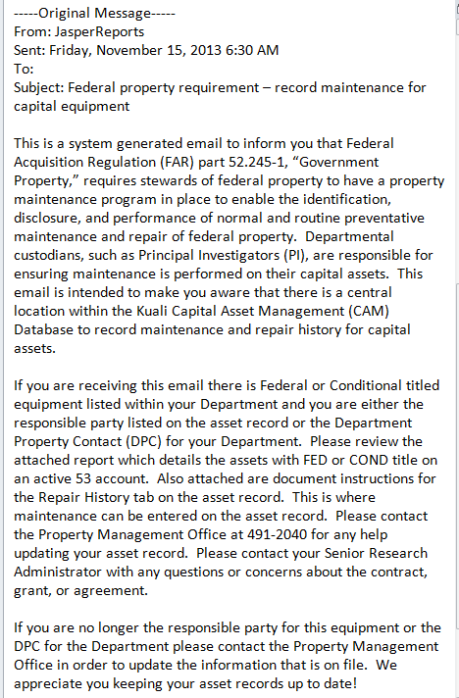
MAINTENANCE
Maintenance
  Routine Upkeep
    To be logged in the asset record
  Quarterly Maintenance Report
    Equipment out of compliance
    Sent to DPC and Reps
  Offsite Service
    More than 30 days requires a loan document to update property record
Notes:
Maintenance:
Most equipment requires some sort of maintenance for optimal performance. Maintenance done by a 3rd party; including oil changes, tunings, high level calibration, cleaning, and preventative service, should be logged in the property record. This will also help with inventory management.
Maintenance records are required on all conditional, sponsor, or federal titled equipment. Maintenance reporting may also be required for leased assets. So CSU doesn’t fall out of compliance with contract requirements, a bi-annual report is emailed to the DPC’s and Principal Investigators (PI’s) listing equipment requiring maintenance. If equipment needs to be sent off campus for servicing for more than 30 days, a loan document is needed to record its location, expected duration of time it will be used off campus, and a custodian that can be contacted regarding the equipment. If there is a chance the equipment cannot be repaired, do not release the equipment to the vendor without authorization from Surplus Property.

Slide 23
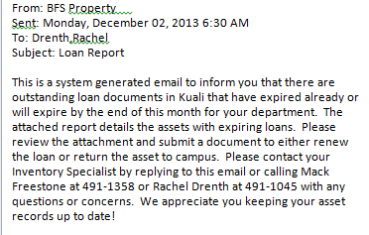
MOVEMENT
Movement
  Between Users
  Change of Physical Location
  Renovation and Relocation
  Checked-Out for Offsite Use
    Monthly loan report sent to DPC and Rep
Property Management provides trainings for step-by-step instructions on all asset edit documents
Notes:
Movement:
Sometimes it feels like equipment grows legs and wanders around. It’s amazing how often we verify something, then a few weeks later find it in a completely different lab across campus! It is critical that property records reflect the correct physical location of all capital asset items, not only for equipment inventories but for external audits and insurance reasons. Often times, auditors will choose a building location for a full wall to wall audit of capital equipment and score the entire university on the result.
If you are anticipating a renovation or relocation of your office, include Property Management in the planning phase. Property Management can assist with identifying capital assets and help the department with updating any new locations. This way the department can avoid write-offs due to lost equipment or improper disposals.
Just like assets going out for repair over 30 days, assets used or stored off campus for more than 30 days require a loan document with the appropriate information. A monthly report is sent out to the DPC’s for all assets with expiring loan documents.

Slide 24
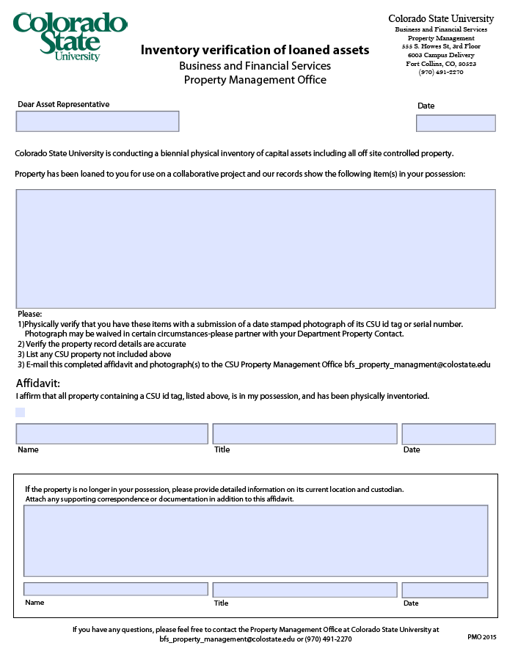
MOVEMENT
INVENTORY VERIFICATION
Notes:
If the renewal loan document is submitted during an inventory year or the loaned asset needs inventory verification, a Loan Verification Form can be used as an alternative inventory verification means to ensure the current condition, location, and custodian are still accurate and up-to-date.

Slide 25
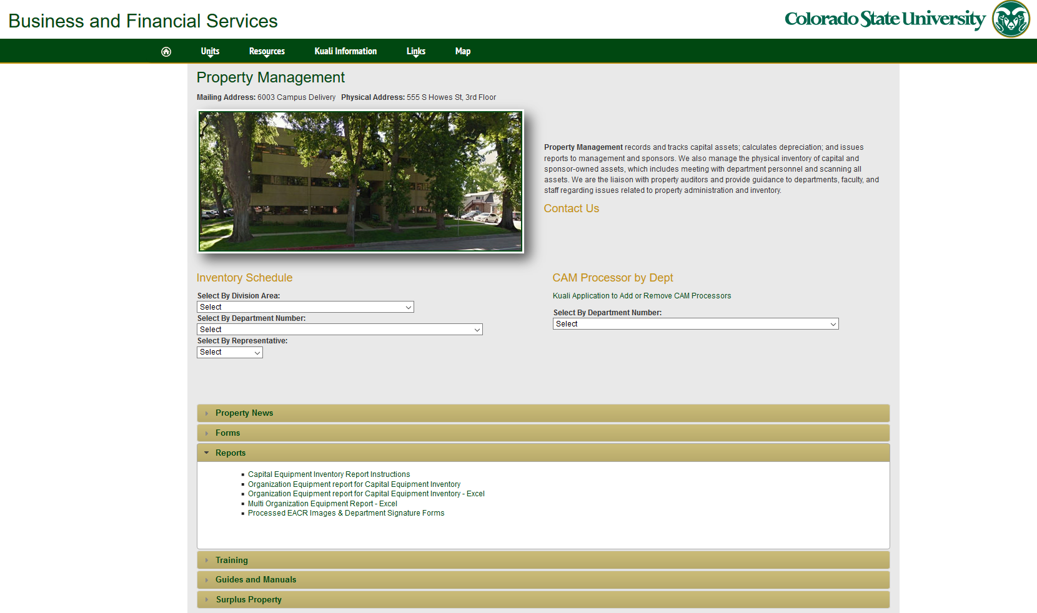
INVENTORY PROCESS
Inventory Process
  Biennial
  Contact + Planning
    Who should be involved
    Best practices
    Timeframe for completion
  Inventory Verification
    Requirements in the event we locate un-decaled or un-declared assets
  Reconciling
    Partner with individual reps for location of missing assets
  Results and consequences
    Notification of close out meeting with department head, DPC and any reps concerned
    Action plan required at time of closeout
    Results reported to the Provost
Notes:
Inventory:
Our inventory process is in place to validate property records:
A full physical inventory verification is completed every other year (or more frequently when determined to be necessary or required) for every department on campus. Departments are required to meet an inventory performance goal of 98% or higher (100% for federal, sponsor, or other owned).
In advance of the inventory, an inventory specialist will contact the DPC to plan the best approach for conducting the inventory. As a best practice, we encourage the DPC to do a thorough review of all assets on their report and present any changes to the inventory specialist before they arrive. We try to complete inventories for departments on a quarterly basis however, we can extend the completion date, as necessary.
On the first pass, we will use an electronic scanner to verify every located asset within the selected building or area. This is also the time when non-listed items are recorded. The DPC is notified and they will need to research how the asset was acquired. If it is determined the asset should be capitalized, either an Incoming Property Declaration Form or a General Error Correction document will be used to bring the asset into the system.
For any assets not located after the initial pass, the DPC will coordinate with the asset representative to help locate the missing items. Departments that do not meet the inventory performance goal, require a face to face meeting with the Department Head, the DPC, and any others deemed necessary. The results of the inventory and an action plan are discussed. The action plan is a record outlining the effort made to locate the missing items, the reasons for the loss, and the procedures put in place to correct the situation.
The results of all physical inventories will be sent to the Office of the Executive Director and University Controller of Business and Financial Services at the end of each fiscal year for distribution as they see fit.

Slide 26
PROPERTY MANAGEMENT
Property Management
  Assist Departments
  Equipment Reports
  3rd Party Verification
  Assist with External Audits
  Record Retention
Notes:
Property Management:
Tracking and Recording assets is overseen by property management.
Property Management and OSP can assist departments regarding property compliance regulations related to contracts (which will help keep sponsor funding), and help with any required Property Equipment Reports for sponsor funded assets. When a 53 closes, the department will need to provide necessary disposition information to OSP and Property Management. (i.e. return to sponsor, title transfer to CSU, permission to transfer to another 53, etc.). Property can also help departments be good stewards of tax payer’s investments through accurate record keeping.
Since Property Management is not funded by the departments, agencies that provide CSU funding consider Property Management as an unbiased 3rd party. This reduces the need for audits conducted by external agencies.
In the event CSU is chosen for an external audit, the records we keep are provided upon request. Property Management’s asset processor can help with locating backup documents and the inventory specialists are available to facilitate with the department regarding any physical verification of equipment.
Records, regarding all capital assets, are retained in Kuali.

Slide 27

ACQUISITION
TRACKING
DISPOSAL
Notes:
Any questions before we discuss disposal of assets?

Slide 28
DISPOSAL
Regulations
  CSU
  Federal FAR and FMR
  State, County, and City Regulations
  CSU Electronics Recycling Program
Surplus Property
  Re-utilization
  Re-allocation
  Disposal Procedures
  Equipment Accountability Change Request (EACR)
Notes:
Disposals include:
Regulations governing disposal – There are multiple restrictions on equipment disposals. CSU assets route to Surplus Property because Surplus Property is up-to-date on the proper codes regarding disposal regulations.
Utilization –How is the asset benefitting the department or university?
Documentation –There are required documents involved to properly authorize and record disposals.

Slide 29
REGULATIONS
Regulations
Colorado State University
Federal (FAR and FMR)
http://busfin.colostate.edu/Forms/FRP/CSU_Financial_Rules.pdf#zoom=100
Page 35 of Financial Rules 4.8.
Surplus Property has been delegated the authority and responsibility for administering the disposal of property other than land or buildings. Departments are not authorized to dispose of any items or equipment without prior approval from the Director of Surplus Property or his/her delegate. No department or individual should make or authorize any sale, trade-in, or donation without prior approval of Surplus Property.
http://www.gsa.gov/portal/ext/public/site/FMR/file/SubchB.html/category/21858/hostUri/portal
45.604-1 Sales procedures.
Surplus personal property that has completed screening in
accordance with 45.602-3(a) shall be sold in accordance with
the policy for the sale of surplus personal property contained
in the Federal Management Regulation, at part 102-38 (41
CFR part 102-38). Agencies may specify implementing procedures.
Notes:
Departments are not authorized to unilaterally release any equipment purchased with university or sponsor funds to any outside entity. This is per university, federal, and state statutes.
Everything from broken binders, software programs, mass spectrometers, etc., need to go through Surplus Property. Surplus Property has an ethically regulated:
Reuse program,
Certified recycling vendor list, and
Certified disposal resource list.
These programs and resources are in place to protect the university from improper disposals and to ensure CSU is maximizing its investments and staying compliant with CSU’s green initiatives.

Slide 30
REGULATIONS
State of Colorado Larimer County Fort Collins
http://www.fcgov.com/ewaste/
Amendment to the City Code to prohibit disposal of electronic equipment (as defined by the State of Colorado Hazardous Waste Regulations 1007-3, Section 260.10) in the waste system.
http://www.larimer.org/solidwaste/electronic_waste.htm
Electronic Recycling Landfill Disposal Ban
Effective Monday, July 1, 2013, a statewide electronics landfill disposal ban went into effect in Colorado. The Electronic Recycling Jobs Act prohibits disposal of a number of electronic items in landfills and at transfer stations.
http://www.colorado.gov/cs/Satellite/CDPHE-HM/CBON/1251616360802
The Colorado Solid Waste Act requires that all solid waste be disposed of, treated or recycled at designated facilities approved by both the Division and the local governing body with jurisdiction (county, city, town) in which the facility is located.
Notes:
In 2007, the city of Fort Collins passed an ordinance banning the landfill disposal of electronics. In 2013, a statewide electronics landfill disposal ban went into effect.
There is a hefty fine for improperly disposing of data containing electronic equipment and devices. E-waste does not include toasters, blenders, or other small appliances, however, it is recommended that those items be taken to scrap metal facilities.

Slide 31
REGULATIONS
CSU Electronics Recycling Program
http://www.green.colostate.edu/
Each year, millions of computers, monitors, cell phones, TVs and other electronics designated as "e-waste" end up in landfills in the United States. These items contain significant quantities of hazardous materials, such as lead and mercury.
Surplus Property and its recycling vendor provide a secure and safe process for responsible, environmentally conscious electronics recycling.
CSU's Surplus Property will accept personal electronics recycling items from faculty, staff, and students for a standard service fee. All data containing electronic devices (cell phones, hard drives, etc.) are sanitized before destruction or re-sale.
Notes:
CSU’s Surplus Property Department is staying ahead of new and continuously restricting regulations on e-waste disposal.
Look for them during CSU’s earth week events for some interesting information on the methods they use and other approved methods of e-waste disposal.

Slide 32
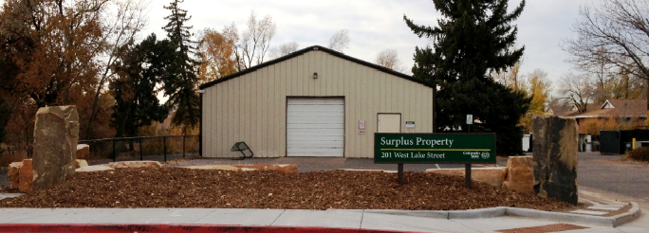
SURPLUS PROPERTY
Surplus Property
Asset disposals require Surplus Property to be involved either directly or indirectly. When items are identified as being no longer needed by the university, Surplus Property will offer to sell them to the public through weekly walk-in sales, sealed bid, negotiated price, auction, or salvage. Items having zero market value will be recycled as scrap. This maximizes the value of taxpayer’s investment in university property and helps prevent these items from winding up in the landfill.
Notes:
With the exception of land and buildings, Surplus Property handles any redistribution or disposal of all CSU assets.
Items no longer needed by the university will be offered for sale. Items unable to be sold will be recycled as scrap.

Slide 33
SURPLUS PROPERTY
Utilization
Utilization is the practice of providing value to the university by making efficient and effective use of an asset throughout its useful life. In order to allow the best return for both the department and the university’s investment, Property Management recommends departments:
Create a process for identifying any un-used or under-utilized equipment that the department is directly responsible for;
Attempt to make equipment available to others within the department or building;
Send idle, outdated, or obsolete equipment to Surplus Property once it is determined to be of no additional use.
Notes:
Providing value and savings to your department and to the university by efficient use of your equipment throughout its useful life is vital.
It is recommended that departments have a utilization program in place to ensure proper usage of your equipment throughout its entire life cycle.

Slide 34
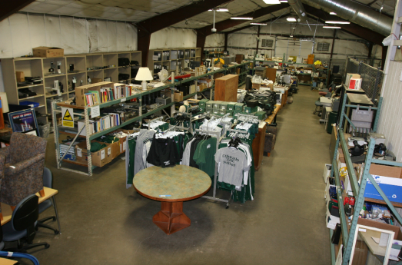
SURPLUS PROPERTY
Re-utilization
Did you know your department can purchase items from Surplus at a fraction of the cost of buying new? Every year this method of procurement saves the university tens of thousands of dollars!
Re-allocation
Did you also know that Surplus Property reallocates proceeds back to the department that transferred the asset to them?
Below is the method Surplus Property uses for determining the amount to reallocate:
Surplus Property will first deduct any external fees associated with the sale of the item
Then, they will retain the next $100 of the sale plus 10% thereafter capping at $500
For all cell phones, Surplus keeps the first $50 of the sale only
*Currently computers and servers are exempt from reallocations based on the internal time to test and process them properly.
Notes:
Re-utilization maximizes the taxpayer investment and helps prevent items from becoming additional trash at a landfill. One department alone saved $63K by purchasing computer equipment that had been refurbished by Surplus!
On average, over $200K a year is reallocated back to campus!

Slide 35
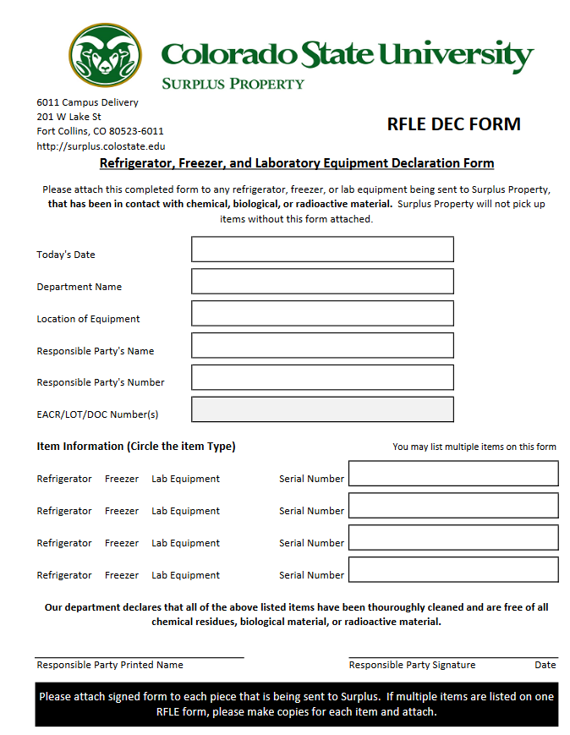
SURPLUS PROPERTY
Disposal Procedures
It is the departments’ responsibility to maintain accurate records of all items purchased with CSU funding or acquired through alternate funding, including proper disposal.
Any equipment disposal involving an active asset in Kuali, must be processed with a KFS document in a timely manner.
CAM Processors are expected to process KFS documents.
Before submitting an Asset Edit document to transfer an asset to surplus, check for any components and applicable accessories that may have been capitalized with the asset. If necessary, Property Management can assist with any asset separate documents or cannibalization requests. Otherwise, the asset will be retired as a whole.
Prior to pickup, items should be adequately secured in order to prevent damage or theft.
The department is responsible for contacting EHS to certify any property that has been in contact with any hazardous or biological contaminates is cleared, prior to submitting for disposal. An RFLE form is required.
Notes:
KFS property record accountability:
Proper disposal is part of the department’s responsibility and must be processed in a timely manner.
For all active capital assets, an authorized CAM Processor can submit Asset Retirement Global documents for the following reasons: External Transfers, Trade-Ins, Thefts, and Write-Offs (Lost/Improper Disposal).
If you have a system asset and you are not sending the entire system to Surplus Property, contact Property Management for review and assistance with any documents that may be necessary.
Make sure the equipment is adequately secured to deter theft or damage prior to pickup. Don’t leave it sitting in a hallway where people can walk by and remove items.
For equipment exposed to contaminates, please contact Environmental Health Services (EHS) for proper handling procedures prior to submitting a document for disposal. This can include contaminated freezers, etc., which require a Refrigerator, Freezer, and Laboratory Equipment Declaration (RFLE) form (A link for this form is found on the EACR document).
Surplus Property not only handles disposal of equipment sent to them, but must also authorize all other means of disposal. Other means of disposal would include Equipment Transfers, Trade-ins, Vendor Removals, Equipment Exchanges, Cannibalizations, Software Terminations, Removal of Destroyed Assets, Recycling, and Sale of Assets.

Slide 36
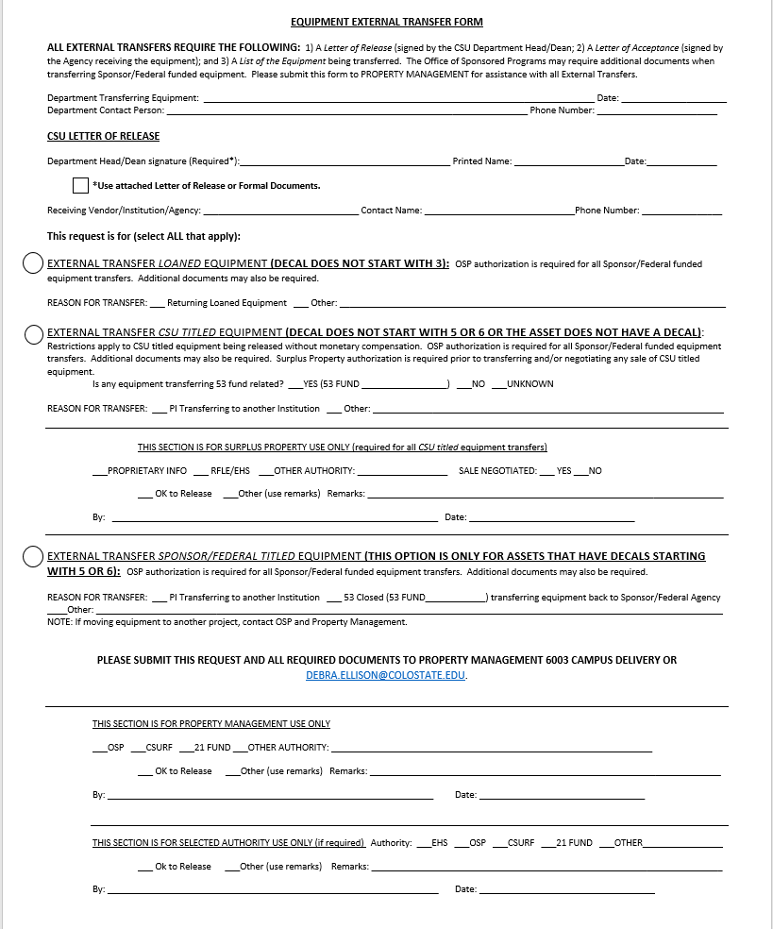
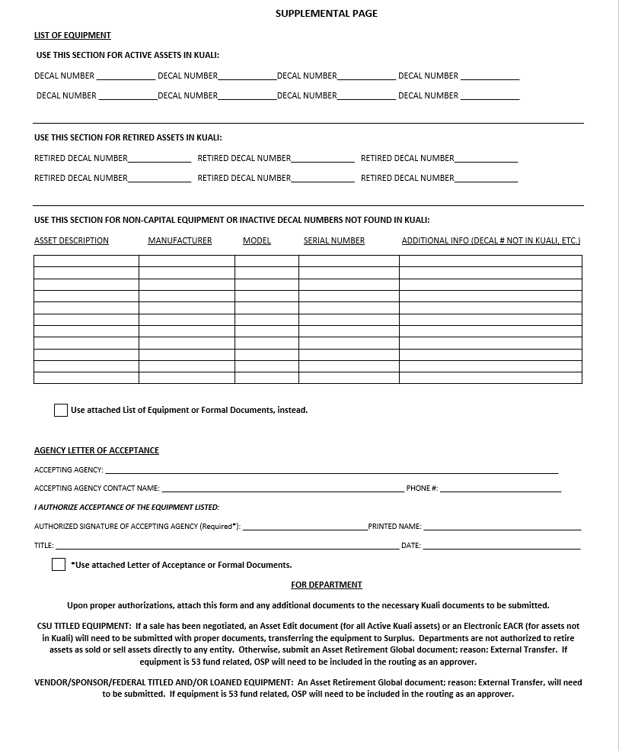
Equipment External Transfer Form
SURPLUS PROPERTY
Notes:
The Equipment External Transfer Form is used to request the transfer of equipment to another entity (i.e. transferring non-CSU titled equipment to a vendor or sponsor or transferring equipment to another university or non-profit agency).
The Equipment External Transfer Form has multiple sections, which allows the department to use the form for submitting all necessary information and required signatures.

Slide 37
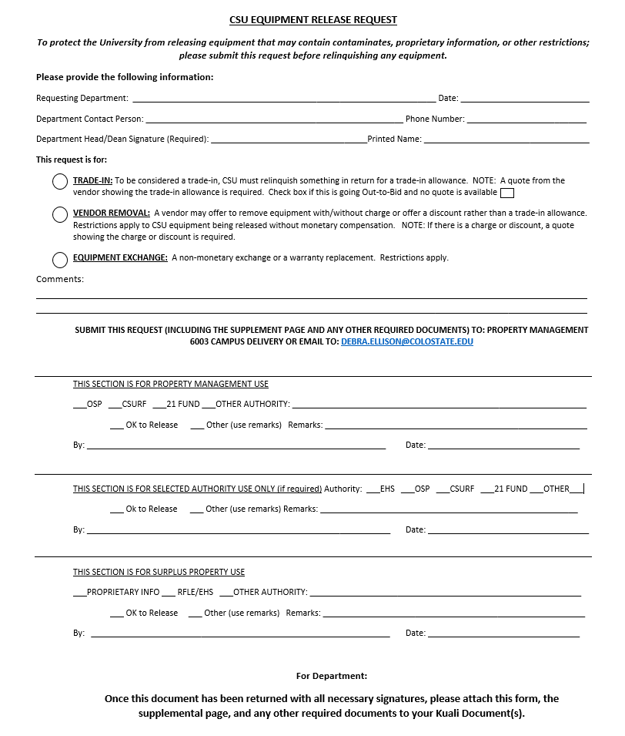
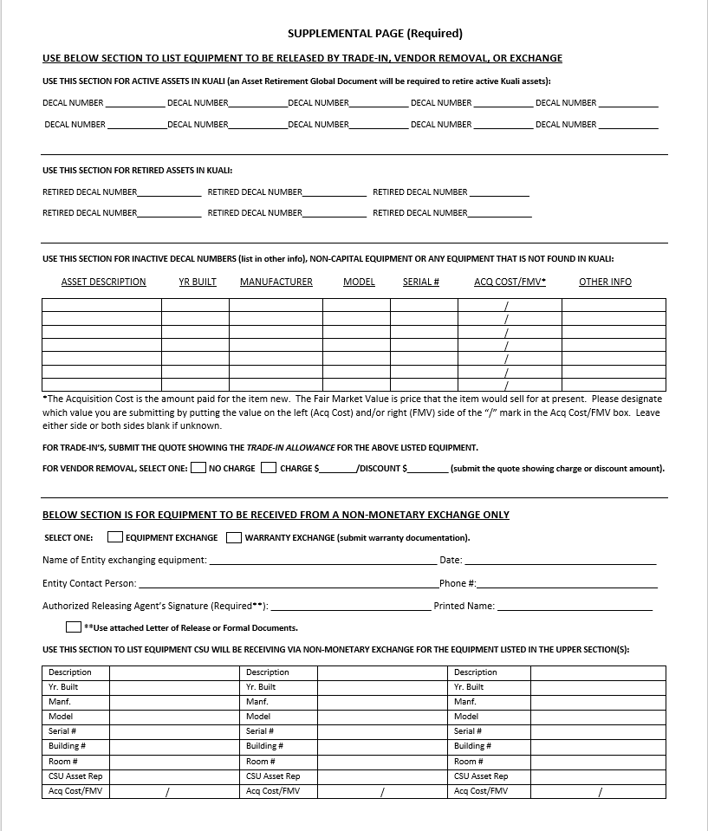
Equipment Release Request
SURPLUS PROPERTY
Notes:
The CSU Equipment Release Request is used to request Trade-Ins (the invoice needs to show a trade-in allowance), Vendor Removals (the vendor may or may not charge to remove the equipment or may offer a discount), and Equipment Exchanges (non-monetary exchanges including warranty replacements).

Slide 38
SURPLUS PROPERTY
Types of Disposals
An Asset Edit document is used to transfer active Kuali assets to Surplus Property for disposal. This will remove the asset from the department’s inventory, but won’t retire the asset. Surplus Property will then schedule a time to pick up the asset. Once the asset has been disposed of, Surplus Property will submit an Asset Retirement Global document selecting the appropriate retirement method used for disposal.
In some cases, assets may not actually be physically disposed of by Surplus Property, but the asset will still need to be retired. Disposal types where the asset may not be physically transferred to Surplus Property include: cannibalization, releasing equipment to an outside entity, destroyed equipment, and software terminations. The department will need to submit the Asset Edit document and state the retirement reason they are requesting, in the Explanation field. Once the retirement reason has been confirmed (usually by an Inventory Specialist, or by Surplus Property), Surplus Property will submit the proper Asset Global Retirement document on behalf of the department.
Notes:
When a department needs to remove equipment from their inventory list in order to retire the asset, they need to submit an Asset Edit document to “transfer” the asset to Surplus Property. Transferring the asset to surplus will not retire the asset.
In some cases, the equipment may not be physically transferred to Surplus Property. The following retirement reasons are examples where equipment may not be physically transferred to Surplus Property, but the department needs Surplus Property to submit the retirement document on their behalf: Cannibalization, Equipment Release, Destroyed, Software Termination, and requests to Sell equipment. If a department has a known buyer for a piece of equipment, they are to contact Surplus Property before starting any sale negotiations. Departments are not allowed to sell equipment to outside entities and will need to transfer the asset to Surplus Property to complete the sale.
If the Asset Edit document does not include a request for one of the mentioned reasons, Surplus Property will assume they are to pick up the asset and dispose of it by means of sold, scrap, recycled, auction, etc.

Slide 39
SURPLUS PROPERTY
Cannibalization
It may be desirable and advantageous to cannibalize an asset when it cannot be economically repaired but its components or parts are usable in the repair or improvement of other items. Prior to permanently removing items from an asset, contact Property Management for assistance and authorization regarding cannibalization requests.
Notes:
Cannibalization:
Taking an asset apart happens frequently. If it is a permanent removal and the system will no longer be usable as intended (i.e. the system will no longer work without the removed component or components), it should be reviewed for cannibalization. Temporarily swapping parts in and out would not have any affect on the value of the asset, but you may need to consider upon which component the decal is affixed to. Also, replacement parts ordered for assets would be expensed, if you are only replacing a worn out part to fix the asset (i.e. a repair part). Upgrades and betterments would be capitalized if they meet specific criteria (i.e. significantly extends useful life, increases its utility or efficiency, or otherwise adds to the benefits it can yield).

Slide 40
SURPLUS PROPERTY
External Transfers
Prior to an employee or faculty leaving your department, verify any assets that are assigned to that individual or research project. Please contact Property Management with specific requests. Once authorized, for active Kuali assets, submit an Asset Retirement Global document, reason: external transfer.
Notes:
External Transfers related to a 53 fund may require additional authorizations.
We recommend you verify assets assigned to anyone leaving your department. They may need to be reassigned to another asset representative. If a PI is transferring with equipment, they will need to obtain proper authorizations before removing any equipment from campus. Also, when CSU holds title to the equipment, Surplus Property may be able to negotiate a sale of the equipment to the new entity (title of the equipment will only transfer to the receiving university or non-profit entity and not to the PI). If the equipment is Federal or Sponsor titled, transfer is based upon the limitations of the contract, grant, or agreement. You may or may not be able to transfer the equipment. OSP should be contacted for assistance with transfers involving 53 funds or continuance of a project or contract that the equipment was acquired for.
For External transfers involving transferring or returning non-CSU titled equipment back to a vendor or sponsor, the department should contact Property Management and/or OSP with any questions or needed assistance related to properly handling the transfer.

Slide 41
SURPLUS PROPERTY
Trade-Ins
If you have an opportunity to obtain value from a vendor for the trade-in of your equipment, contact Surplus Property. Once authorized, for active Kuali assets, submit an Asset Retirement Global document, reason: trade-in.
Notes:
If you have the opportunity to get some return value by trading-in your equipment towards a new purchase, contact Surplus Property regarding authorization to ensure you are receiving the best return value on your equipment. Also, contact Property Management or OSP (for 53 funded equipment) regarding concerns on whether or not the item is eligible to be traded-in.

Slide 42
SURPLUS PROPERTY
Thefts
A Police Report Number is required to submit an Asset Retirement Global doc for reason: Theft.
Write-Offs (Lost/Improper Disposal)
An explanation of the actions taken to find the asset or documentation regarding the improper disposal and what changes have been made within the department to avoid future write-offs should be included in the notes of the Asset Retirement Global doc for reason: Write-Off (Lost/Improper Disposal).
Notes:
Thefts:
You must file a police report for all capital asset related thefts.
Write-Offs (Lost/Improper Disposal):
You must include information in the notes section of the Asset Global Retirement document regarding steps taken by the department to try and find the asset or the best guess as to what happened to the asset, as well as what the department will do to prevent future write-offs. The document must route to the APO. If the APO is not automatically included in the routing, they will need to be ad hoc’d as an approver. Any write-off of equipment is reflected in a report submitted to the Provost Office and can result in a loss for the University.

Slide 43
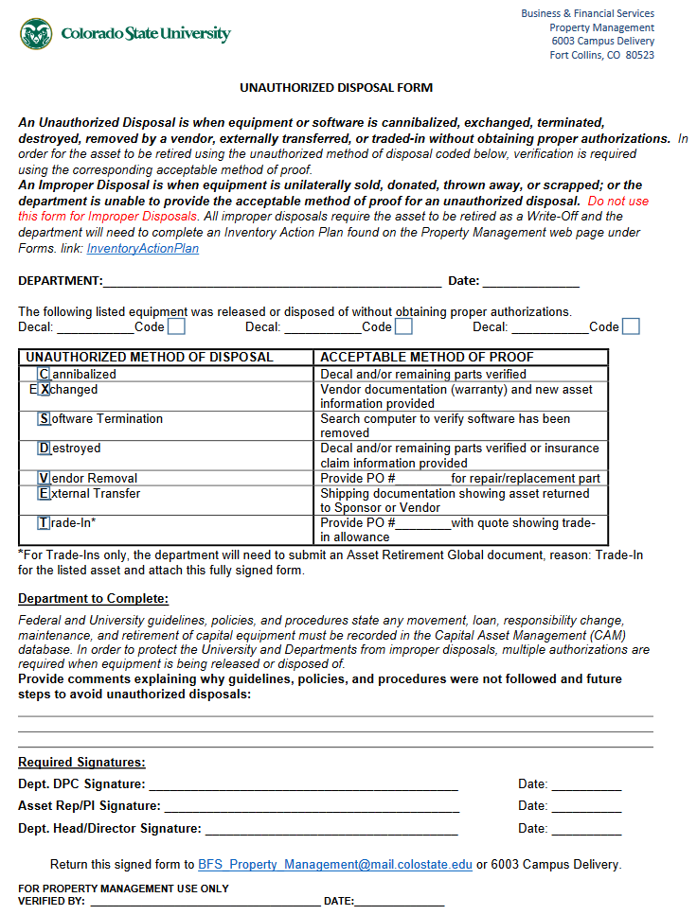
SURPLUS PROPERTY
Unauthorized Disposals
An unauthorized disposal requires proof of the method used to dispose of an asset. If a department cannot provide proof of cannibalization, exchange, software termination, destroyed asset, vendor removal, external transfer, or trade-in, they will need to do a Write-Off instead. Also, the unauthorized disposal exception is not allowed for lost items or items that were improperly disposed of (i.e. unilaterally sold, donated, thrown away, or scrapped; even if proof is provided). Property also reserves the right to disapprove an unauthorized disposal, if it is determined that the department is abusing the unauthorized disposal exception by submitting continuous unauthorized disposals rather than obtaining prior approvals.
Notes:
Things happen and they cannot always be caught upfront. The Unauthorized Disposal form is used for these exceptions. It will require an acceptable method of proof, as well as the signatures of the DPC, Asset Rep/PI, and Department Head/Director. The Unauthorized Disposal Form is available on Property Management’s webpage.

Slide 44
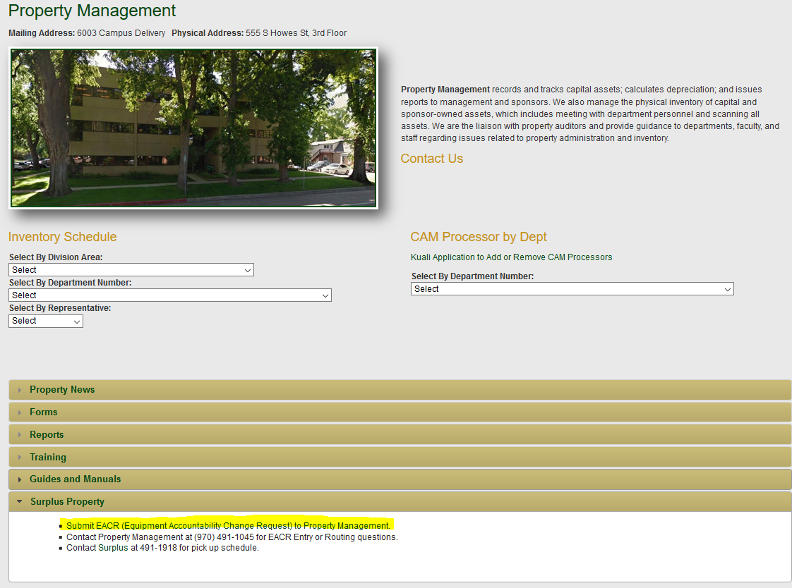
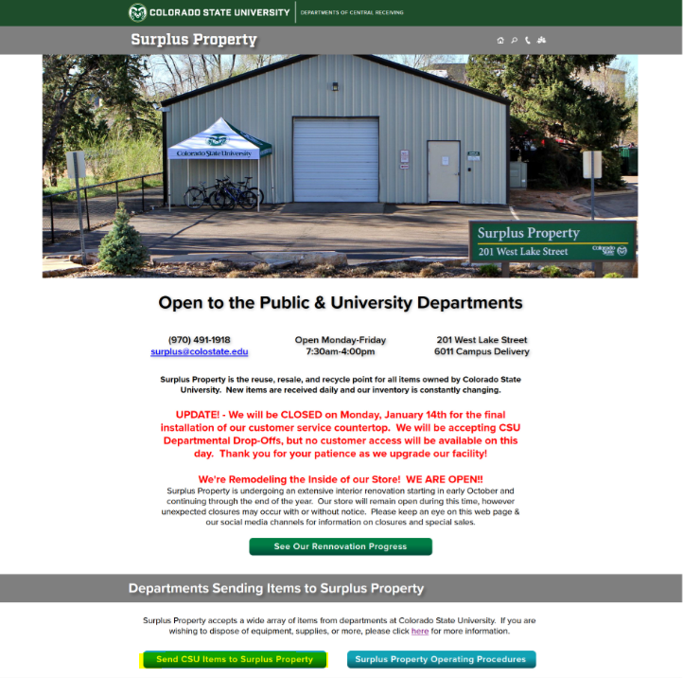
Equipment Accountability Change Request:
SURPLUS PROPERTY
Notes:
When trying to dispose non-capital equipment, an electronic Equipment Accountability Change Request (EACR) needs to be submitted. These forms can be found on both Property Management’s webpage and Surplus Property’s webpage. EACR’s are electronically routed to Property Management for approval in order to be screened for any active capital items (that may not have been recognized as capital), for non-CSU titled equipment (such as leased, sponsor, or federal owned equipment), or for any active 53 fund equipment that is listed on the EACR. If found, these items may be deleted from the EACR so they can be properly handled.

Slide 45
Equipment Accountability Change Request:
SURPLUS PROPERTY
The submitter certifies:
They have the authority to request disposal of equipment for their department
The form is completed with accurate information regarding the description, make, model and serial (often indicated as “sn”)
They have verified that the equipment listed on the form does not include active capital asset decaled items or components thereof
The equipment listed is free from any hazardous material or has been appropriately certified through EHS
Notes:
When completing an EACR, make sure:
You have the authority to request disposal of equipment for your department
The form is filled in with accurate information regarding the description, make, model and serial number
You have verified that the equipment listed on the form does not include any active capital assets or possible components thereof
The equipment is free from any hazardous material or has been appropriately certified through EHS

Slide 46
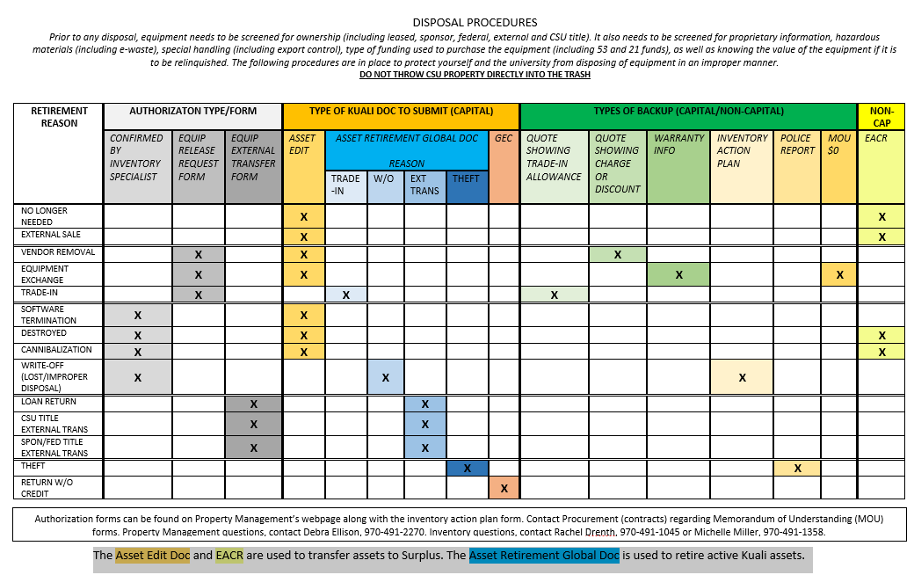

Slide 47



CRADLE TO GRAVE SUMMARY
Acquisition
Receiving triggers Payment
Property will contact Rep. to place the Decal
Movement
Maintenance
Inventory
Utilization
Disposition
Notes:
This is a flow chart showing the life of a capital asset:
It begins with the purchase of a piece of equipment.
Once the invoice is processed for payment and the equipment is received, the asset processor will create an asset record in Kuali. Next, an inventory specialist will contact you in an effort to affix the decal
While the equipment is being utilized, the asset record should be maintained accordingly for all movement, maintenance/repairs, and other status related updates.
When equipment becomes idle or incapacitated and it is determined that it cannot be utilized elsewhere or in some other capacity; the department should take action and submit the appropriate document to remove it from their inventory by means of trade-in, request for disposal, or transferring it to surplus.
Equipment should be retired in a timely manner for all retirement reasons.

Slide 48
OTHER TRAININGS
CAM Financial Documents Training
Purchasing Capital Equipment
Creating GEC’s and DI’s
Asset Management Training
CAM Processor
Equipment Inventory
Notes:
CAM Financial Documents Training
Purchasing Capital Equipment Training will cover selecting the correct capital asset object code and completing the capital asset tab on a requisition.
Creating General Error Corrections (GEC’s) and Distribution of Income and Expense
Documents (DI’s) Training will cover General Error Correction documents and Distribution of Income documents involving capital asset object codes.
Asset Management Training
CAM Processor will review how to create Kuali CAM documents such as department transfer documents (including transfers to surplus), loan documents, trade-in documents, maintenance record updates, and external transfer documents for both transferring assets into the system and transferring assets out of the system. This is an instructional class with use of computers to practice documents in the Kuali CAM module.
Equipment Inventory will discuss industry standards and CSU expectations, as well as overcoming the unique challenges within individual departments. This is an instructional class with some time set aside to address specific questions and concerns.

Slide 49
SUPPORT MATERIALS
http://busfin.colostate.edu/prp.aspx
Business & Financial Services FPI Manual; Section 4 – Capital Construction and Property, Plant & Equipment
Listserv communications
Biannual newsletter
Advice/guidance via phone or email
Notes:
Property Management information can be found under the Business and Financial (BFS) website or by directly searching for Property Management from the CSU main menu search option.
On Property Management’s webpage, you can find direct links to the University’s Financial Procedure Instructions (FPI) Manual; specifically section 4.
Communication to campus is done through the Property listserv.
Please contact us if you would like to be added to our listserv (Busfin and Department Property Contact).
Property releases a bi-annual newsletter, highlighting various topics within the lifecycle of your assets.
And, of course, you may contact us via email or phone call with any questions, or if you simply want us to review a document you’ve initiated in Kuali.

Slide 50

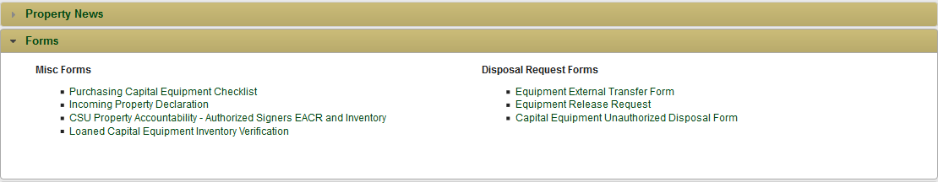
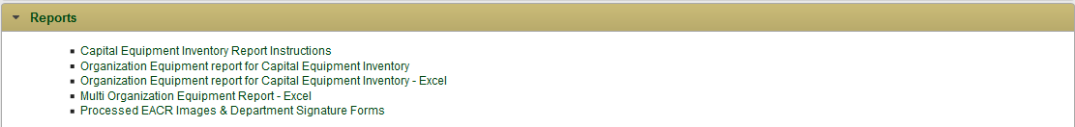
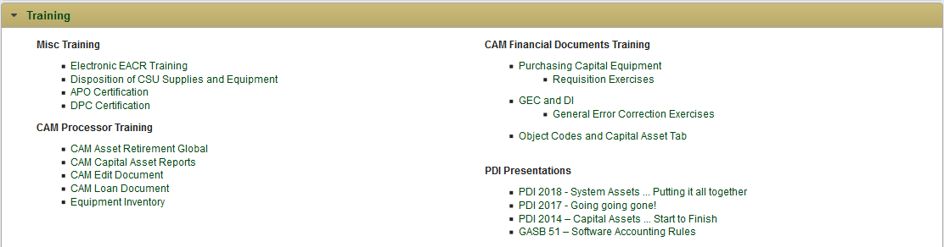
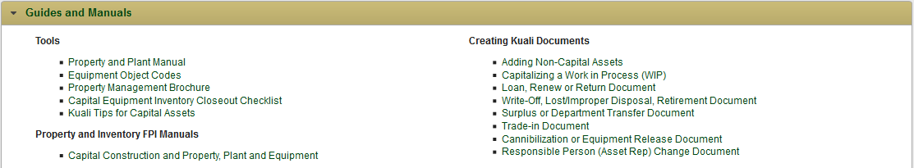
FORMS
REPORTS
TRAINING
REFERENCE
Notes:
Once on Property Management’s webpage, you can find a variety of reference materials available including forms, reports, and training slides.
Forms can be found on the Forms link from the BFS main website.
Reports are available for departments to access information
Training presentations are posted and updated, as needed.
Links to the FPI’s, useful tips, and document instructions are also available.

Slide 51
THANK YOU!
Business & Financial Services – Property Management
Jacque Clark 491-2899
Cheri Richardson 491-7362
Laila Dillsi 491-6513
Debra Ellison 491-2270
Rachel Drenth 491-1045
Michelle Miller 491-1358
Notes:
Thank you

