Slide 1
KUALI
CAPITAL ASSET MANAGEMENT (CAM)
FINANCIAL PROCESSING
Business and Financial Services, Property Management
Presenters: Genevra Scott and Debra Ellison
Notes:
Welcome to CAM Basic Training. This is the first of two classes to introduce you to some of the property management features you will be using.
The handouts cover hands-on exercises that we will be going over during today’s training and some to take back to your desk.

Slide 2
AGENDA
Asset Payment Lookup
Requisition Document
General Error Correction Document

Slide 3
Sign On to the Training Site
Link: CSU CAP (CAMPUS ADMINISTRATION PORTAL)
http://padroni.is.colostate.edu:7778/portal/page/portal/CSUCAP
Non-production Applications:
Training Kuali Financial System (KFS)

Slide 4
CAP MAIN PAGE

Slide 5
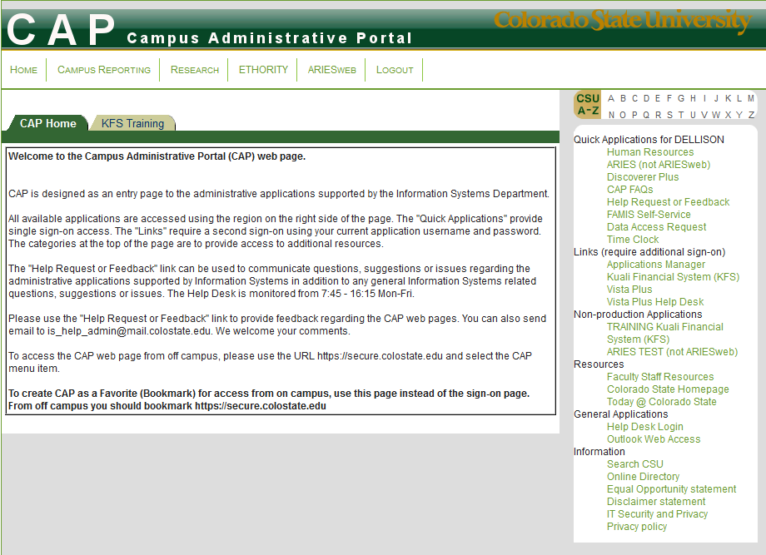

Slide 9
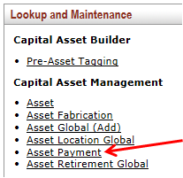
ASSET PAYMENT LOOKUP
From the Lookup and Maintenance box on the Main Menu of Kuali, select the Asset Payment option to lookup financial transactions associated with an asset
Search options include
Purchase Order Number
Account Number
Object Code
And more…

Slide 10
ASSET PAYMENT LOOKUP
This asset has two financial transactions posted to it. From a quick glance the user can see the account number, object code, document number and type, amount, and posting date.
Notes:
The export to spreadsheet option can be used here.

Slide 11
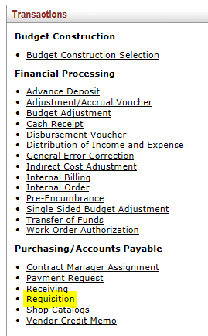
REQUISITION – CAPITAL ASSET TAB
The Requisition document is a Purchasing document; however, this document requires the user to fill out the Capital Asset tab when capital object codes are used to purchase equipment or other capital goods.

Slide 12
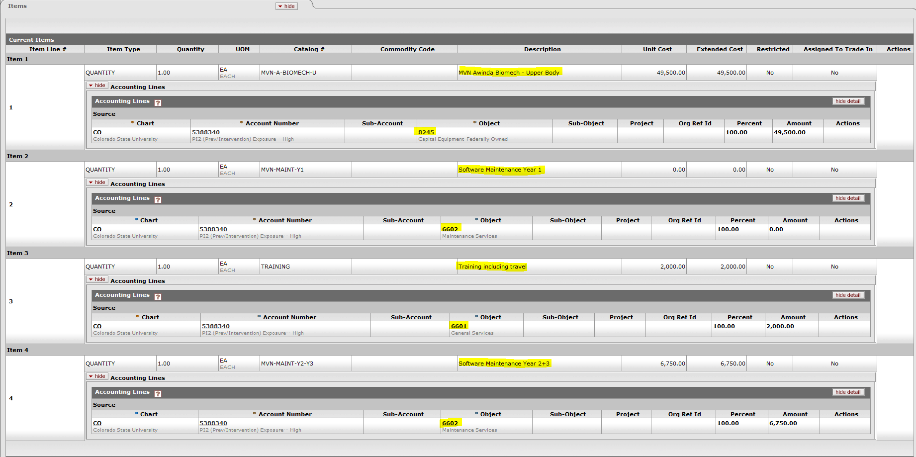
REQUISITION – ITEMS TAB
Example 1:
Line 1 has a capital object code. Lines 2, 3 and 4 have non-cap object codes because maintenance and training are not included in the cost of a capital asset.

Slide 13
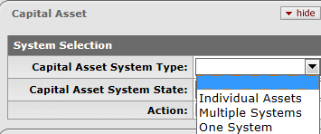
REQUISITION – CAPITAL ASSET TAB
Once the Item and Accounting Lines have been added to the Requisition document, the Capital Asset Tab will need to be populated.
Select the Capital Asset System Type
Individual Assets
Multiple Systems
One System
Notes:
Choose the Capital Asset System Type (individual, multiple, or one) and the Capital Asset System State (new, modify existing)

Slide 14
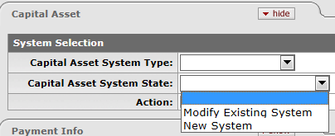
REQUISITION – CAPITAL ASSET TAB
Select the Capital Asset System State
Modify Existing System
New System
Notes:
Choose the Capital Asset System State (new, modify existing)

Slide 15
This is what your Capital Asset Tab will look like:
REQUISITION – CAPITAL ASSET TAB
Individual Assets is used because line 1 is the only cost that will be used to create the asset and line 1 is not going to be combined with any other costs or lines on the requisition. Also notice, because it is the only line that used a capital asset object code, it is the only line that was brought into the capital asset tab.
New System is used because this will create a new asset.

Slide 16
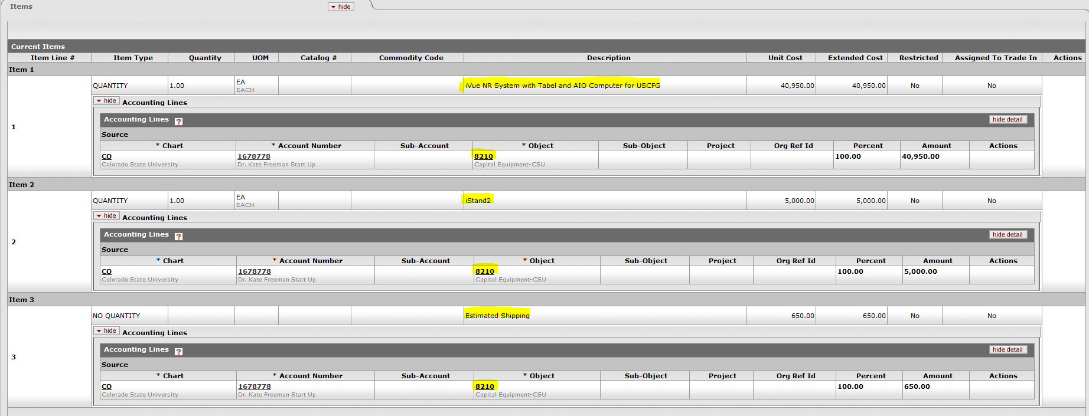
REQUISITION – ITEMS TAB
Example 2:
Notice the object code for shipping (line 3) uses capital object code and the accessory (line 2) cost is $5,000.00 and also uses a capital object code. So, how would you capitalize this?

Slide 17
REQUISITION – CAPITAL ASSET TAB
Select the Capital Asset System Type
Individual Assets
Multiple Systems
One System
Notes:
Choose the Capital Asset System Type (individual, multiple, or one) and the Capital Asset System State (new, modify existing). For this example, One System will be used.

Slide 18
This is what your Capital Asset Tab will look like:
REQUISITION – CAPITAL ASSET TAB
Notice lines 1, 2 & 3 in the Item Line # area because they all used a capital asset object code.
One System is used because we want to capture all 3 lines and their costs to create one asset. Even though the iStand2 is $5,000.00, it is an accessory to the iVue NR so it will not have its own decal but will be included in the cost of the asset. Finally, Shipping is recorded as “Other Service” in the transaction type.
New System is used because this will create a new asset.

Slide 19
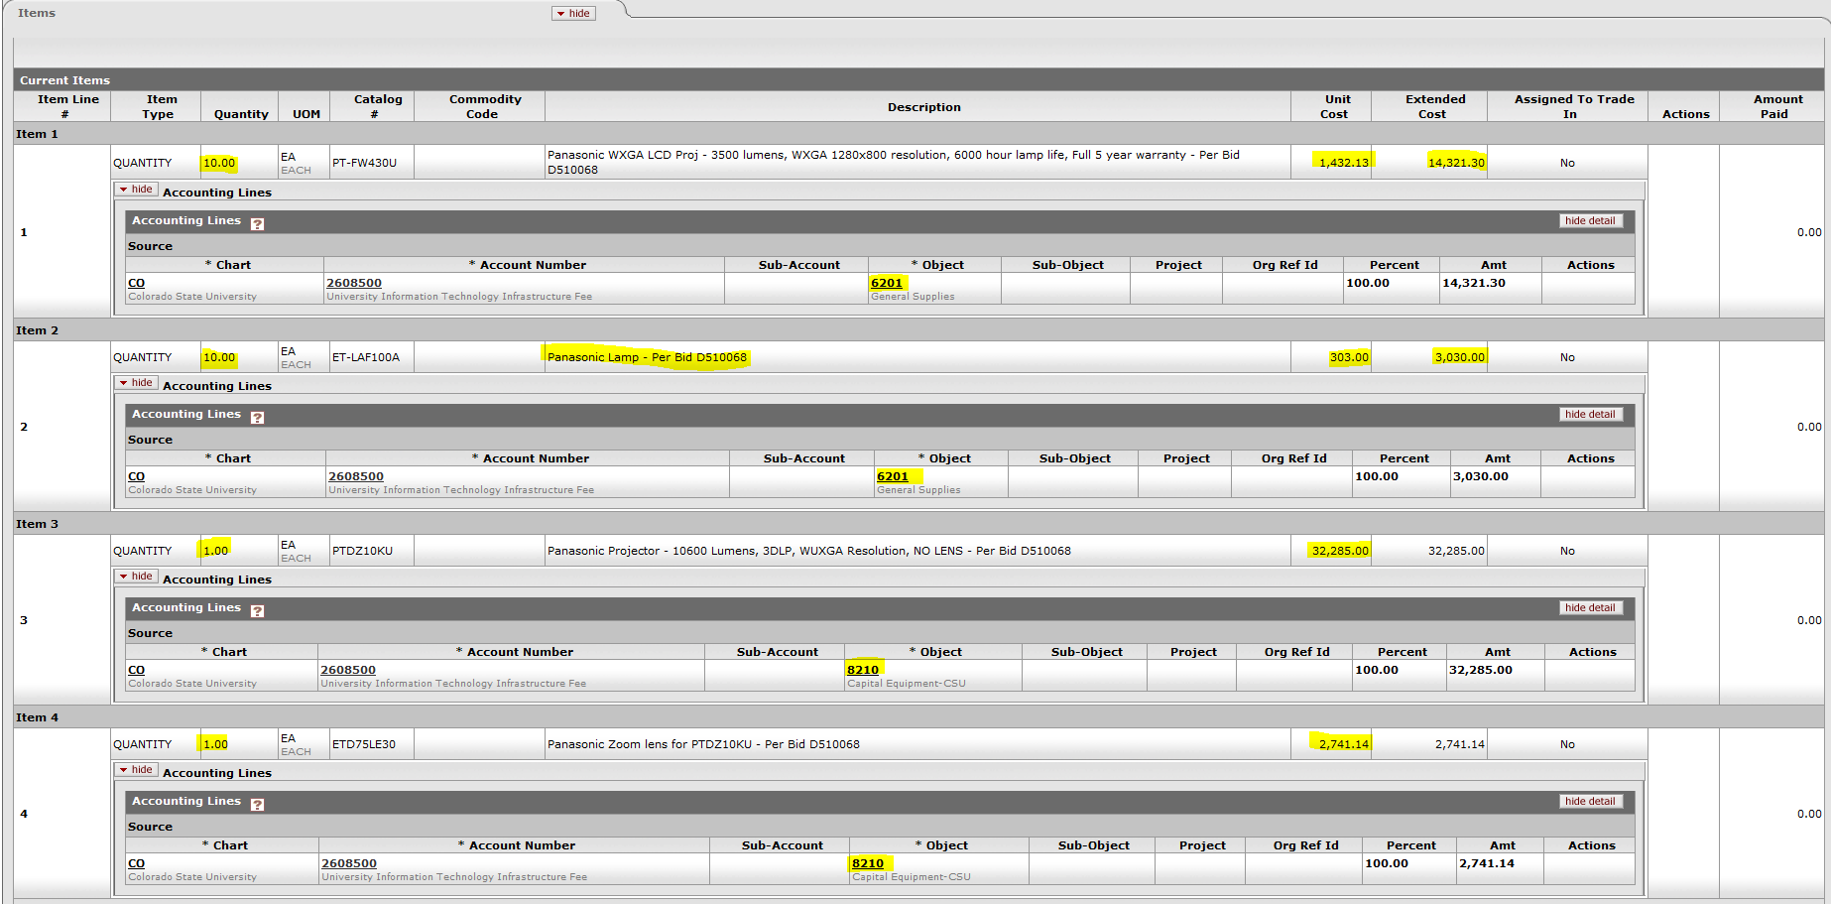
REQUISITION – ITEMS TAB
Example 3:
Notes:
Notice some lines have capital object codes and some lines do not. Also notice, when more than one item is ordered of like items and they are not necessary to make a system asset, the unit cost is reviewed. However, if lines are to be combined, the individual unit cost of the combined lines is totaled or the total extended cost of the combined lines is totaled and divided by the quantity ordered. In the above example, there are 10 each ordered for both lines 1 and 2. The unit cost for line 1 is $1,432.13 and the unit cost for line 2 is $303.00 or the extended cost for line 1 is $14,321.30 and the extended unit cost for line 2 is $3,030.00 for a total of $17,351.30. It appears these items would be combined, but the total cost for each asset is only $1,735.13 or $17,351.30/10 = $1,735.13 (non-cap).

Slide 20
Notice some lines have capital object codes and some lines do not. Also notice, when more than one item is ordered of like items and they are not necessary to make a system asset, the unit cost is reviewed. However, if lines are to be combined, the individual unit cost of the combined lines is totaled or the total extended cost of the combined lines is totaled and divided by the quantity ordered. In the above example, there are 10 each ordered for both lines 1 and 2. The unit cost for line 1 is $1,432.13 and the unit cost for line 2 is $303.00 or the extended cost for line 1 is $14,321.30 and the extended unit cost for line 2 is $3,030.00 for a total of $17,351.30. It appears these items would be combined, but the total cost for each asset is only $1,735.13 or $17,351.30/10 = $1,735.13 (non-cap).

Slide 21
This is what your Capital Asset Tab will look like:
REQUISITION – CAPITAL ASSET TAB
Lines 3 and 4 are the only lines with a capital asset object code so they are brought into the capital asset tab. The Capital Asset Tab is critical to designate how these lines will be capitalized. One System cannot be used since Lines 1 and 2 are not capitalized and were not brought into the capital asset tab. Individual Assets cannot be used because line 4 is not $5,000.00. Therefore, Multiple Systems is used. The capital Asset Note Text is used to describe how the lines brought into the capital asset tab are to be combined. It states to “Combine lines 3 & 4”. This will be the asset that is created in the Capital Asset System Description.

Slide 22
TIPS:
One System should only be used if all of the lines have a capital asset object code and are being combined to create a system. If the requisition has mixed capital and non-capital object codes, do not use One System.
In order to use Individual Assets in the Capital Asset Tab, each line item brought into the Capital Asset Tab needs to be over $5,000.00 and will not be combined with any other lines on the requisition. So if shipping should be capitalized with the line item, do not use Individual Assets.
Multiple Assets is used when line items do not meet One System (all lines are combined) or Individual Assets (each line is treated separately) definitions. In other words, the requisition may have some lines that are capital and others that are non-capital or the lines are combined in a way that multiple assets are created or a service can be combined with other lines.
Multiple Assets is used when selecting Modify Existing or when combining a requisition with another requisition.
Multiple Assets does not ask for Manufacturer, Model Number or Asset Type so it is important to describe how the lines will be combined in the Capital Asset Note Text and what is being purchased.

Slide 23
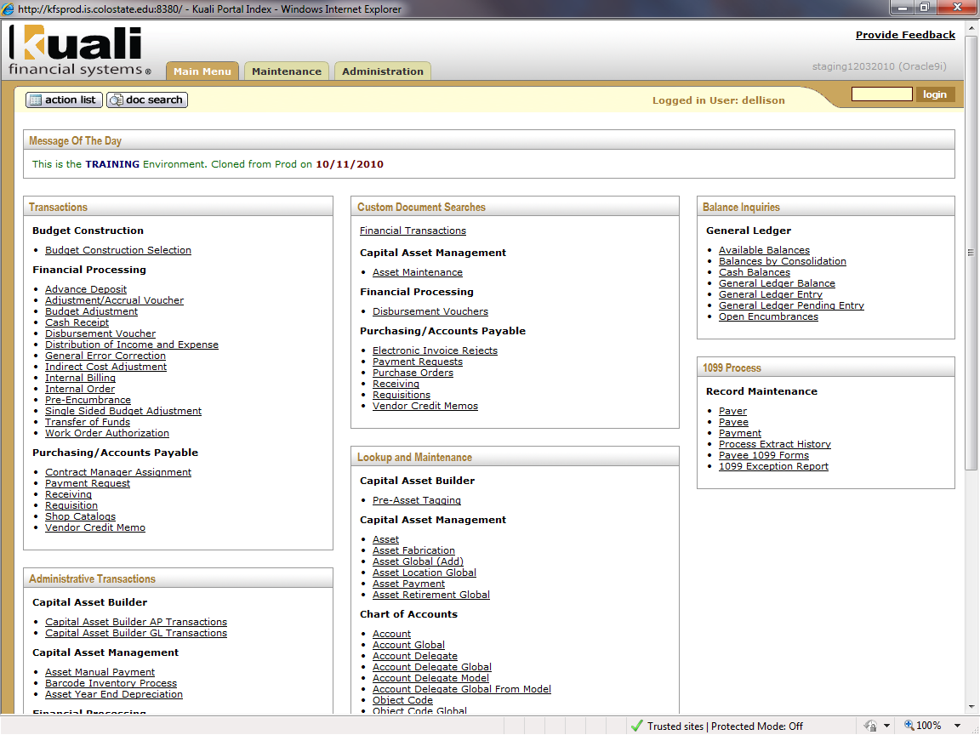
GENERAL ERROR CORRECTION (GEC)
Click on General Error Correction from the Kuali Main Menu.
Notes:
The reasons a user may want to initiate a GEC document include reclassifying an item from capital to non-capital, reclassifying an item from non-capital to capital, change an object code, change funding, and capitalizing a WIP.

Slide 24
GENERAL ERROR CORRECTION (GEC)
Nine tabs make up the General Error Correction document.

Slide 25
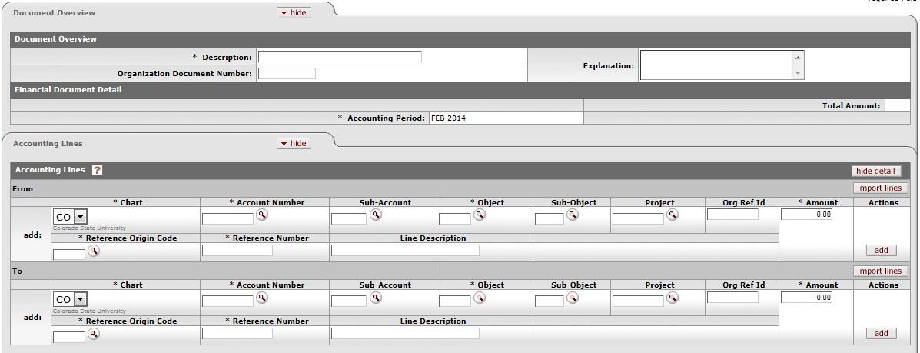
The following tabs should be populated with Description and Accounting Line information. Click “add” for each line entered.
GENERAL ERROR CORRECTION (GEC)
Notes:
Users can enter a description and populate the From and To Accounting Lines. Using an object code from the 8xxx series will trigger the Capital Asset information to be entered.

Slide 26
After the Accounting Lines have been added in order to process the Accounting Lines for Capitalization click on “Select Line” and then select either “Distribute cost evenly” or “Distribute cost by amount.”
GENERAL ERROR CORRECTION (GEC) – CAPITAL EDIT TAB
Notes:
Distribute cost evenly will split the amount into the number of assets evenly. Distribute cost by amount lets you put the amount in for each asset.

Slide 27
If there is an existing active asset click on “modify asset.” If there isn’t an existing asset click on “create asset.”
GENERAL ERROR CORRECTION (GEC) – CAPITAL EDIT TAB
Notes:
To find out if an asset exists, you can do a PO search or Asset Payment lookup. Usually modify existing is used when changing funding. Usually create asset is used to Capitalize a WIP . Object code changes can be either create or modify depending upon what you are doing.

Slide 28
When Modify Asset is selected the Modify Capital Assets tab opens; enter the Asset Number and then click “redistribute total amount.”
GENERAL ERROR CORRECTION (GEC) – CAPITAL EDIT TAB
Notes:
If you are modifying more than one asset, you will need to click on “modify asset” for the number of assets you are modifying and enter the asset number for each one.

Slide 29
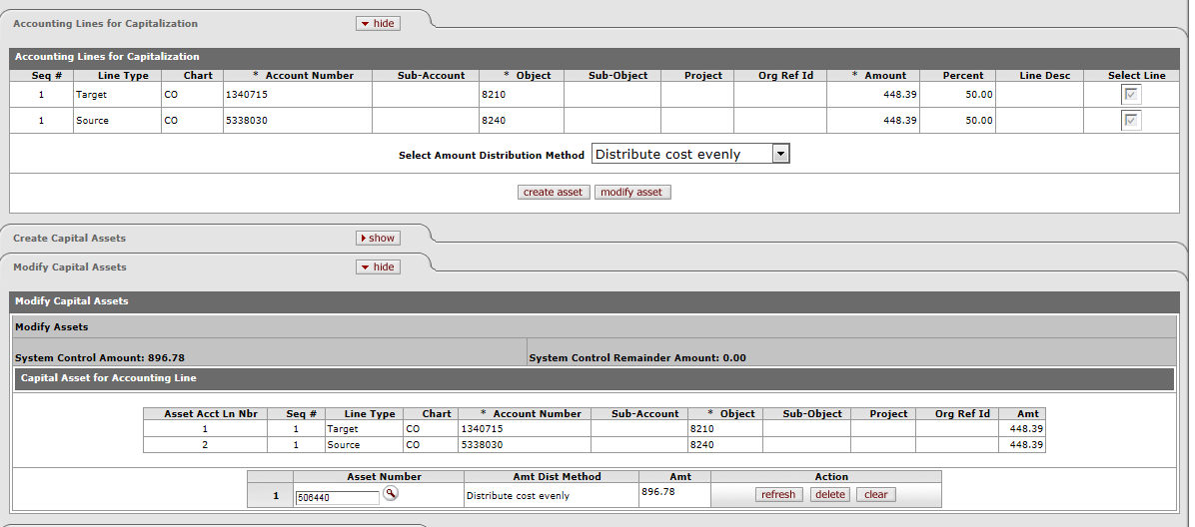
The System Control Remainder Amount should be 0.00 and your Accounting Lines for Capitalization should be grayed out. The document is ready to be submitted.
GENERAL ERROR CORRECTION (GEC) – CAPITAL EDIT TAB

Slide 30
If “create asset” was selected the Create Capital Assets tab will open. Enter the Number of assets to create, Asset Type, Vendor, Manufacturer, Model and Asset Description. Then click the “add tag/location” button.
GENERAL ERROR CORRECTION (GEC) – CAPITAL EDIT TAB
Notes:
If the assets are the same, you only need to click on create asset once. If you are creating different asset types, you will need to click on create asset for the number of different asset types you are wanting to create.

Slide 31
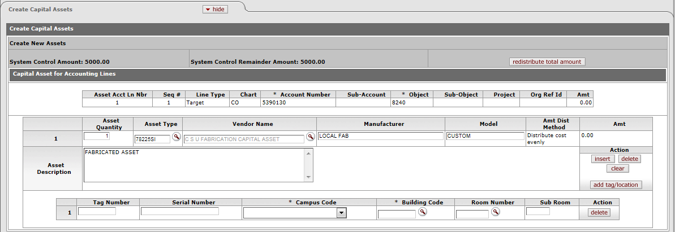
Next enter Campus Code, Building Code and Room Number. Click on “redistribute total amount,” and then document can be submitted.
GENERAL ERROR CORRECTION (GEC) – CAPITAL EDIT TAB
Notes:
Tag Number is not required. If needed, Contact Property Management for the Tag Number/Decal Number, otherwise it will be entered when it is in Property Management’s action list for approval.
Hands on training examples are available to work on at this time.

Slide 32
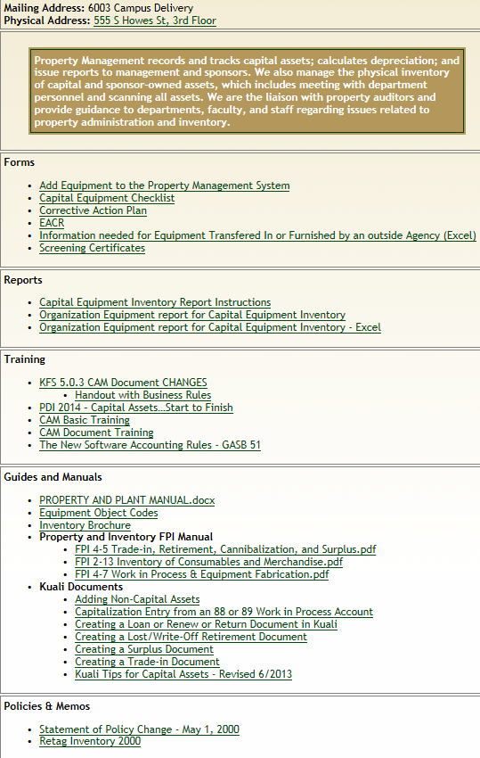
FORMS
REPORTS
TRAINING
REFERENCE
Notes:
From CSU main webpage select P from the A-Z lookup, then click Property Management
To add CAM Processor role for a user go to BFS webpage, Forms, Access Applications and Signature Forms, “Application for Kuali Financial System”; be sure to check the KFS Capital Assets KFS-CAM Processor checkbox

Slide 33
THANK YOU!
Please fill out the evaluation forms, we appreciate your feedback.
Business & Financial Services – Property Management
Genevra Scott 491-2040
Debra Ellison 491-2270
Rachel Drenth 491-1045
Mack Freestone 491-1358
Linda Brucker 491-6513

